Slide 1
Introduction
As we move into 2024/25, we have taken stock of our system maturity and have challenged ourselves to think through how we can make the highest impact changes for our populations. Now the ICB is starting to recover from the long legacy of the COVID-19 pandemic we have grand ambitions to radically improve health and care experiences and outcomes for the people we serve. In 2024/25 the ICB, working within our wider system partners in the ICS, will develop so that we can deliver the areas where we believe we can and need to have the biggest impact.
In this second-year refresh of our Joint Forward Plan, we have set out our renewed and refreshed strategy, re-confirming our shared ambitions and direction for our ICB within the wider ICS. Our Joint Forward Plan refresh sets out how within our Strategy we will focus on how we transform and shape the health care experiences and outcomes for our population.
We will plan our services to respond to the continuing rise of chronic ill-health and frailty, shifting the focus to preventing ill health and tackling the wider determinants of health. We will drive the future design of our system, to set up a model which integrates cares so that people can access healthcare in a joined- up way that is as local to them as possible.
This will mean that our ICB will work with partners to ensure:
A much greater emphasis on system leadership, maximising interdependencies and mutual accountability
Focus on maximising the capability and potential of our operating model
Prioritise system level actions that drive the refreshed ICS strategy
We have set out in the Joint Forward Plan how we will deliver this in our organisation through our drivers for change

Slide 8
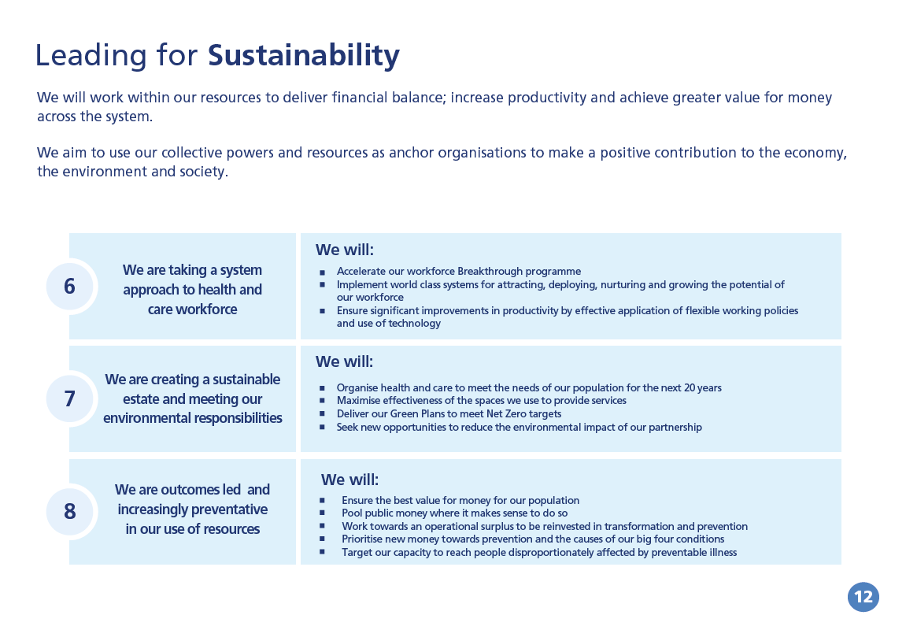

Slide 10
Appendix 1: Joint Forward Plan refresh: delivery for 2024/25
2hj
Our aims
Narrowing the gap in healthy life expectancy by 2030
Increasing healthy life expectancy by five years by 2035
Our Ambitions
Radically improving the health and wellbeing of children and young people
Enabling wellbeing, health and care equity
Transforming people’s health and care experiences and outcomes
Big 4 health outcomes
Reducing harm from cancer
Cutting cardiovascular disease
Living with frailty
Enabling mental health resilience
Key deliverables for 2024/25
Improve performance against the headline 62-day standard to 70% and the 28-day Faster Diagnosis Standard to 77% by March 2025
Increase the percentage of patients diagnosed with cancers at stages 1 and 2 in line with the 75% early diagnosis ambition by 2028.
Increase the percentage of patients with hypertension treated with the NICE guidelines to 80% by March 2025
Increase the percentage of patients aged 25-84 years with a CVD risk score greater than 20% on lipid lowering therapies by 65% by March 2025 on Lipid lowering therapies
Improve A&E waiting times with a minimum of 78% of patients seen within 4 hours in March 2025
Improve category 2 ambulance response times to an average of 30 minutes across 2024/25
Improve community services waiting times, with a focus on reducing long waits
Continue to improve the experience of access to primary care
Eliminate waits of over 65 weeks for elective care as soon as possible and by September 2024 at the latest
Increase the percentage of patients receiving a diagnostic test within 6 weeks in line with the March 2025 ambition of 95%
Improve patient flow and work towards eliminating inappropriate out of area placements
Increase the number of people accessing transformed models of adult community mental health
Increase the number of adults completing a course of treatment for anxiety and depression via NHS Talking Therapies
Work towards 75% of people with severe mental illness receiving a full annual physical health check
Reduce reliance on mental health inpatient care for people with a learning disability and autistic people
Leading for…
Excellence
Prevention
Sustainability
Voice at the heart

Slide 11
Appendix 2: How our system works

Slide 12
Appendix 3: Delivering our statutory duties
ICB duty | How we are delivering it
Addressing the particular needs of children and young people | Golden ambition
Duty to promote integration | How our system works together Drivers for change – leading for prevention
Duty to consider the wider effect of decisions (the ‘triple aim’) | Drivers for Change – leading for prevention How our system works together
Implementing Joint Local Health and Wellbeing Plans | How our system works together
Financial Duties | Drivers for change – leading for sustainability
Duty to improve quality of services | Drivers for change – leading for excellence
Duty to reduce inequalities | Drivers for change – leading for prevention
Duty to promote involvement of each patient | Voice at the Heart
Duty to involve the public | Voice at the Heart
Duty to patient choice | Drivers for change – leading for excellence and leading for prevention
Duty to obtain appropriate advice | Our big four health priorities
Duty to promote innovation | Drivers for change – leading for excellence
Duty in respect of research | Drivers for change – leading for excellence
Duty to promote education and training | Drivers for change – leading for sustainability
Duty as to climate change | Drivers for change – leading for sustainability
Supporting wider social and economic development | How our system works together

Slide 13
Appendix 4: Delivering our statutory duties
The ICB has engaged widely in the content of the JFP through the development of the Shared Strategic Framework, including:
Integrated Care Partnership
Humber and North Yorkshire Leaders Forum
Local Authority Chief Executives/equivalent
ICB Board
Local Authority Cabinets

