Slide 1


ICB – Board
Annual Operating Plan - Performance Report
[Date: 11 September 2024]

Slide 2

Executive Summary
Introduction
The monthly ICB operating plan performance report is specifically concerned with the short term annual objectives related to the HNY ICBs Annual Operating Plan 2024/25. The report is a single part of a wider performance management framework across the ICB. The overall framework has width and covers a wide range of aspects of performance relating to themes such as quality of care, patient experience, operating plan access metrics, public health statistics, and health prevention data. It also has depth in that any of these themes are being considered at provider, place, in some cases condition level. The framework also considers time frames in that some performance expectations are measured daily, weekly, monthly whereas others are to be reviewed annually. These different aspects of performance do not sit in isolation; improving access to cancer services this year, goes hand in hand with ICB mid term ambitions to increase engagement of vulnerable populations with cancer screening programmes, and reduce harm from cancer. Both support the long term aim of increasing healthy life expectancy. The report will demonstrate how these short term annual operating plan indicators support long term aims and ambitions of the ICB. It will describe the full list of indicators in the 2024/25 planning guidance but will focus on areas that have been identified as priorities by NHSE. A small number of indicators are better performance managed through other reporting mechanisms and these are identified in the report also. The report is supported each month with a deep dive into a theme along with Executive Director updates that will describe any escalations from sub committees.
Notes:
textbox
No alt text provided
image
No alt text provided
image
No alt text provided
shape
No alt text provided
shape
No alt text provided

Slide 3
HNY ICB Strategy, Planning and Reporting Framework

Slide 4
HNY ICB Strategy, Planning and Reporting Framework – Priority Indicators

Slide 5

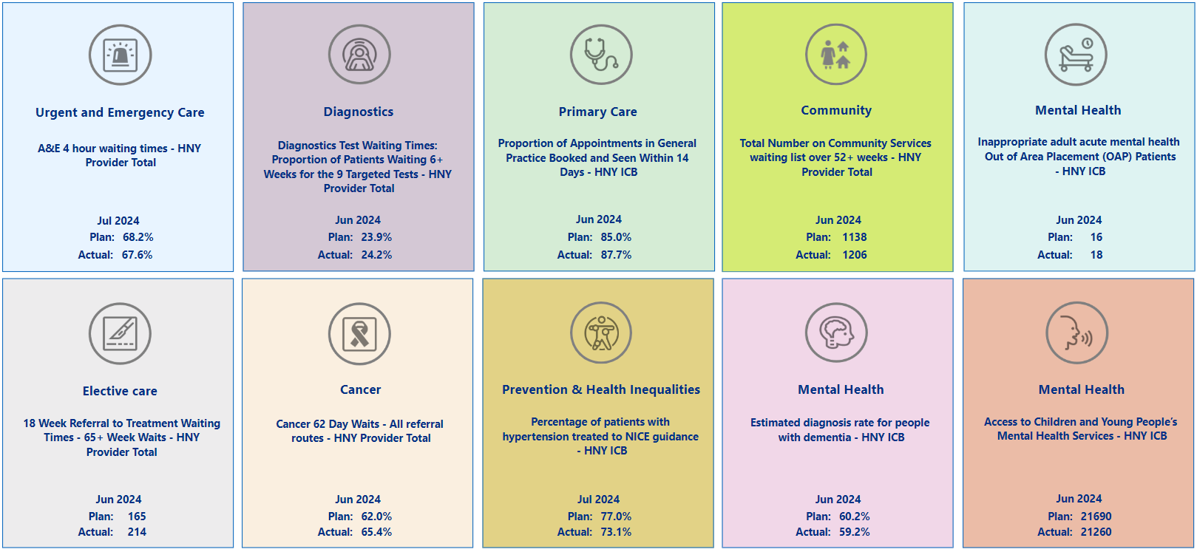
Summary Overview

Slide 6
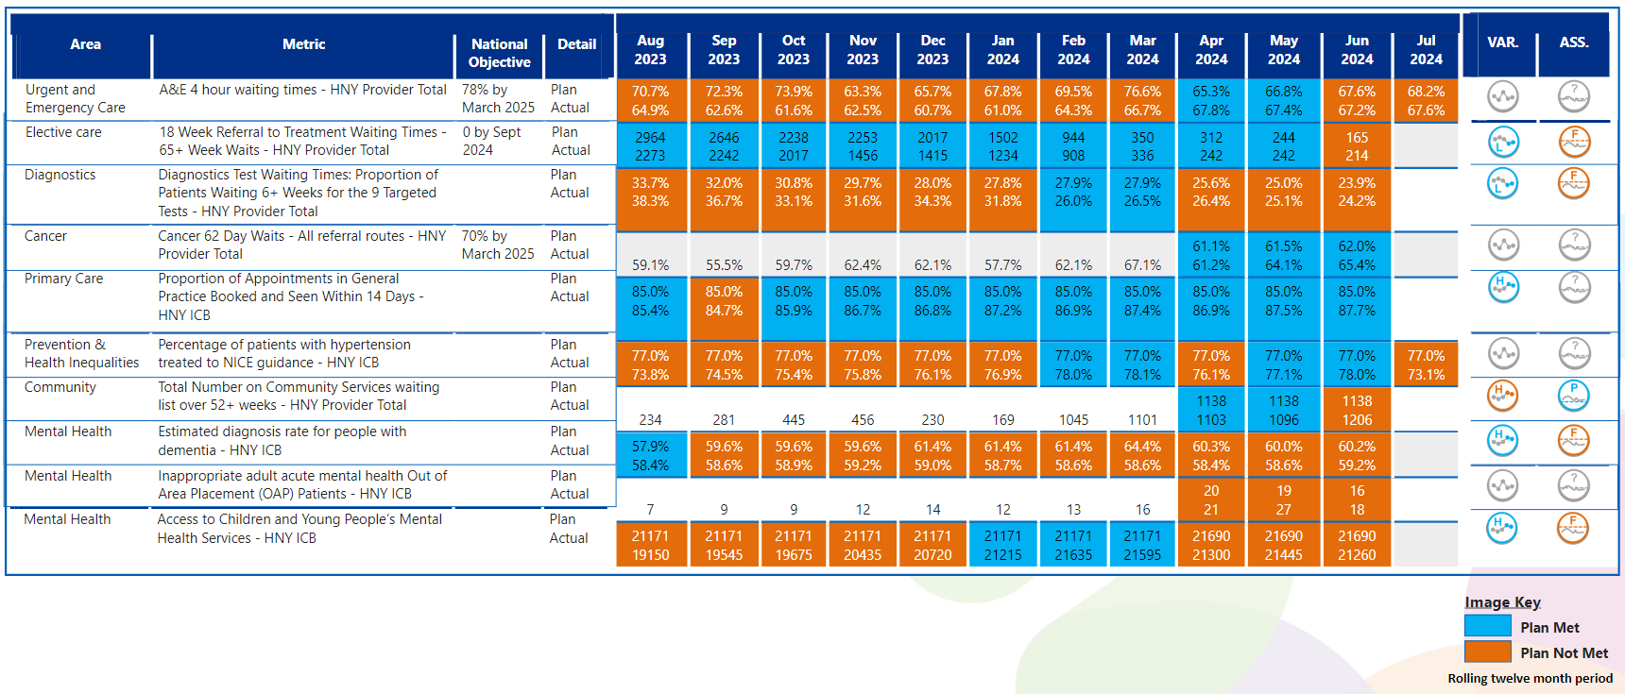
View by Month
In line with Making Data Count recommendations, blue equals achieving, orange equals failing to achieve.

Slide 7

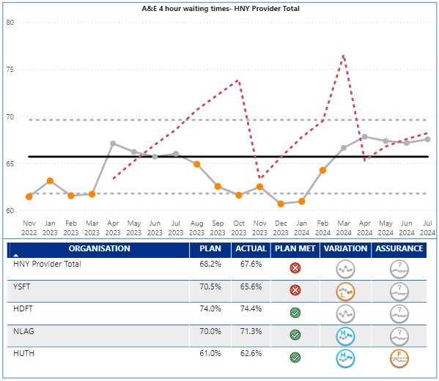
Urgent Care
Key Indicator: Waiting time in ED
Urgent Care Escalation Points
UEC 4-hour performance in July for the overall ICB system was 71.7%. The UEC plan being monitored by NHSE is for the acute providers only and was set at 68.2% for July, and delivery was 67.6%. HUTH (62.6%) and Y&SFT (65.6%) were lowest performing Trusts. UEC performance at HNY has been challenged by NHSE and the ICB is in national UEC Tier 2. The year end target for the acute providers is 73.2% - ICB overall 78%.
4-hour UEC July – HUTH, NLAG and HDFT achieved their monthly plan, Y&SFT did not
HUTH and NLAG are showing improving positions, HDFT no change and Y&SFT worsening
Other none Type 1 facilities were also below plan in June but are showing recovery in August.
Ambulance response time Cat 2 – Overall wait times for cat 2 ambulances was 36:48 minutes against a target of 30:00 minutes. Although the target was not achieved the trend is showing special cause variation of an improving nature. HNY hospital handover performance has been singled out by YAS, EMAS and NHSE as of concern; improvement is required.
Key Actions
UEC summit held 31st July – outputs included: call to action across the System to reprioritise recovery plans to identify 3-4 immediate actions to turn the dial on 4 hours and CAT2 in the next 6-8 weeks; revised UEC governance arrangements proposed including but not limited to CAP involvement and responsibility for UEC, identification of a UEC SRO, revision to system and place UEC board membership and Terms of Reference, and the development of ICB UEC data reports to ensure focus on one version of the truth
UEC Clinical summit held 15th August with aim of improving clinical culture of ownership, improving patient flow and reducing patient harm
Tier 2 meetings with NHSE region stepped up to a more formal approach in all 4 ICB Trusts, which will monitor the delivery of actions produced in the immediate recovery plan ahead of winter
Continued development of 2 x Integrated Care Coordination hubs – locations identified in HNY to increase non-conveyance and reduce dispatch where an alternative care pathway can be followed. Due to go live in October 2024.
How does indicator link to long term priorities:
Patients across HNY use ED services as a way of accessing healthcare, we also know that patients from areas of high deprivation are high users of ED. Improving access to ED will therefore support all of the ICB strategic ambitions including the golden ambition of improving services for CYP.
Evidence suggests the longer patients wait in ED the worse the clinical outcome will be, and congestion in ED can lead to delays to ambulance handovers, meaning ambulances are not freed up to pick up other emergency cases, leading to further clinical risk.
Notes:
Table subject to change depending on what detail is needed.
Consider keeping the original table for this slide and change the table header to the dark blue for consistency.

Slide 8

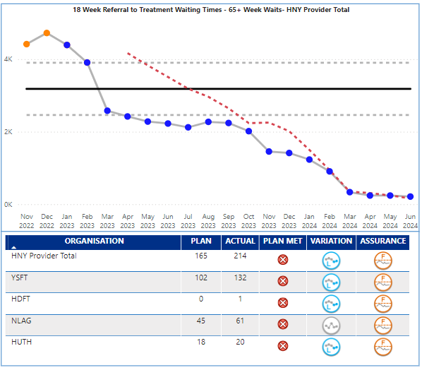
Elective
Key Indicator: RTT 65+ Week Waits
Elective Services Escalation Points
Elective waiting times over 65 weeks reduced to 214 in June against a target of 165. The ICB continues to benchmark well in NEY on all long wait metrics. Performance is outside expected control limits and demonstrates real cause variation of an improving nature. All providers have demonstrated significant progress, Y&SFT in particular though they still have the majority of breaches (132 of the 214). Latest unvalidated data is forecasting August at 97 patients over 65 weeks.
Specialties with highest numbers of long wait patients are; for admitted waits, Oral Surgery, T&O, ENT, Urology, Ophthalmology; and for non-admitted waits, Ear Nose and Throat, Neurology, Gynaecology. NLAG. NHSE plan is for backlog to be cleared by Sept. 24.
Key Actions
Clinical networks – Current planning for ENT deep dive. Analysis taking place on the CYP waiting list to ensure recovery in line with adults. Standardising pathways for hips and knees and cataracts to share with ISP’s
Peri-op clinical network – nationally agreed peri-op metrics received and distributed to network for wider analysis
Eyecare – 1st meeting of the medical retina meeting taken place to standardise pathways. Glaucoma T&F group, stocktaking local optometry skills to review stable glaucoma commissioning rather than HES attendances
Gynaecology – SOP agreed for day case hysterectomy
Orthopaedics – 4 joints on an all day list at Goole, with an additional all day list being sought. Agreement to roll out video post-op across system.
Outpatients – review of top 5 specialties clinic templates with a view to standardise
Day case procedures – deep dive at next elective board into the 29 HVLC procedures by Trust
TWL – analysis to be presented at next ICS Board on growth position
Theatres - National Theatre Board have proposed a new method of theatre utilisation data validation for Model Hospital which based on current Data Quality returns will mean majority of submitted data will be excluded. Trusts currently have a rejection rate of between 9-30%. Working with Trust BI leads
How does indicator link to long term priorities:
Access to planned care elective services supports primary care and urgent care as delays can lead to patients seeking alternative routes to treatment or return to primary care to raise concerns. If not managed for risk, delays to elective care can also affect patient outcomes and certainly affect patient experience, if the condition is one that worsens over time. There are also social impacts to delays that may affect patient’s ability to work. Access to elective services affects all of the ICB strategic ambitions and long term aims. The ICB has made significant investment in elective care through ERF and £80m on IS capacity.
Notes:
Table subject to change depending on what detail is needed.
Consider keeping the original table for this slide and change the table header to the dark blue for consistency.

Slide 9

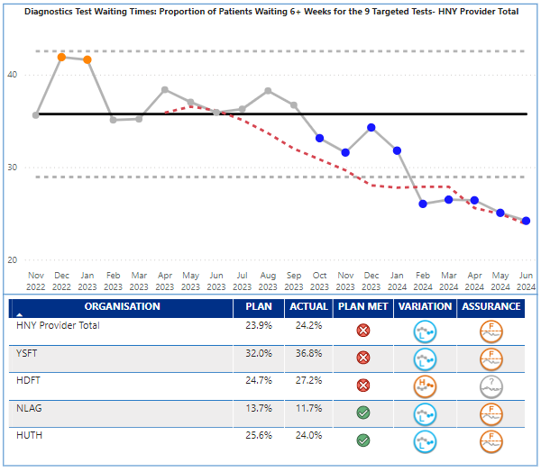
Diagnostics
Key Indicator: Waiting time for tests
Diagnostics Services Escalation Points
Diagnostic 6 week performance was 24.2% in June against a reducing plan of 23.9%; statistically performance is demonstrating special cause variation of an improving nature.
At June 24 there were 9,803 patients waiting over 6 weeks for diagnostic tests in total, but the NHSE plan was based on 9 key tests. The number of patients waiting over 6 weeks for the 9 tests was 9,130 in June, an improvement from 9,868 in May (738). 7,728, of the breaches were in the following modalities – CT (1,891), DEXA (1,286), Audiology (1,263), Echo (1,238), NOUS (1,075), MRI (975).
DEXA, Audiology and Echo are of particular concern, as their high volumes of breaches are from smaller waiting list sizes, and their performance is 47.2%, 42.2%, 39.7% respectively against a national target of 5%. From a provider perspective, of the 9,130 breaches, 3,624 of the breaches are at Y&SFT, and this is reflected in their performance of 36.8% being over 6 weeks (though this is an improving position). The ICB remains an outlier in NEY and Nationally.
Key Actions
CDC programme continues to support activity across HNY and at month 4 has delivered a total of 52,039 tests across all the modalities. Four spoke sites are live (Ripon, Selby, Askham Bar and East Riding Community Hospital (ERCH)) Four more sites (3 hubs in Scunthorpe, Scarborough and Hull and 1 spoke in Grimsby) are under development and delayed.
The HNY CDC mobiles (CT and MRI) rotate between Askham Bar and Selby for Y&STH, Castle Hill Hospital and ERCH for HUTH, St Hughes in Grimsby for NLaG, all of which are providing additional activity.
CDC Workforce plans have been for each site and recruitment is underway
Endoscopy; Staff Collaborative Bank to be explored across trusts commencing September. Phase 2 of data review to determine productivity opportunities commenced. ICB agreed to host dashboard across system for productivity
Imaging; DDCP review completed with discussions heled with regional and national colleagues. Procurement has commenced for AI bid Fracture detection in ED at Y&SFT to support winter pressures. Submission of network maturity assessment to NHSE outcome pending . Phase 2 of data review to commence in August to explore further productivity opportunities.
Audiology review ongoing to ascertain workforce, demand and productivity modelling across HNY.
ICB newly agreed MoU for moving staff across sites to be trialled in diagnostics environment- discussions commenced
How does indicator link to long term priorities:
Quick access to diagnostic services supports primary care, urgent care, elective care and cancer service delivery targets. Early supported diagnosis therefore supports all of the ICB strategic ambitions.
longer waits for diagnosis can affect cancer outcomes, as well as added delay to planned care pathways. Patient experience of care can be affected by delays to diagnosis.
Notes:
Table subject to change depending on what detail is needed.
Consider keeping the original table for this slide and change the table header to the dark blue for consistency.

Slide 10

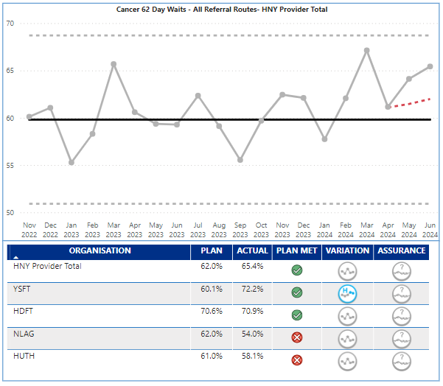
Cancer
Key Indicator: 62 day waits
Cancer Services Escalation Points
In 2024/25, the priority is to deliver a 70% performance on the 62 day cancer wait time target. June performance was 65.4% against a plan of 62% and therefore the target was achieved in the month.
In regard to 62 day performance, the trends on the chart opposite are showing common cause variation no significant change; which reflects a fluctuating position over the mid point.
Y&SFT (72.2%) and HDFT (70.9%) both achieved the end of year national target (70+%), with Y&SFT demonstrating special cause variation of an improving nature.
NLAG and HUTH at 54% and 58.1% are below plan. The ICB as a whole, and HUTH, and NLAG as individual providers, are in NHSE Tier 1 category for Cancer.
Key Cancer Alliance Actions in July 24:
Awareness & Early Diagnosis: Cancer Awareness Measures provider appointed, brief drafted and approved. Four PCN Cancer Care Coordinator projects selected.
Cancer Diagnostics and Innovation: 12 Cancer Innovation Grants ratified and KPIs agreed with bidders.
Nursing and AHP: Recruited to ACCEND and Nursing and AHP Project Delivery Manager posts.
Comms & Engagement: KPOW!: Film premiere took place on 8 July. Annual Conference agenda and keynote speakers confirmed.
Health Inequalities: Facilitation of session at ICB Population Health celebration event. Cancer LGBT educational session developed.
Lung Health Check: 5 Year plan approved by LHCSC and submitted to NHSE.
Non-Surgical Oncology: SACT Pre assessment survey commenced. SACT C&D audit at YSTHFT completed.
Treatment, Pathways and Personalised Care: Innovation grant awarded for delivery of Fatigue Blueprint and milestones set. GIRFT H&N Peer review completed.
How does indicator link to long term priorities:
Quick access to cancer diagnostic and treatment supports all of the ICB strategic ambitions, in particular reducing harm from cancer, and long term improvement in Healthy Life Expectancy.
longer waits for treatment can affect cancer outcomes, and overall patient experience of care. NHSE will be scrutinising performance in this indicator and it forms part of the NHSE Oversight Framework and Tiering process. Delivery is supported by the Cancer Alliance.
Notes:
Table subject to change depending on what detail is needed.
Consider keeping the original table for this slide and change the table header to the dark blue for consistency.

Slide 11

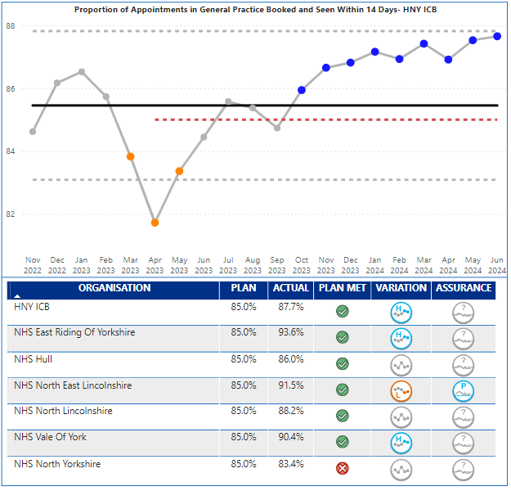
Primary Care
Key Indicator: Booked within 14 days
Primary Care Escalation Points
HNY June performance has delivered 87.7% against the 85% target for 14 day booking. Performance has been closer to the upper control limit and demonstrating special cause variation of an improving nature.
Performance differs by place; East Riding 93.6, NE Lincs 91.5%, Vale of York 90.4%, North Lincs 88.2%, Hull 86%, North Yorks 83.4%. All places delivering the target except North Yorks.
Primary care met the June target for appointments delivered. The majority of the last 6 months delivery have all been towards the upper control limit but due to a slight drop in appointments in June2, the trend is showing common cause variation of no significant change.
Expectations in the operating plan are to recover dental levels of provision to pre pandemic levels. April saw a slight reduction from March but statistically numbers have fluctuated between 70-98% over the last 18 months with no consistent trend.
Key Actions
Practices have the ability to exception report excluding patients who choose to book an appointment outside the 2 week period. Planning assumptions for 24/25 have been updated to reflect the appropriate data source for this indicator and confine the reporting to certain types of appointment rather than the full list which has impacted on the improved performance.
Investment has been initiated to increase access to Dental Services through increased urgent access sessions, orthodontic appointments and waiting list initiatives. Flexible Commissioning initiatives are under review in order to develop robust and consistent methods for reporting on delivered activity. Procurements concluded with 3 new contracts due to mobilise imminently in 2024 which will lead to improved access and use of commissioned UDAs. Alternative approaches for Bridlington are being planned. These new services will account for up to 84,777 UDAs.
In an effort to stabilise practices who may be struggling, the ICB is committed to working with providers to offer temporary reductions in their UDA delivery and to review their tariffs.
How does indicator link to long term priorities:
Primary care is singularly, the most used service in healthcare and is the entry point for many other services. It is therefore key to all of the ICB strategic ambitions, and long term aims.
Actual Inability or perceived inability to access primary care (and dental services) can lead to patients either incorrectly using emergency services, adding pressure there, or reluctance to engage with healthcare at early stages of symptoms. Patient experience and outcome can be affected by these delays which is why improved access to primary care is vital.
Notes:
Table subject to change depending on what detail is needed.
Consider keeping the original table for this slide and change the table header to the dark blue for consistency.

Slide 12

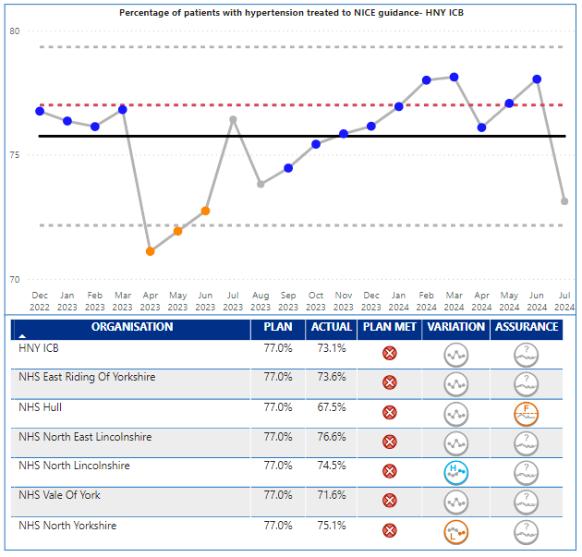
Prevention and Health Inequalities
Key Indicator: % Hypertension NICE Guidelines
Prevention Escalation Points
July 2024 performance was 73.1% against a target of 77%. The performance is showing a common cause variation of no significant change. No Places achieved their plan in July. However, the overall performance was within the control range and similar to the trend seen last summer.
Hull’s performance still remains away from the other places and is showing a common cause variation of no significant change.
Key Actions
Whilst successfully achieving the target for 23/24 ICB recognises that an inequalities gap remains between treated to target results between most and least deprived communities. The ICB continues to work with place teams and system partners to deliver several initiatives that seek to improve the detection and management of hypertension across our population with a particular focus of delivery within our most deprived at risk communities. This includes:
Utilising data to inform local improvement conversations regarding hypertension detection and management with practices, PCN's, LCP's and INT's, to help inform local priorities and projects
Ensuring opportunities within primary care workforce are maximised to improve detection of hypertension through collaborative working between GP practices, community pharmacies and through pilot projects delivering opportunistic testing in optometry and dental sites in the most deprived populations.
Scoping and testing hypertension treatment pathways through National pharmacy Independent Prescriber pathfinder pilot.
Delivering opportunistic blood pressure testing in community sites, with a focus on increasing access within our most deprived and at-risk populations and developing train the trainer education packages.
Evaluate incentivised scheme to improve treatment to target of diagnosed hypertensive patients in more deprived populations.
Continued delivery of NHS Health check programme with exploration of opportunities to take a population health management approach.
Improving public awareness of importance of 'knowing your numbers' through delivery of a series of national campaigns targeting BP monitoring.
How does indicator link to long term priorities:
Improved the % of patients with hypertension being treated following NICE Guidelines supports several strategic ambitions and outcomes such as reducing CVD; and enabling wellbeing health and care equity. It also has a direct link to the long-term ambition of improving healthy life expectancy.
1 in 3 adults has hypertension, which in turn can lead to heart disease, stroke and kidney disease, it is also linked to deprivation, and socioeconomic factors can be markers. This suggests that improving the care and treatment and prevention of hypertension could reduce the gap in healthy life as well..
Notes:
Table subject to change depending on what detail is needed.
Consider keeping the original table for this slide and change the table header to the dark blue for consistency.

Slide 13

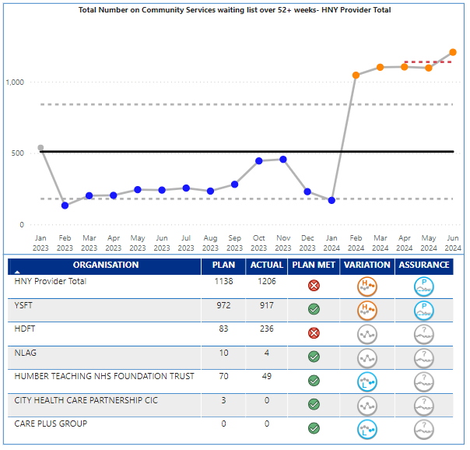
Community Care
Key Indicator: Waiting List over 52+ Weeks
Community Care Escalation Points
The priority indicator for community waiting times in the operating plan is patients over 52 week waits. The latest validated data available is June 2024, which saw 1,206 patients wait over 52 weeks for community services against a plan of 1,138. The data is showing Special Cause variance of a concerning nature. There is variation across providers and services. All areas achieved plan except HDFT, however, Y&SFT (917), HDFT (236) and Humber Teaching FT (49) all had material breaches. HDFT more than doubled their waits from 112 in May to 236 in June. At a service level 889 (920 last month) of the 1,206 are in CYP Speech & Language service – 841 of which are at Y&SFT. The growth in HDFT is on the Nursing Therapy Support for LTC: Respiratory/COPD service
Overall waiting list size stands at 21,974 a growth of 1,252 since May, although statistically performance has shown no significant change (no improvement or deterioration in the last twelve months). At a provider level; Y&SFT are showing statistical growth as are Humber Teaching. HDFT, NLAG, CHCP and Care Plus are showing no significant change.
Key Actions
HDFT and NLaG continue to report discrepancies with services being omitted and some services showing inconsistent returns. These have been escalated to ops and BI teams to validate accuracy.
As a result of ongoing pressures within SaLT services across HNY (particularly in CYP), the Community Collaborative have linked in with the ICB’s Children's services teams who are undertaking a stock take of all SaLT services across the patch to identify similarities and workforce models. The workforce stocktake has been completed with the service descriptors due to be completed at the end of August. A meeting between CYP and Collab teams has been scheduled in September to review next steps and transformation opportunity.
York Place Director has reached out to local HNY providers to understand if mutual aid for York’s CYP SLT service could be explored. Responses are being collated by the end of August 24 to review how this might (or might not) be able to be progressed.
Y&SFT have set up a specific session to discuss internal plans for SaLT transformation and review options to reduce the waiting list. This is scheduled in September.
The Community Collaborative are progressing the development of an ICB wide community access policy to help improve coherence in reporting and standardisation in waiting list management processes across the ICB. The first meeting has taken place, and a set of principles are being drafted in line with RTT practice which will be drafted into a policy with the first draft expected November 24.
How does indicator link to long term priorities:
Community services play a key role in delivering several of the ICBs long term ambitions and outcomes; in particular the golden ambition to radically improve the health and wellbeing of children and young people, and outcome measure of living with frailty.
Community services are a key support to patients with long term conditions in particular, they support primary and secondary care by being an alternative provision, but also are key to future innovations in pathway redesign, of which virtual ward is an example. The structure of community services forms part of the ten priorities for 2024/25
Notes:
Table subject to change depending on what detail is needed.
Consider keeping the original table for this slide and change the table header to the dark blue for consistency.

Slide 14

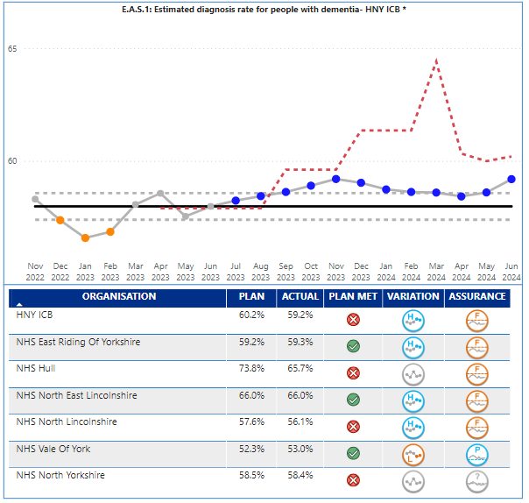
Dementia
Key Indicator: Dementia Diagnosis Rate
Dementia Escalation Points
The dementia diagnosis rate for the ICB in June was 59.2%, which is below the ICB plan target of 60.2%. Performance since September 2023 has been above or at the upper control limit and therefore demonstrating special cause variation of an improving nature. However, even with the improved performance, the ICB remains adrift from the national target and planning expectation of 66.7%, and the ICB target for 2024/25 of 62.5% by March 2025.
Performance is variable across the Places within the ICB; NE Lincs 66%, Hull 65.7% , East Riding 59.3%, North Yorks 58.4%, North Lincs 56.1%, and Vale of York 53%. NE Lincs, North Lincs and East Riding are all showing special cause variation of an improving nature. York did achieve plan, but they are showing special cause variation of a concerning nature and are a national outlier. A detailed understanding at a practice level is available and being worked through.
Key Actions
A dementia briefing paper has been completed to support the request for SDF to address diagnosis rates and wait times. This outlines the priority planning intentions and the relevant supporting evidence. Awaiting ICB approval.
Current Quality Improvement project to cleanse the GP registers to resolve coding issues and identify additional possible diagnoses. Continues to progress with more miscoded diagnoses and further recommendations for review. York is being prioritised.
Recent meeting with York Clinical Director – proposal in development to target the most challenged PCN.
5 year dementia strategy ‘Hope of a Live Still to be Lived’ out for stakeholder feedback – going to the MHLDA ESLG in September for sign off before ICB Exec sign off. One key priority is ‘communication’ and will see the roll out of comms aimed at improving identification, referral, assessment and diagnosis. ICB comms team supporting.
Reduction in Hull DDR being addressed by Hull ICB via recovery action plan.
MCI error in methodology identified on the dashboard impacting on previous MCI figures. Will be amended for next version.
How does indicator link to long term priorities:
Improving Dementia Diagnosis Rate directly supports the ICB long term ambition of Transforming people’s health and care experiences and outcomes.
Earlier diagnosis of often vulnerable patient’s empowers patients and their families and carers to take control of their situation, leading to better management of the disease, better time to plan and therefore an enhanced quality of life.
Notes:
Table subject to change depending on what detail is needed.
Consider keeping the original table for this slide and change the table header to the dark blue for consistency.

Slide 15

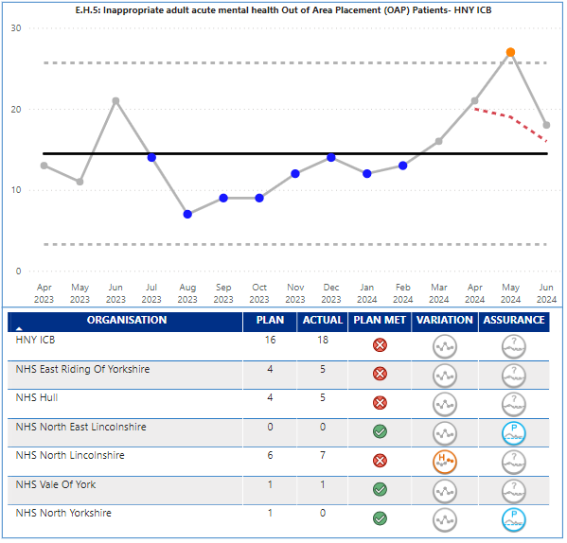
Out of area placements
Key Indicator: Inappropriate OOA placements
Mental Health Out of Area (OOA) Escalation Points
The target for 2023/24 related to out of area bed days; for 2023/24 the key performance indicator has changed to inappropriate acute out of area placements. The actual performance in June was 18 against a plan of 16. The performance has shown no significant change in the last twelve months with variation around the mid point.
There is variation at Place with NE Lincs at 0 and North Lincs at 7, Hull and East Riding at 5. North Lincs is showing a deterioration.
Key Actions
Confirmation for the allocation of Sustainable Development Funding (SDF) has now been received and priorities for the funding have been agreed, these include recruiting additional centralised short term case management capacity, development of a community rehabilitation service in NL and expanding the Hull/ER older adults community and crisis teams, as well as developing an additional 4 functional beds.
The Inpatient Quality Transformation three-year plan was submitted to NHS England in June 24 and is being led through the programme Assurance and Oversight Steering group. Next meeting 9th September 2024.
The HNY OOA dashboard is updated with data from providers and Place and shows the monthly updated position for our OOA placements of all types including older adult acute, adult acute, PICU, and rehabilitation.
Bed modelling has been undertaken and a proposed model is in development to provide Learning Disability beds across the patch.
Discussions are also underway with LPFT and Humber FT to develop a PICU solution for a wider patch by splitting the units by gender.
Desktop reviews are under way for the patients with the longest lengths of stay. Mini MADE's are being introduced to areas that don’t already have them implemented with scoping underway to potentially develop a system wide MADE for cases that require further escalation.
A letter has been sent to the independent providers where HNY patients are placed to request completion of an adapted 12-point discharge plan for each patient to gain assurance of admission purpose, active interventions and discharge plans.
How does indicator link to long term priorities:
Reducing inappropriate out of area placements directly supports the ICB long term ambition of Transforming people’s health and care experiences and outcomes.
Transporting often vulnerable patient’s long distances out of area can often be poor experience and demonstrates a lack of local capacity and available services. It has also been identified as one of the ten key priorities due to financial impact of having to fund inpatient stays over and above existing contracted provision.
Notes:
Table subject to change depending on what detail is needed.
Consider keeping the original table for this slide and change the table header to the dark blue for consistency.

Slide 16

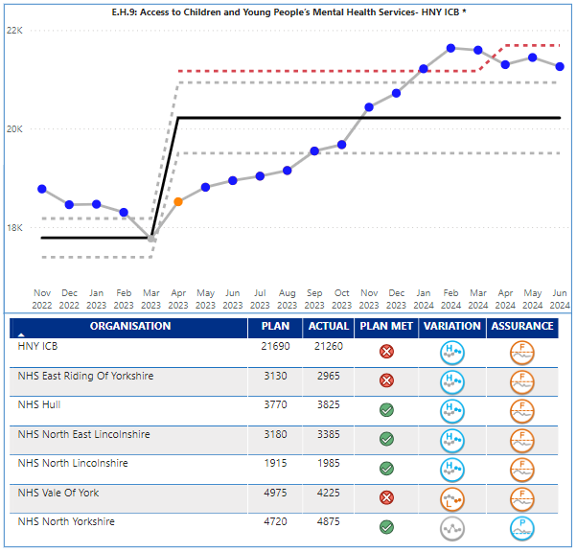
CYP Mental Health Services
Key Indicator: CYP MH Services
Access to Children’s & Young People’s MH Services
ICB actual performance for available appointments in June was 21,260 against a plan of 21,690, and therefore below target. The provision made available has shown special cause variation of an improving nature, but is below the increased plan for 2024/25.
Place level performance is variable; Hull, North East Lincs, North Lincs, and North Yorkshire achieved target, whereas East Riding, and Vale of York did not. All areas except North Yorkshire and York are showing special cause variation of an improving nature. North Yorkshire is showing no significant change and York is showing special cause variation of a concerning nature.
Key Actions
Finalise the increased investment in SDF for CYP MH to enable increased capacity in the system to return to the upward trend. The increased activity ambition for 2024/25 Operational Planning relates to national increases in CYP MH funding; this indicates a risk that the new 24/25 Operational Planning target will may not be achievable without the additional investment. As agreed with the ICB board, places have identified additional schemes to be funding though SDF uplift to improve CYP access, reduce waiting times and improve outcomes. These schemes have been reviewed by the MHLDA collaborative with those which will also improve access and early intervention, address gaps in provision and reduce variation across the system prioritised for funding (subject to sign off by ICB Board).
Progress the work on the CYP MH dashboard to better understand and address the challenges in improving CYP MH access, outcomes and experience. All currently NHS funded services now all flow data and so any increase in access in 24/25 is likely to be very limited without additional investment. Access is only one indicator and should not be considered in isolation. Other key indictors to be included in reporting to be agreed with ICB lead for planning and performance.
Working with CYP with Lived experience from the ‘Nothing About Us Without Us’ advisory group and senior leaders across the system to coproduce solutions and implement recommendations from improving access to mental health services consultation.
Planned event in October with multi agency stakeholders to review whole pathway for CYP Eating disorders (early intervention, community CAMHS/eating disorder services and inpatient)
Refresh the HNY CYP MH strategic plan for November 2024 with improved emphasis on early intervention, reducing waiting times and improving waiting well initiatives, improving outcomes and addressing inequalities, which prevent early access for those most at risk of poor mental health. The refreshed plan will also deliver against the Core20plus5 for CYP. ”
How does indicator link to long term priorities:
Improved access to CYP Mental Health Services supports one of the ICB four big outcomes - enabling mental health resilience, as well as the golden ambition of radically improving the health and wellbeing of children and young people, which in turn helps improve healthy life expectancy.
All national data and evidence suggests that mental health and wellbeing is worsening across all age groups and communities; and that poor mental health can impact on physical health. Improved access to MH services at an early age is vital for the ICB to meet its long term strategic ambitions.
Notes:
Table subject to change depending on what detail is needed.
Consider keeping the original table for this slide and change the table header to the dark blue for consistency.

Slide 17

Executive Summary
Appendices with further information relating to:
Non Access Indicators
Full list of operating Plan metrics
Extra supporting Information
Ms Powerpoint Stock Images
Notes:
textbox
No alt text provided
image
No alt text provided
image
No alt text provided
shape
No alt text provided
shape
No alt text provided

Slide 18


The Indicators described in the quadrants below form part of the annual operating plan guidance but are picked up through other reporting routes. A high-level overview is provided on the following slides
Finance The following indicators are discussed at the Finance and Performance Committee, and escalated to the ICB Board via the Chief Finance Officer paper Deliver net system balanced position Reduce agency spend Deliver VWA activity total – Income Target | Workforce The following indicators will form part of the update to Finance and Performance Committee along with any necessary escalations to ICB Board from the Director of HR. Key indicators are described below, with further information on the following slides. Increase workforce turnover – June 13.2% against target of 14% Reduce staff absence – June 4.6% against a plan of 4.5% WTE staff in post plan – June 33,735 against a plan of 33,270 Other measures: Improve working lives of doctors Provide sufficient clinical placements and apprenticeships
Prevention and Health Inequalities The following indicators are discussed at the Population Health and Prevention Committee along with a wider number of metrics. The Board will be updated via papers agreed at certain times in the year. Improve vaccination uptake for CYP (WHO) Deliver on the Core20Plus5 approach for adults, CYP | Quality The following indicators are discussed at the Quality Committee along with a wider number of quality metrics. Updates on the quality agenda and these three operating plan metrics will be escalated to the Board from the Quality Committee. Implement 3 year plan for maternity and neonates Develop at least one women’s Health Hub Implement the patient safety incident response framework The following slide gives a brief headline updates, and these will be updated quarterly for this report. (July Board, October, January, April to describe the previous quarters progress)

Slide 19
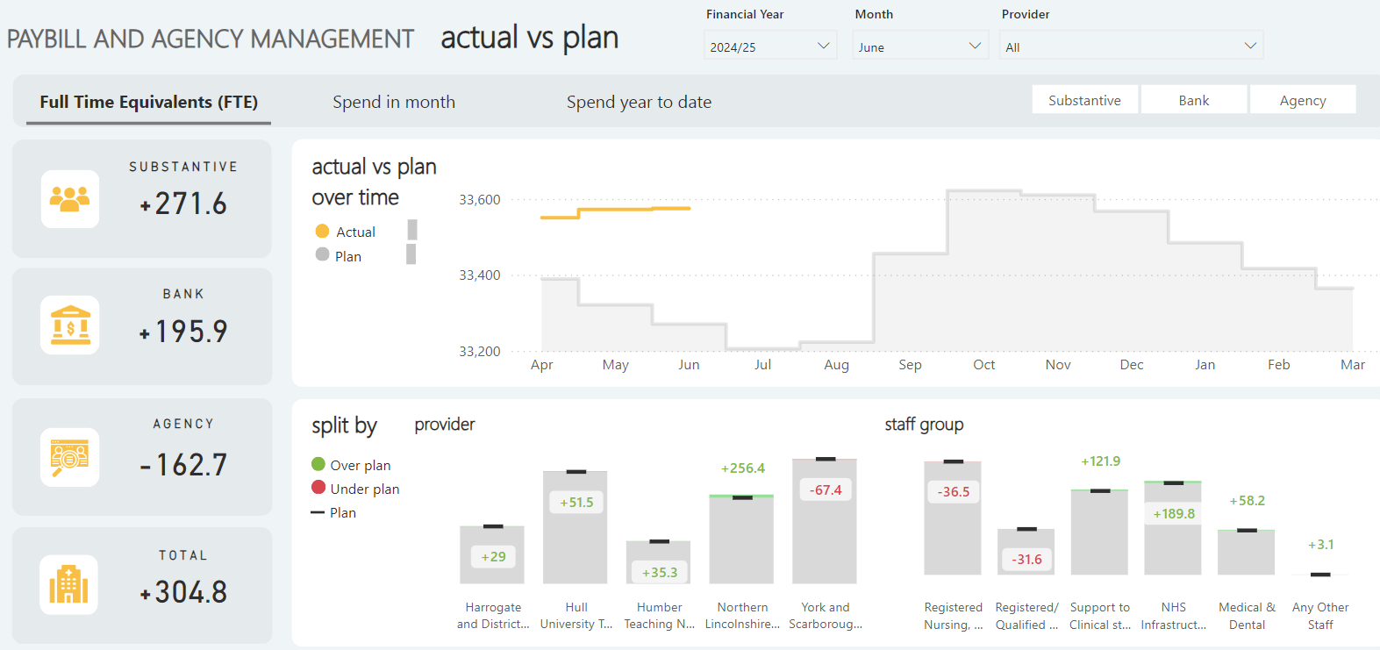
Workforce Summary

Slide 20
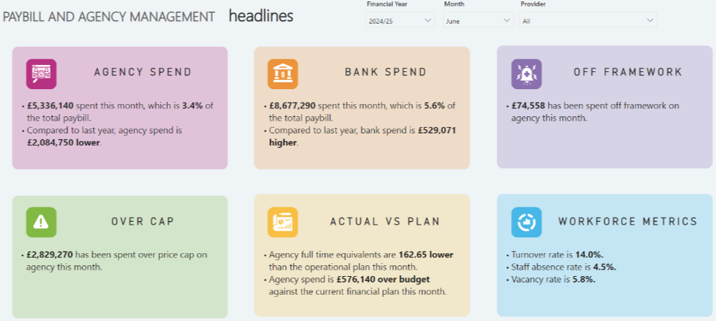
Workforce Summary (Cont.)

Slide 21
Quality Cont. Implement 3 year plan for maternity and neonates (this will be a quarterly update next one due in October Board relating to Q2 progress) Currently at Year 2, Q1; improvements noted for Year 1, Q4. The LMNS have an ongoing oversight process to assess progress at each Trust as well as leading system improvement projects, acknowledging that there are two Trusts working through the Maternity Safety Support Programme and there is a lot of crossover between these and Ockenden requirements. Theme 1: Working with women and families; significant improvement in Maternity & Neonatal Voices Partnerships input, baby passport introduced, good progress with Perinatal Pelvic Health. Theme 2: Workforce development; first cohort of Midwifery Support Workers through programme, plan for workforce & equity lead progressed, QI work with bereavement midwives to establish robust teams Theme 3: Safety & learning culture; supporting system wide improvements from CQC/Score surveys, induction of labour project commenced, escalation and mutual aid processes in place Theme 4: Underpinning standards & structures; Badgernet now in place in 3/4 Trusts, Maternity Incentive Scheme trajectories agreed and scheduled, MBRRACE data review completed Implement the patient safety incident response framework (this will be a quarterly update next one due in October Board relating to Q2 progress) All of the larger providers have made the transition to PSIRF. Providers continue to work through their legacy serious incidents to expected timescales. TEWV in particular have made extremely positive progress in addressing their backlog. The Patient Safety Committee has been established and is considering the system based quality improvement initiatives that will be commissioned to address the main safety themes arising from provider patient safety priorities. The oversight framework is in development and will be presented to the PSIRF Implementation group in August 2024. The ICB has submitted an expression of interest to the National Team to be a pilot ICB for the development of PSIRF in GP Practices.

Slide 22
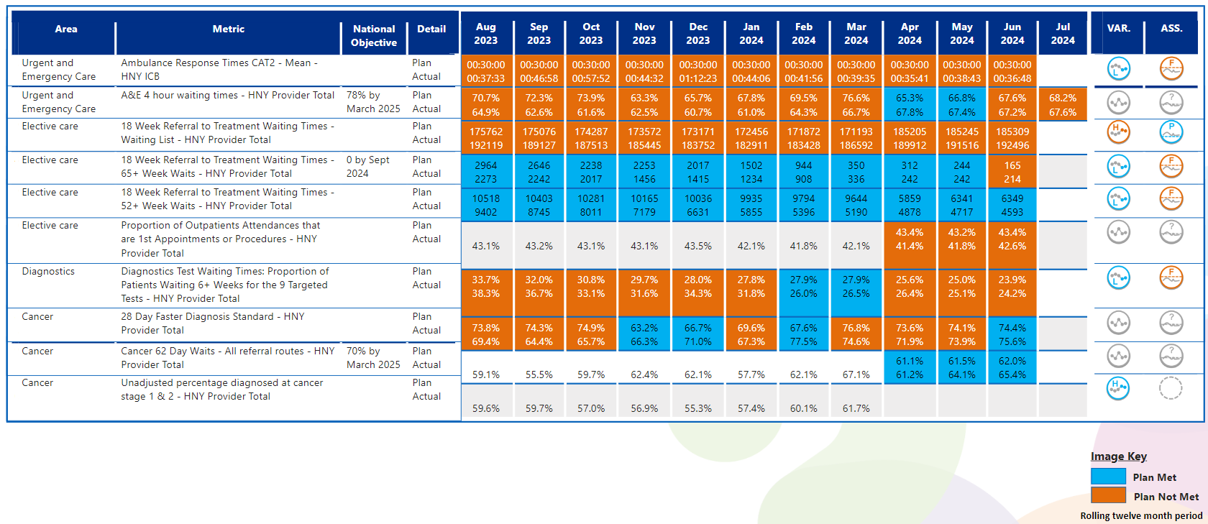
View by Month – Other Operating Plan Indicators
In line with Making Data Count recommendations, blue equals achieving, orange equals failing to achieve.

Slide 23
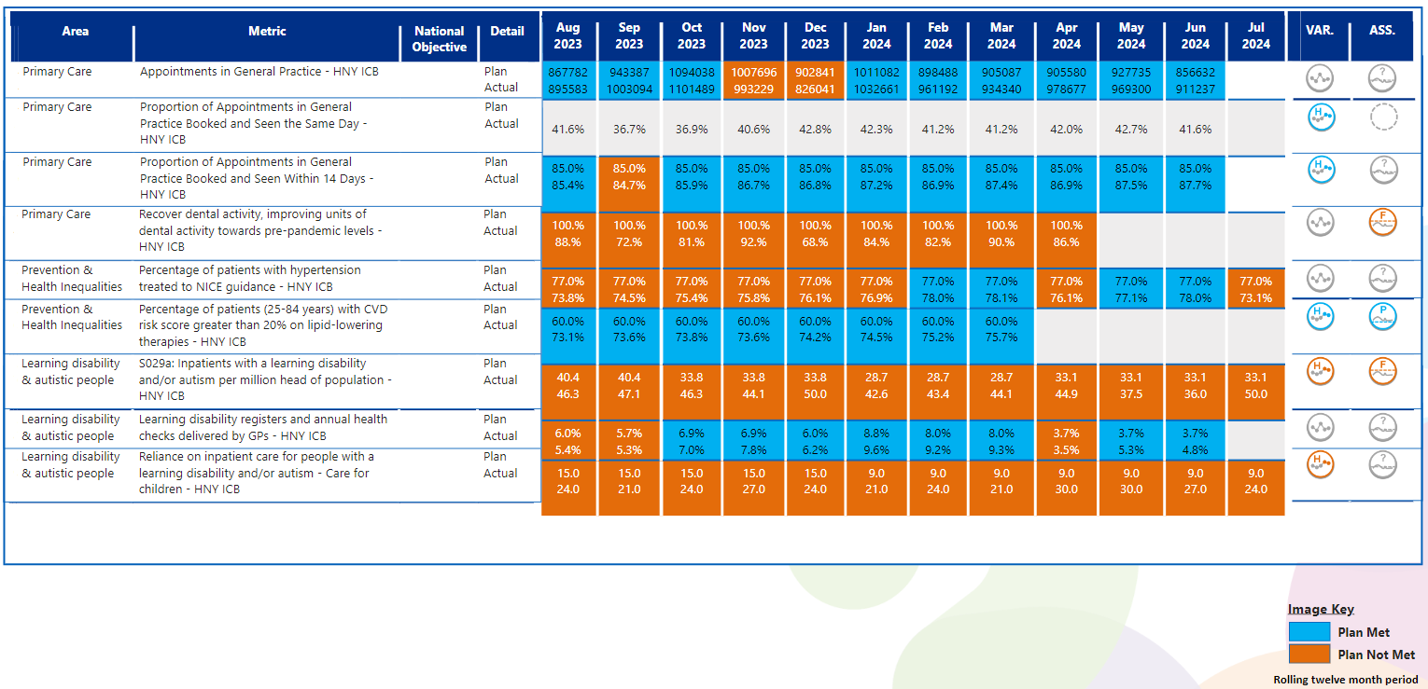
View by Month – Other Operating Plan Indicators
In line with Making Data Count recommendations, blue equals achieving, orange equals failing to achieve.

Slide 24
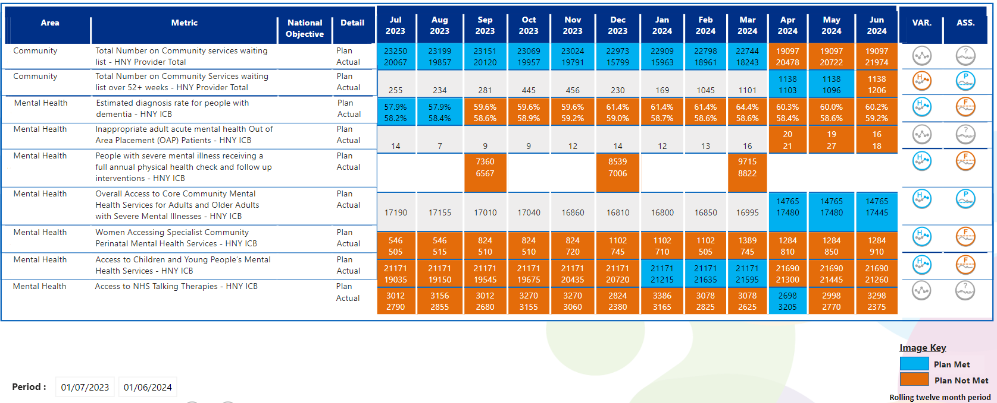

View by Month – Other Operating Plan Indicators
In line with Making Data Count recommendations, blue equals achieving, orange equals failing to achieve.

Slide 25
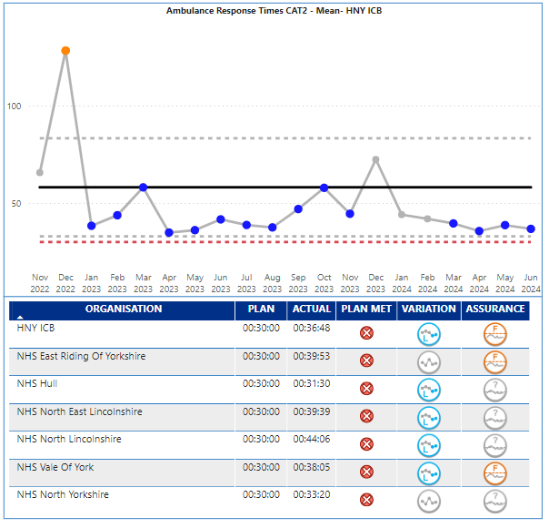
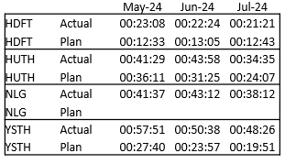
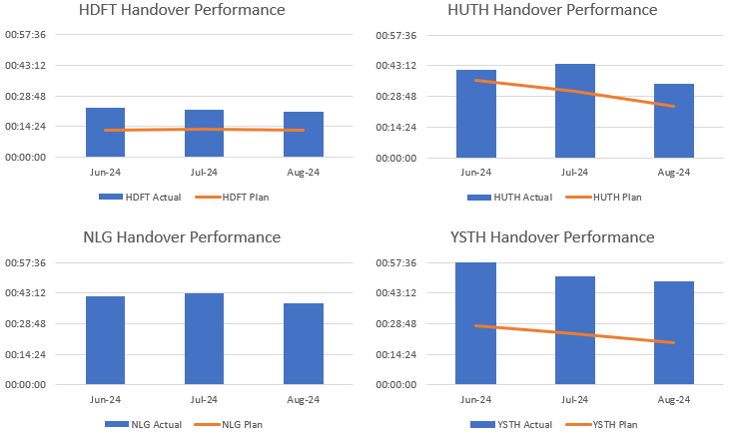
Urgent Care
Additional Key Indicators
Supporting Indicators and Intelligence:
Ambulance Handovers:
At a place level we see variation from Hull (31:30) through to N Lincs (44:06) – No place is achieving the 30 minute target.
At a provider level July data is available and is showing an improving position from last month - YAS performance was 27:58 and EMAS at 36:08 against June numbers of 30:43 and 38:04 respectively.
Notes:
Table subject to change depending on what detail is needed.
Consider keeping the original table for this slide and change the table header to the dark blue for consistency.

Slide 26
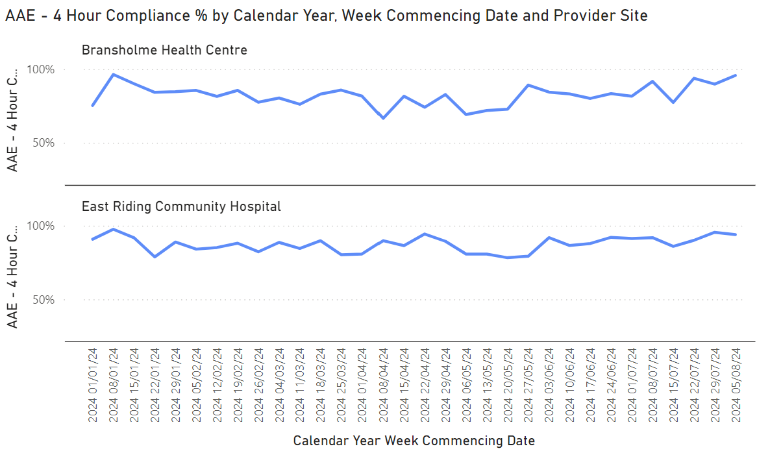
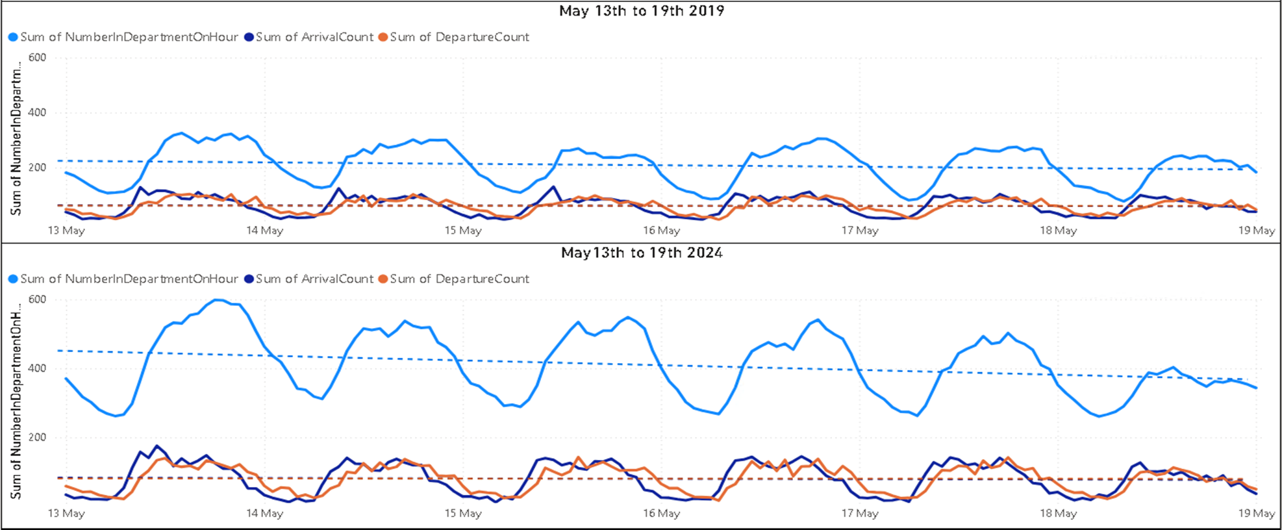
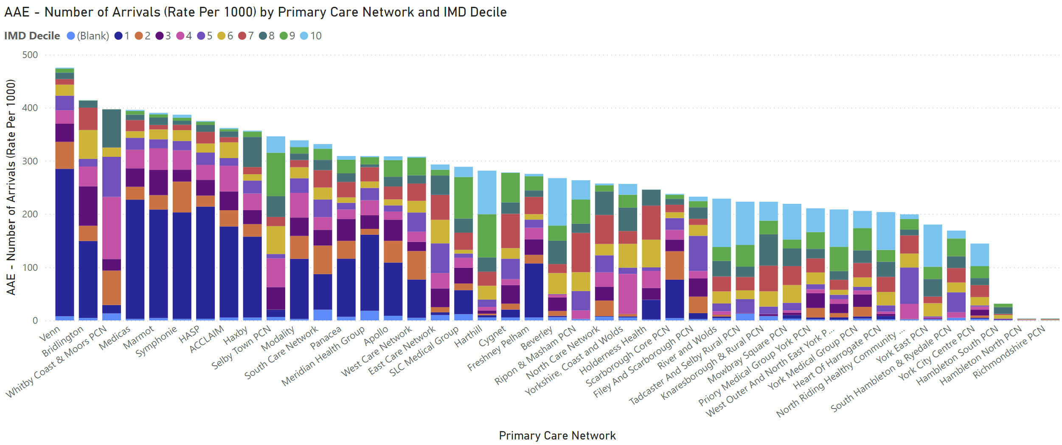
Supporting Indicators and Intelligence:
Urgent Care
Crowding - Although activity has increased by approx 12% across the period, the numbers in department have nearly doubled. This is driven from longer average times in department.
PCN Rate of Attendance by Decile (2024)
Notes:
Table subject to change depending on what detail is needed.
Consider keeping the original table for this slide and change the table header to the dark blue for consistency.

Slide 27
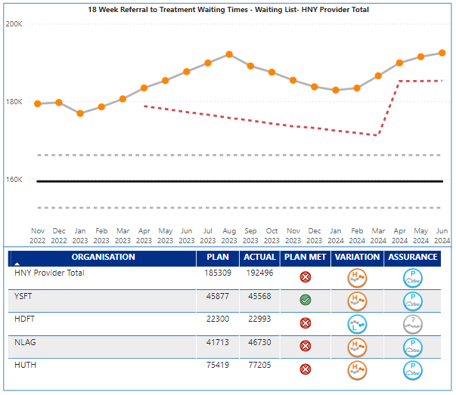
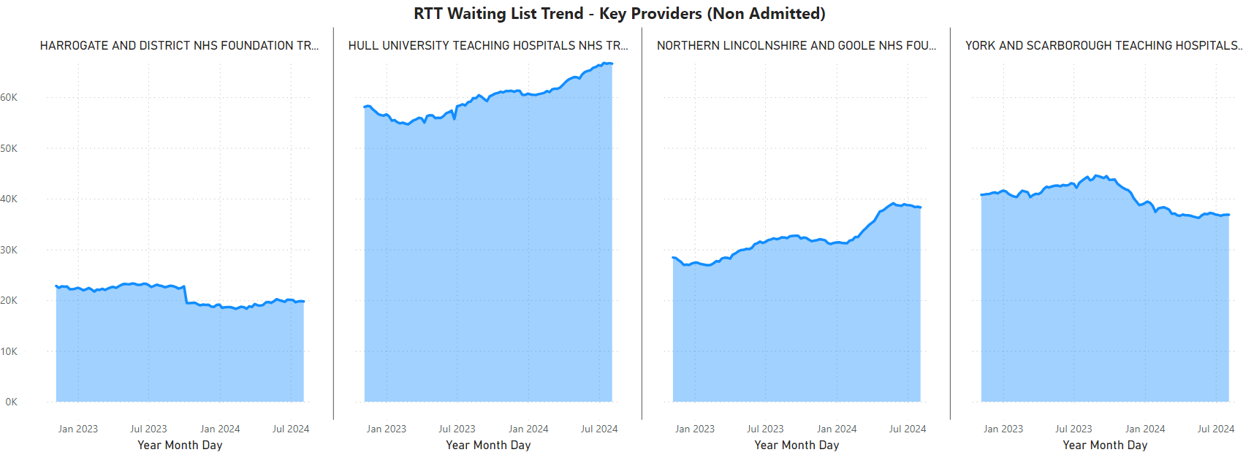
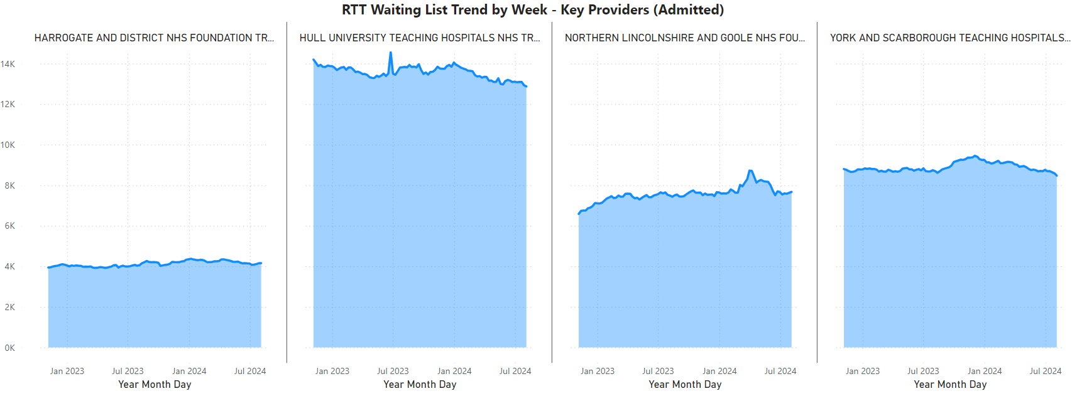
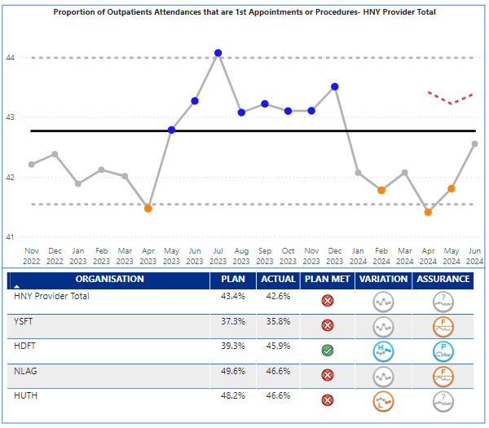
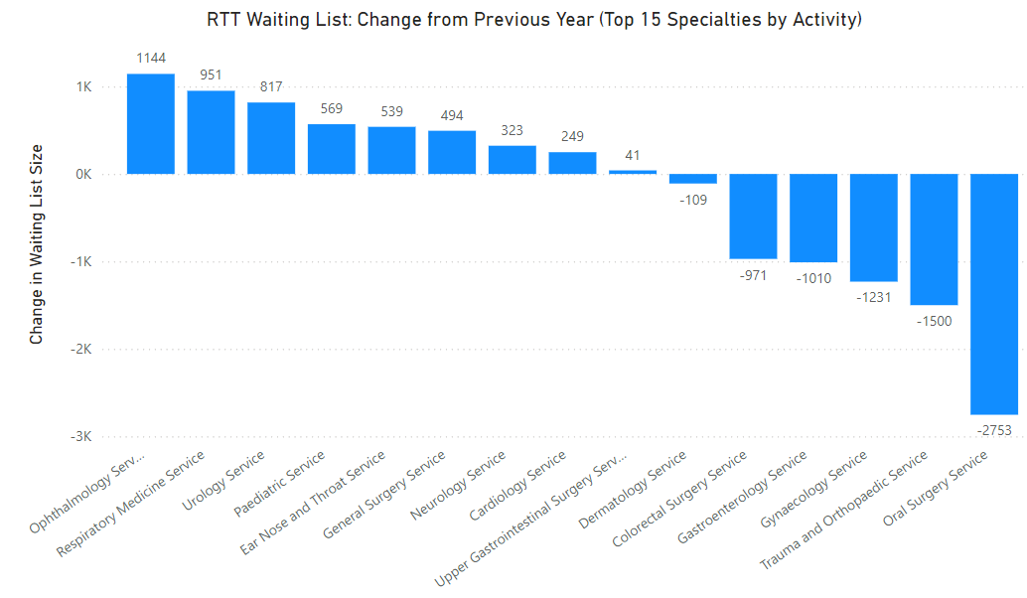
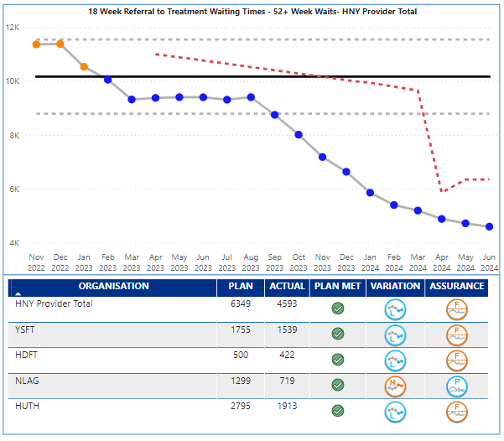
Elective
Additional Key Indicators
Supporting Indicators and Intelligence
Total Waiting List Size
From September, the plan is for 65 weeks to have been delivered, at which point total elective waiting list size will become the priority indicator in the Board report. In the meantime, SOAG will have an update to maintain visibility. June performance demonstrated continued growth in the overall waiting list which at the end of May was 191,516 a growth of 5,904 since March (186,592). NLAG and HUTH are both showing cause for concern with growth above the upper control limits. In general, the growth is on the non admitted waiting list.
Proportion of 1st to FUs to 46%
Notes:
Table subject to change depending on what detail is needed.
Consider keeping the original table for this slide and change the table header to the dark blue for consistency.

Slide 28
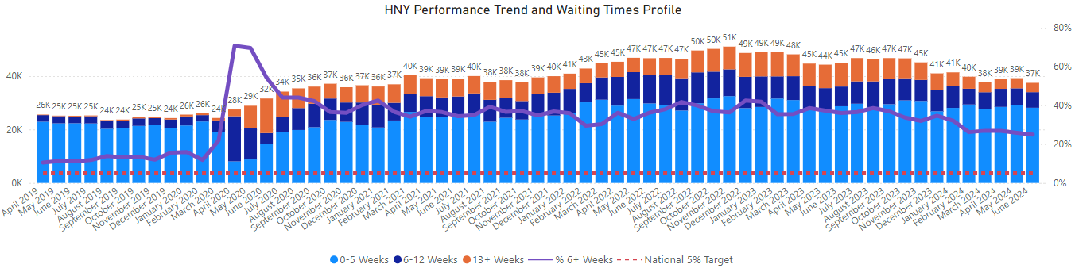
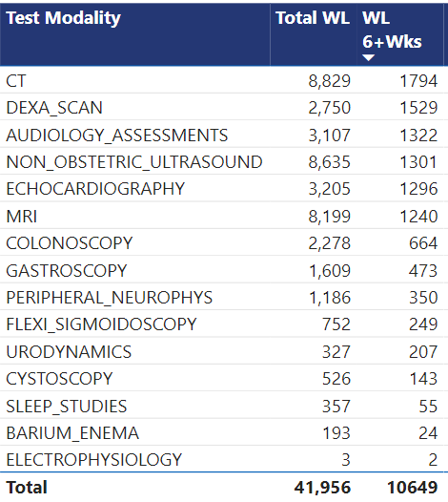
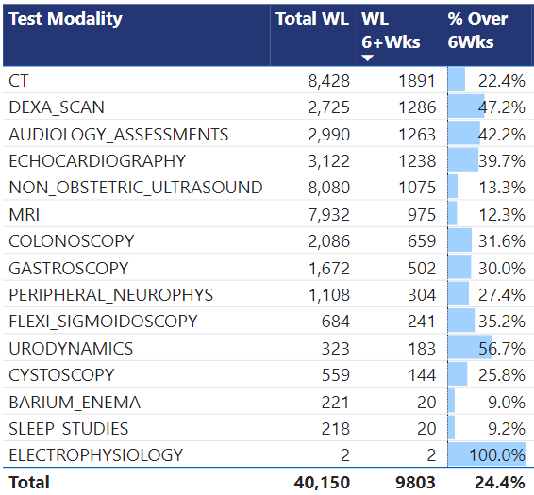
Supporting Indicators and Intelligence
Diagnostics
May 24
June 24
Continued reduction in total waiting list size, and the longer waits are being squeezed which is positive.
By reducing the proportion over 6 weeks the % performance has improved.
At a test level, CT position worsened from 1,794 to 1,891, however DEXA, Audiology, Echo, NOUS and MRI all improved to different degrees.
Y&SFT remains of concern but improved from 4,460 to 3,624
Notes:
Table subject to change depending on what detail is needed.
Consider keeping the original table for this slide and change the table header to the dark blue for consistency.

Slide 29
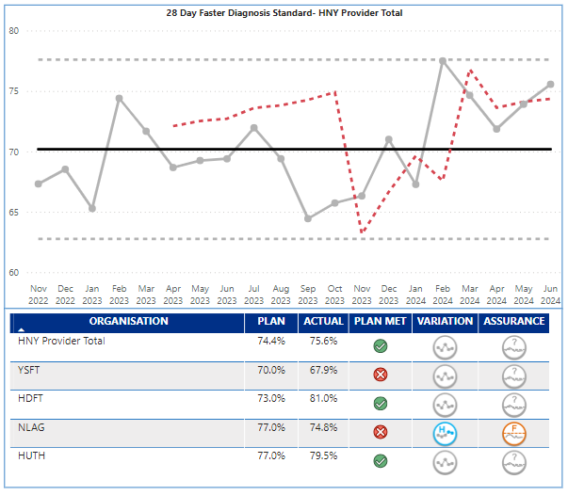
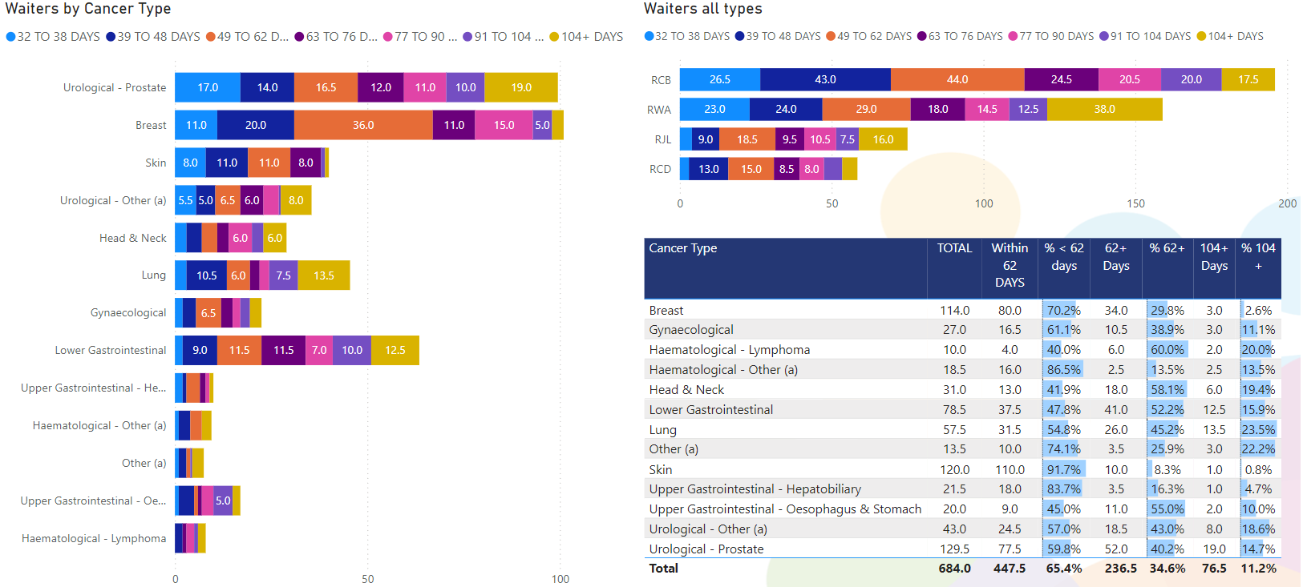
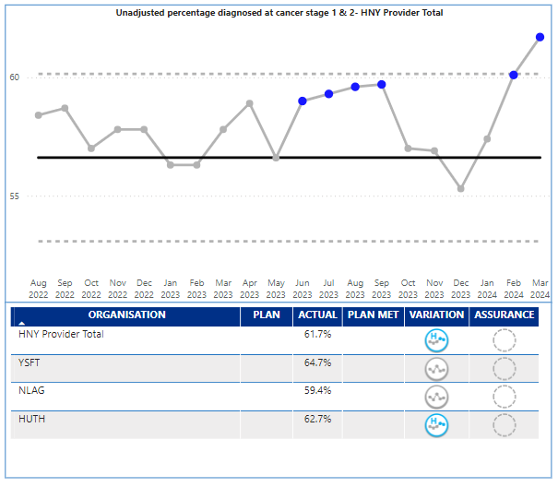
Cancer
Additional Key Indicators
Supporting Indicators and Intelligence
Faster diagnosis performance was 75.6% against a target of 74.4%. Although recent months have been comparatively high compared to 2023, trends on the chart opposite are showing common cause variation no significant change; which reflects a fluctuating position over the mid point against this standard.
However, although they are red against plan in May (74.8% against a plan of 77%), NLAG have demonstrated special cause variation of an improving nature.
Waiting time by site
Notes:
Table subject to change depending on what detail is needed.
Consider keeping the original table for this slide and change the table header to the dark blue for consistency.

Slide 30
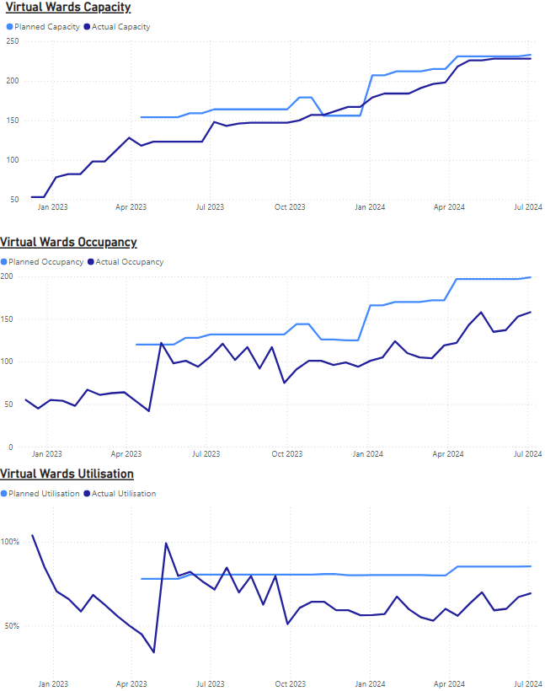
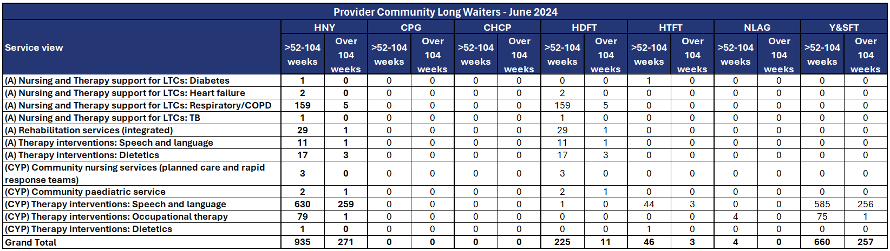
Community Care
Additional Key Indicators
Supporting Indicators and Intelligence
Number of patients waiting over 52 weeks split by service and provider
Community Waiting Lists
Y&SFT have developed an options appraisal to review improvement opportunities in CYP therapy areas which has been completed and will be presented at the communications session in September.
HNY have nominated a representative to attend the newly established NEY Community Services waiting times recovery steering group with focus to be on improvement in; MSK, Audiology, Community Paediatrics and CYP SaLT.
Virtual Wards
95% capacity delivery against plan.
The shortfall is as a result of DQ issues associated with NLaG’s reporting, meaning open beds are omitted from the SitRep. YSFT have also re-profiled their cystic fibrosis virtual ward which has reduced from 10 virtual beds to 3. This is as a result of the acuity of patients which is a very specifically monitored patient cohort and them never having more than 2-3 patients on the virtual ward at any one time.
Utilisation and occupancy rates are fluctuating but continue to incrementally trend positively.
As at week ending 09/08/24 | NLaG | CPG | HUTH | CHCP | YSFT | HTFT | HDFT | STFT | HNY
Planned Capacity | 40 | 18 | 25 | 45 | 33 | 25 | 18 | 29 | 233
Actual Capacity | 28 | 18 | 25 | 45 | 33 | 25 | 18 | 29 | 221
Actual vs Planned | 70% | 100% | 100% | 100% | 100% | 100% | 100% | 100% | 95%
Number of patients in a VW bed | 40 | 6 | 13 | 34 | 21 | 3 | 5 | 19 | 141
Current Utilisation | 143% | 33% | 52% | 76% | 64% | 12% | 28% | 66% | 64%
Patients Using Tech Enabled Services | 0% | 0% | 100% | 12% | 0% | 0% | 0% | 0% | 12%
Notes:
Table subject to change depending on what detail is needed.
Consider keeping the original table for this slide and change the table header to the dark blue for consistency.

Slide 31



