Slide 1


ICB – Board
Annual Operating Plan - Performance Report
[Date: 13th November 2024]

Slide 2

Executive Summary
Introduction
The monthly ICB operating plan performance report is specifically concerned with the short term annual objectives related to the HNY ICBs Annual Operating Plan 2024/25. The report is a single part of a wider performance management framework across the ICB. The overall framework has width and covers a wide range of aspects of performance relating to themes such as quality of care, patient experience, operating plan access metrics, public health statistics, and health prevention data. It also has depth in that any of these themes are being considered at provider, place, in some cases condition level. The framework also considers time frames in that some performance expectations are measured daily, weekly, monthly whereas others are to be reviewed annually. These different aspects of performance do not sit in isolation; improving access to cancer services this year, goes hand in hand with ICB mid term ambitions to increase engagement of vulnerable populations with cancer screening programmes, and reduce harm from cancer. Both support the long term aim of increasing healthy life expectancy. The report will demonstrate how these short term annual operating plan indicators support long term aims and ambitions of the ICB. It will describe the full list of indicators in the 2024/25 planning guidance but will focus on areas that have been identified as priorities by NHSE. A small number of indicators are better performance managed through other reporting mechanisms and these are identified in the report also. The report is supported each month with a deep dive into a theme along with Executive Director updates that will describe any escalations from sub committees.
Notes:
textbox
No alt text provided
image
No alt text provided
image
No alt text provided
shape
No alt text provided
shape
No alt text provided

Slide 3
HNY ICB Strategy, Planning and Reporting Framework

Slide 4
HNY ICB Strategy, Planning and Reporting Framework – Priority Indicators

Slide 5

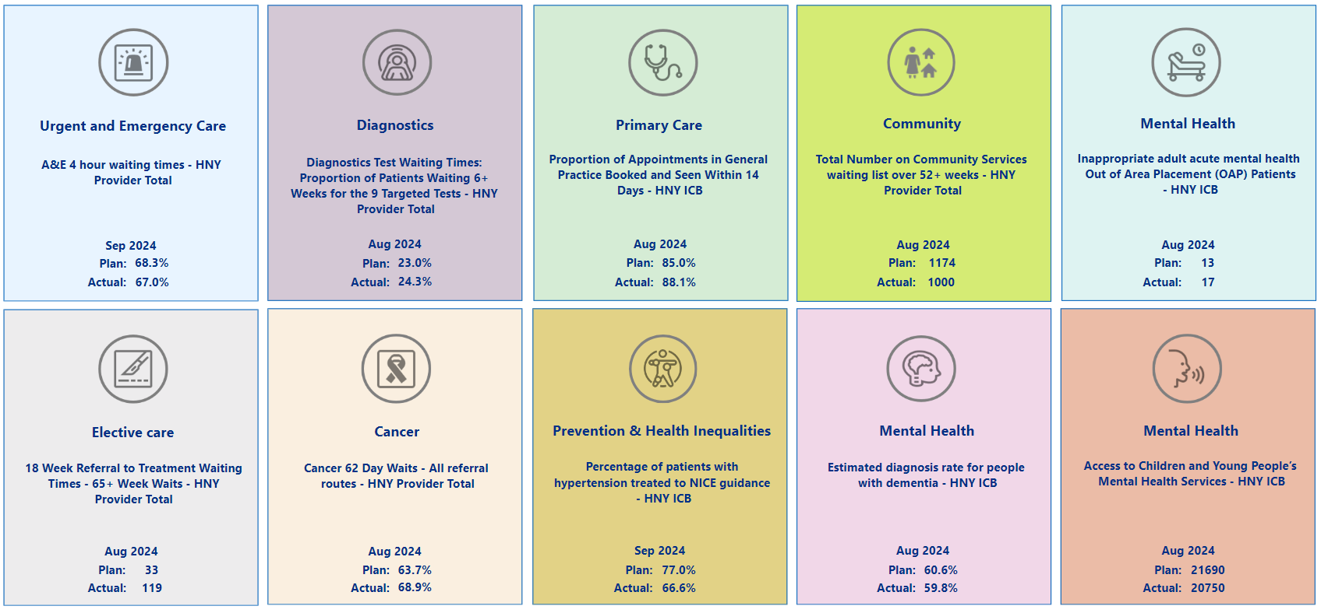
Summary Overview

Slide 6
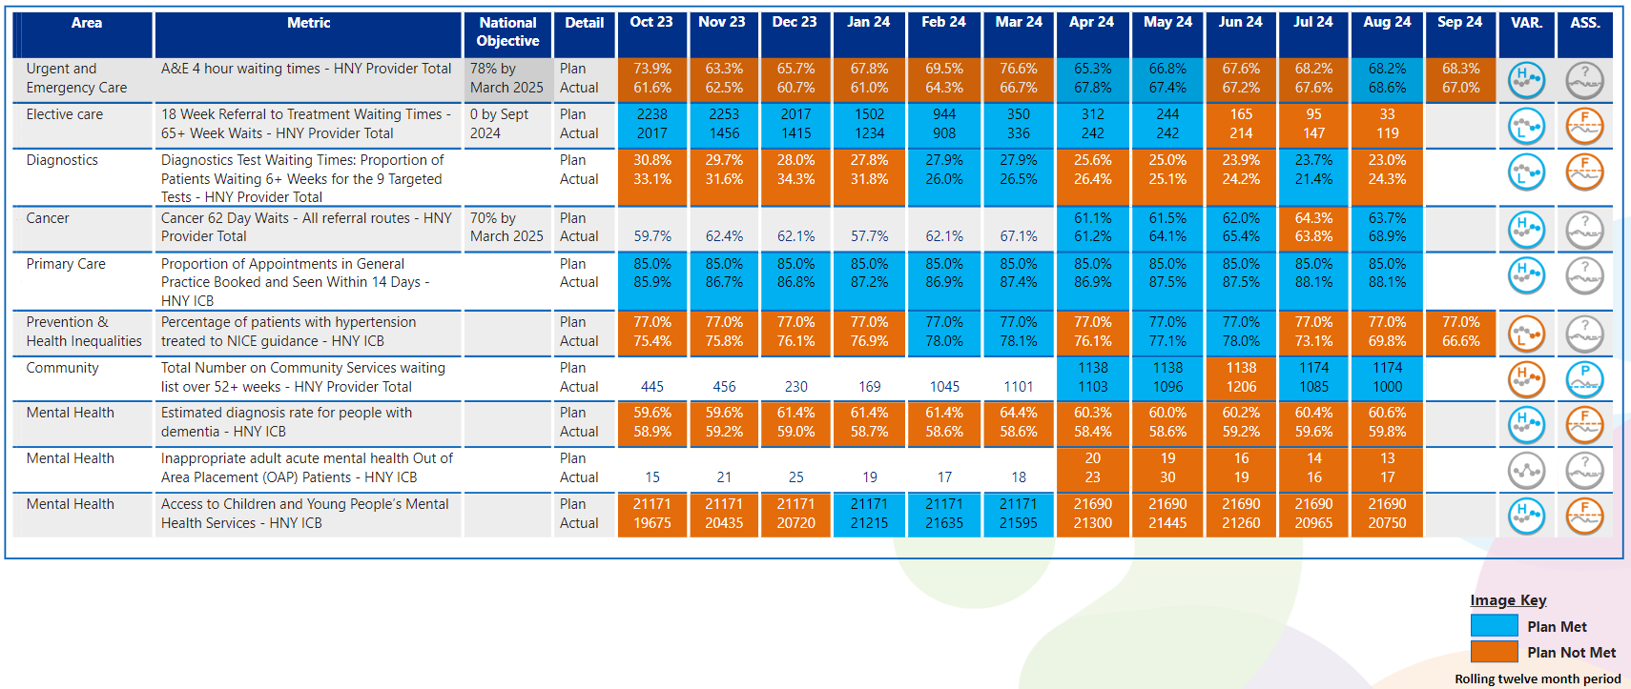
View by Month
In line with Making Data Count recommendations, blue equals achieving, orange equals failing to achieve.

Slide 7

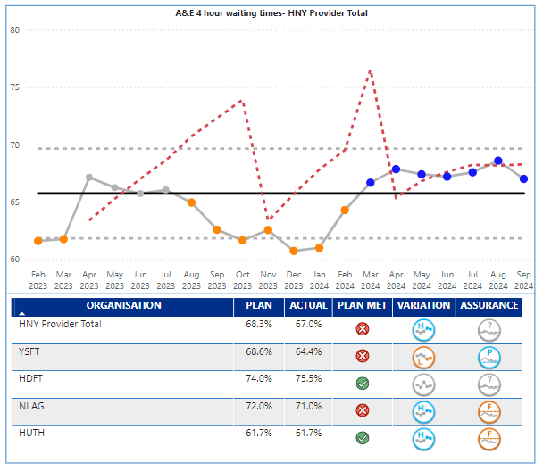
Urgent Care
Key Indicator: Waiting time in ED
Urgent Care Escalation Points
UEC 4-hour performance in September for the overall ICB system worsened from 73.3% (August) to 71.8%. The UEC plan being monitored by NHSE is for the acute providers only and was set at 68.3% for September, and delivery was 67%. HUTH (61.7%) and Y&SFT (64.4%) were lowest performing Trusts. UEC performance at HNY has been challenged by NHSE and the ICB is in national UEC Tier 2. HNY benchmarks adversely across NEY for other patient experience indicators related to urgent care such as time in department and ambulance handovers. The year end 4 hour target for the acute providers is 73.2% - ICB overall 78%.
4-hour UEC Sept. – HUTH, HDFT achieved their monthly plan, NLAG and Y&SFT did not
HUTH and NLAG are showing improving positions, HDFT no change and Y&SFT worsening
Ambulance response time cat 2 available for August – Overall wait times for cat 2 ambulances improved in August to 31:22 minutes against a target of 30:00 minutes. HNY hospital handover performance has been singled out by YAS, EMAS and NHSE as of concern; further improvement is required.
Key Actions
Slight delay on ICC go live due to staffing, however new go live date of 4th November for both North and East hubs
Weekly UEC Tactical group established under new UEC governance chaired by Russell Nightingale as COO lead for UEC. Group of Acute UEC leaders to focus on 1 or 2 agreed key actions – Ward & Board rounds identified as first area of focus to improve discharge and flow.
Revised SDEC exclusion criteria agreed across clinical leads for all Trusts. Updated on YAS and EMAS systems to improve numbers of patients identified for SDEC via ambulance
York ward moves have taken place to improve location of SDEC and Acute frailty, along with support increased footprint for the new IAU model. Continuous flow model due to go live Nov/Dec
Focus of ambulance handover improvements is on actions that will reduce ED crowding and improve flow, creating capacity for more timely handover. Supported by Regional Ambulance Handover Sprint which consists of a number of learning sets including ward and board rounds, direct to SDEC, Criteria 2 Admit and managing risk for patients. HNY colleagues encouraged to sign up
Final A-teds for Scarborough and Hull taking place. Report for York received and date for presentation back to the Trust and Place being arranged. This will underpin areas of focus for alternative to ED
UTC stocktakes completed across the ICS to benchmark where each UTC is against the standards, along with capacity and demand modelling to identify areas where UTC provision can be increased to support urgent care
How does indicator link to long term priorities:
Patients across HNY use ED services as a way of accessing healthcare, we also know that patients from areas of high deprivation are high users of ED. Improving access to ED will therefore support all of the ICB strategic ambitions including the golden ambition of improving services for CYP.
Evidence suggests the longer patients wait in ED the worse the clinical outcome will be, and congestion in ED can lead to delays to ambulance handovers, meaning ambulances are not freed up to pick up other emergency cases, leading to further clinical risk.
Notes:
Table subject to change depending on what detail is needed.
Consider keeping the original table for this slide and change the table header to the dark blue for consistency.

Slide 8

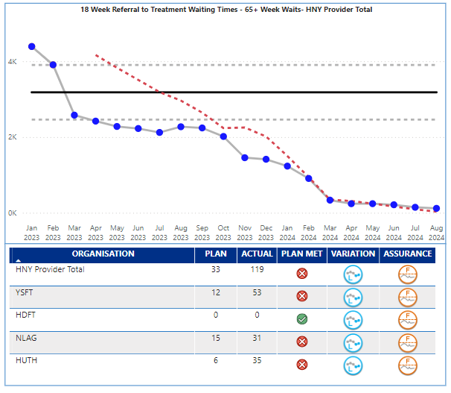
Elective
Key Indicator: RTT 65+ Week Waits
Elective Services Escalation Points
Elective waiting times over 65 weeks reduced to 119 in August against a target of 33. The ICB continues to benchmark well in NEY and is the best performing ICB in the region on elective long wait metrics. Performance is outside expected control limits and demonstrates real cause variation of an improving nature. All providers have demonstrated significant progress, Y&SFT in particular, though they still have the majority of breaches (53 of the 119).
The latest unvalidated data is forecasting the September position as 45 patients over 65 weeks. The potential breaches that will be reported next month are likely to be in the following specialties; T&O, Gynaecology, Neurology, Plastic Surgery and ENT. The final validated September position will be reported next month, after which this report will focus on Total Waiting List size.
Key Actions
ENT – Standardised practice for tonsillectomies in line with BAPO guidelines across HNY. Trialling coblation procedure in HUTH which will improve recovery time and readmission rates
Peri-op clinical network – Standardising pre-assessment processes across HNY. Standardising risk stratification for hubs. Standardising pre-assessment for converting daycase to inpatient.
Eyecare – Signed off standardised cataract pathway. SPoA business case to be presented to November elective Board . Three Trusts trialling 10 cataracts on a weekend list, prior to progressing to in week lists. HHP supporting transport for patients from HUTH to Goole.
Gynaecology – Working with primary care to develop and standardise high volume pathways
Orthopaedics – Signed off standardised hip and knee pathways. Developments in anaesthetic pathways have led to an increased numbers of cases going through Goole hub.
Outpatients – Pep bid submitted to extend PKB for another 12 months, still awaiting outcome. Daycase procedures – Working with networks and trusts to ensure all 29 HVLC procedures are listed as daycase as default. Working with Trusts and peri-op network to understand deviation from this.
TWL – analysis to be presented at next ICS Board on growth position
Theatres – Focussing on late starts, early finishes, golden patient and OTD cancellations
How does indicator link to long term priorities:
Access to planned care elective services supports primary care and urgent care as delays can lead to patients seeking alternative routes to treatment or return to primary care to raise concerns. If not managed for risk, delays to elective care can also affect patient outcomes and certainly affect patient experience, if the condition is one that worsens over time. There are also social impacts to delays that may affect patient’s ability to work. Access to elective services affects all of the ICB strategic ambitions and long term aims. The ICB has made significant investment in elective care through ERF and £80m on IS capacity.
Notes:
Table subject to change depending on what detail is needed.
Consider keeping the original table for this slide and change the table header to the dark blue for consistency.

Slide 9

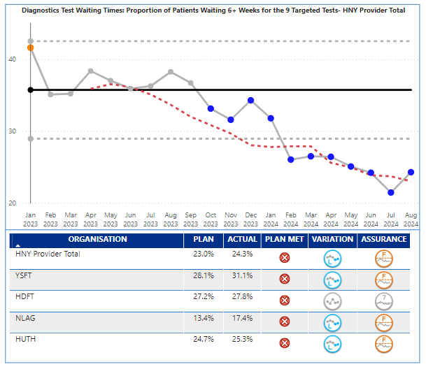
Diagnostics
Key Indicator: Waiting time for tests
Diagnostics Services Escalation Points
Diagnostic 6 week performance was 24.3% in August against a plan of 23%; statistically performance is demonstrating special cause variation of an improving nature, although August itself worsened.
At August 2024 there were 9,724 patients waiting over 6 weeks for diagnostic tests in total, but the NHSE plan was based on 9 key tests. The number of patients waiting over 6 weeks for the 9 tests was 8,921 in August, an increase from 8,504 in July (417). 7,786 of the breaches were in the following modalities – Audiology (1,576), CT (1,520), NOUS (1,373), MRI (1,160), Echo (1,130), DEXA (1,027).
Audiology, DEXA and Echo are of particular concern, as their high volumes of breaches are from smaller waiting list sizes, and their performance is 50.1%, 41.6%, 39% respectively against a national target of 5%. Over half of patients waiting for an audiology assessment are waiting over 6 weeks. From a provider perspective, York still have the lowest performance at 31.1% but have improved the number of patients waiting over 6 weeks in recent months, showing an improving trend.
Key Actions
CDC programme continues to support activity across HNY and at month 6 has delivered a total of 83,716 tests across all the modalities (this is under plan by 16,972 tests).
Four spoke sites are live (Ripon, Selby, Askham Bar and East Riding Community Hospital (ERCH)). Four more sites (3 hubs in Scunthorpe, Scarborough and Hull and 1 spoke in Grimsby) are under development and although delayed from original dates are planned to go-live between December 2024 and March/April 2025.
The HNY CDC mobiles (CT and MRI) continue to rotate between Askham Bar, Selby, Castle Hill Hospital, ERCH and St Hughs in Grimsby providing additional activity.
Trusts have undertaken a re-profiling exercise, submitted late August 2024. NHS have approved the plans with a few minor adjustments.
Mitigation is underway at each site to recover to planned levels. The re-profiling exercise for some Trusts heavily re-phased activity into H2, therefore the expectation is that Trusts will recover in H2.
Robust CDC workforce plans are in place for each site and recruitment is ongoing.
Endoscopy Strategic Lead in post, with revised ToR and governance from November. Productivity dashboard shared with Trusts and BaU regular reporting in development to commence in December.
Imaging; DDCP recovery plan submitted to region. Digital Programme lead to commence in November with digital workshop proposed in early December.
Procurement continues for AI bid Fracture detection in ED at Y&SFT to support winter pressures.
NHSE moderation of the Imaging Maturity Matrix complete, with agreed baseline for improvement trajectories.
How does indicator link to long term priorities:
Quick access to diagnostic services supports primary care, urgent care, elective care and cancer service delivery targets. Early supported diagnosis therefore supports all of the ICB strategic ambitions.
longer waits for diagnosis can affect cancer outcomes, as well as added delay to planned care pathways. Patient experience of care can be affected by delays to diagnosis.
Notes:
Table subject to change depending on what detail is needed.
Consider keeping the original table for this slide and change the table header to the dark blue for consistency.

Slide 10

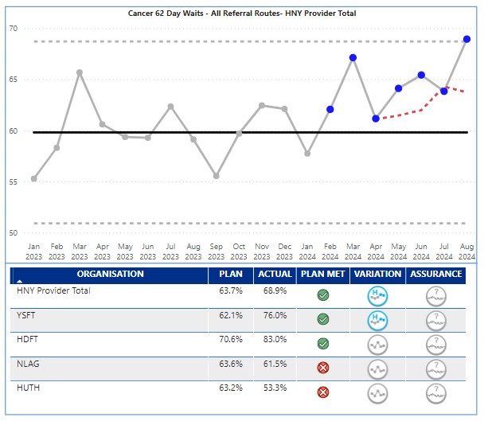
Cancer
Key Indicator: 62 day waits
Cancer Services Escalation Points
In 2024/25, the priority is to deliver a 70% performance on the 62-day cancer wait time target. August performance was 68.9% against a plan of 63.7% and therefore the monthly target was achieved, and the ICB almost achieved the year end target. Performance is now showing common cause variation of an improving nature which reflects the significant improvement seen since January 24. There is however variation in performance.
HDFT (83%) and Y&SFT (76%) both achieved the end of year national target (70+%), and Y&SFT demonstrating special cause variation of an improving nature.
Patients on pathways at NLAG (61.5%) and HUTH (53.3%) are more likely to wait over 62 days than those at Y&SFT and HDFT. The ICB as a whole, and HUTH, and NLAG as individual providers, are in NHSE Tier 1 category for Cancer.
Key Cancer Alliance Actions in September 24:
Awareness & Early Diagnosis: Cervical calling-script initiative in partnership with NHSE Y&H Public Health Programmes progressed. 25/26 Planning commenced. Successful awareness sessions held at St Stephens shopping Centre in Hull.
Cancer Diagnostics and Innovation: Planning commenced for 25/26 round of Cancer Innovation and Research Grants. Selby Cancer Café launched.
Nursing and AHP: Planning for inaugural Skin CNS Community of Practice commenced. HNY Workforce Strategy ratified.
Comms & Engagement: HNY CA Annual conference held in York with record number of attendees. Addresses from David Fitzgerald and Dr Lennard Lee and inaugural Excellence in Cancer awards ceremony held.
Health Inequalities: Health Inequalities SMI and Cancer Education session held.
Lung Health Check: Scoping work and initial meetings held to progress delivery of LHC to those in seldom heard groups, i.e. homeless / roofless people or traveller groups.
Non-Surgical Oncology: Capacity and demand audit completed. NSO education event with a focus on Immuno-oncology took place 27/09/2024. Keynote speaker from Velindre Cancer Centre
Treatment, Pathways and Personalised Care: NEY HPB Rare Tumours Network Clinical Lead has attended tertiary centres and MDTs to formulate priorities for regional network.
How does indicator link to long term priorities:
Quick access to cancer diagnostic and treatment supports all of the ICB strategic ambitions, in particular reducing harm from cancer, and long term improvement in Healthy Life Expectancy.
longer waits for treatment can affect cancer outcomes, and overall patient experience of care. NHSE will be scrutinising performance in this indicator and it forms part of the NHSE Oversight Framework and Tiering process. Delivery is supported by the Cancer Alliance.
Notes:
Table subject to change depending on what detail is needed.
Consider keeping the original table for this slide and change the table header to the dark blue for consistency.

Slide 11

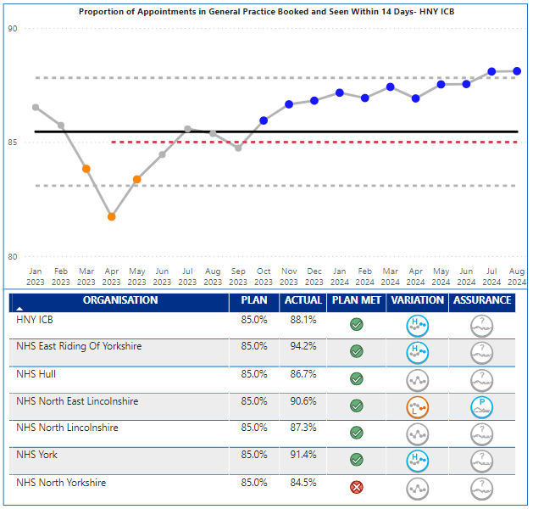
Primary Care
Key Indicator: Booked within 14 days
Primary Care Escalation Points
HNY August performance has delivered 88.1% against the 85% target for 14 day booking. Performance has been closer to and just over the upper control limit and demonstrating special cause variation of an improving nature.
Performance differs by place; East Riding 94.2%, Vale of York 91.4%, NE Lincs 90.6%, North Lincs 87.3%, Hull 86.7%, North Yorks 84.5%. All places delivering the target except North Yorks. East Riding and York are driving the HNY improving position.
Primary care met the August target for appointments delivered. The majority of the last 8 months delivery have all been towards the upper control limit, and even with the slight seasonal drop in overall appointments in August, the practices are still meeting their plan, and the overall trend is showing special cause variation of an improving nature.
Expectations in the operating plan are to recover dental levels of provision to pre pandemic levels. April saw a slight reduction from March but statistically numbers have fluctuated between 70-98% over the last 18 months with no consistent trend.
Key Actions
The ICB is working with our system partners to understand and seek mitigations to GP Collective Action. Despite GP CA commencing on 1st August the number of appointments being delivered across our practices remains above plan. We remain committed to a positive outcome for our patients and GP Practices.
How does indicator link to long term priorities:
Primary care is singularly, the most used service in healthcare and is the entry point for many other services. It is therefore key to all of the ICB strategic ambitions, and long term aims.
Actual Inability or perceived inability to access primary care (and dental services) can lead to patients either incorrectly using emergency services, adding pressure there, or reluctance to engage with healthcare at early stages of symptoms. Patient experience and outcome can be affected by these delays which is why improved access to primary care is vital.
Notes:
Table subject to change depending on what detail is needed.
Consider keeping the original table for this slide and change the table header to the dark blue for consistency.

Slide 12

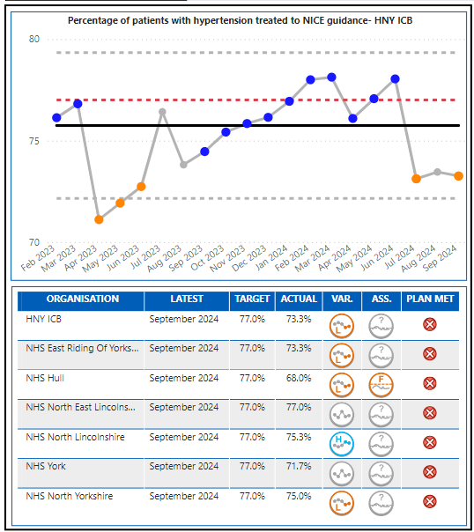
Prevention and Health Inequalities
Prevention Escalation Points
September 2024 performance was 73.3% against a target of 77%. The performance is showing a special cause variation of a concerning nature. No Places achieved their plan in September and there is a range of delivery from 68% in Hull to 77% in NE Lincs. The overall performance is within the control range. Historic trends do show lower levels of performance in Q1 and Q2 with improved delivery in Q3 and Q4 due to an association with GP practice QOF targets. When comparing similar time periods, treated to target numbers are higher in September 24 than previous years as is the number of diagnosed patients with hypertension (denominator). Increase in prevalence will reduce the overall achievement level in this metric however, increasing diagnosed prevalence of hypertension is a key objective of the CVD programme and the metric may be reflecting the success of a number of projects that aim to improve opportunistic testing across the ICB.
Key Actions
The ICB continues to work with place teams and system partners to deliver several initiatives that seek to improve the detection and management of hypertension across our population. Q1&2 has seen a significant focus on increasing opportunistic blood pressure testing capacity across the ICB, this has included:
Delivery of ‘Know Your Numbers’ national campaign in September across the ICB footprint delivering collaborative outputs (ICB, LAs, VCS) inclusive of comms campaign, BP website page on Lets Get better site, toolkit, comms assets and place-based opportunistic testing events across the system with a focus on at risk communities.
Implementation of a new BP Check Train the Trainer Model across the system in collaboration with Y&H Health Innovation network. Delivering BP training to place-based partners such as LA and VCS staff, building on MECC approach. This model is currently been expanded across the ICB and will continue over the coming months.
Funding confirmed for Health Check workplace pilots in NY and ER projects now able to proceed but will need to complete by March 25.
Work continues across all places in the following areas:
Utilising data to inform local improvement conversations regarding hypertension detection and management with practices, PCN's, LCP's and INT's, to help inform local priorities and projects
Ensuring opportunities within primary care workforce are maximised to improve detection of hypertension through collaborative working between GP practices, community pharmacies and through pilot projects delivering opportunistic testing in optometry and dental sites in the most deprived populations.
Scoping and testing hypertension treatment pathways through National pharmacy Independent Prescriber pathfinder pilot (no sites in NY).
Scoping training/toolkits to support improving case finding and stratification of hypertensive patients to improve diagnosis coding and optimising treatment to target, with focus on at risk groups.
Continuing to explore and challenge variance at Place.
Key Indicator: % Hypertension NICE Guidelines
How does indicator link to long term priorities:
Improved the % of patients with hypertension being treated following NICE Guidelines supports several strategic ambitions and outcomes such as reducing CVD; and enabling wellbeing health and care equity. It also has a direct link to the long-term ambition of improving healthy life expectancy.
1 in 3 adults has hypertension, which in turn can lead to heart disease, stroke and kidney disease, it is also linked to deprivation, and socioeconomic factors can be markers. This suggests that improving the care and treatment and prevention of hypertension could reduce the gap in healthy life as well..
Notes:
Table subject to change depending on what detail is needed.
Consider keeping the original table for this slide and change the table header to the dark blue for consistency.

Slide 13

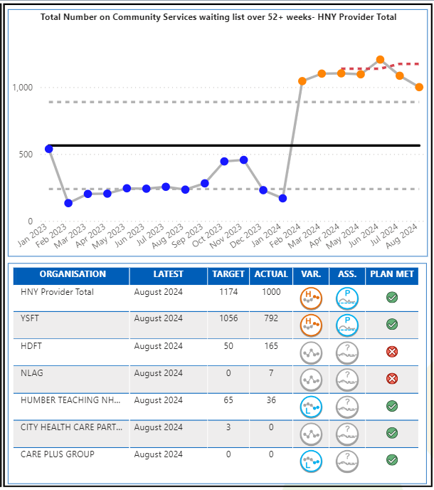
Community Care
Key Indicator: Waiting List over 52+ Weeks
Community Care Escalation Points
The priority indicator for community waiting times in the operating plan is patients over 52 week waits. The latest validated data available is August 2024, which saw 1,000 patients wait over 52 weeks for community services against a plan of 1,174. Although this is an improvement from July, the data is showing Special Cause variance of a concerning nature. There is variation across providers and services. HDFT and NLAG were over plan, however, Y&SFT (792), HDFT (165) and Humber Teaching FT (36) had the highest number of breaches. At a service level, 747 (884 last month) of the 1,000 patients over 52 weeks are in CYP Speech & Language service – 712 of which are at Y&SFT. HDFT pressures are on Nursing Therapy Support for LTC: Respiratory/COPD service and Rehabilitation Services (integrated).
Overall waiting list size stands at 22,445, an increase of 560 from July. This is now showing significant change of a worsening nature. The trend is being driven by worsening nature at York.
Key Actions
All waits are escalated by the collaborative in monthly updates to place community leads for oversight and assurance.
NLaG BI teams have rectified their CWL submission to include relevant services. This has resulted in a 16% growth in their waiting list from last month but now reflects accurately.
Work continues to collate the full picture of CYP SLT by the collab working with local places, however, due to historical commissioning contracts, some services have joint waiting lists which need to be validated and reviewed.
York Place Director has reached out to local HNY providers to understand if mutual aid for York’s CYP SLT service could be explored. At present, this is not something which is able to be carried forward due to clinical model and capacity differences.
The Community Collaborative are linked in with the regional and national community wait recovery programme and part of this work will look to develop nationally agreed community RTT standards. As such, the local access policy being developed by the Collab has paused and will be linked to the national programme.
Work is currently underway with the regional and national teams to understand if paediatric neuro assessment waits are to be included in the returns.
How does indicator link to long term priorities:
Community services play a key role in delivering several of the ICBs long term ambitions and outcomes; in particular the golden ambition to radically improve the health and wellbeing of children and young people, and outcome measure of living with frailty.
Community services are a key support to patients with long term conditions in particular, they support primary and secondary care by being an alternative provision, but also are key to future innovations in pathway redesign, of which virtual ward is an example. The structure of community services forms part of the ten priorities for 2024/25
Notes:
Table subject to change depending on what detail is needed.
Consider keeping the original table for this slide and change the table header to the dark blue for consistency.

Slide 14

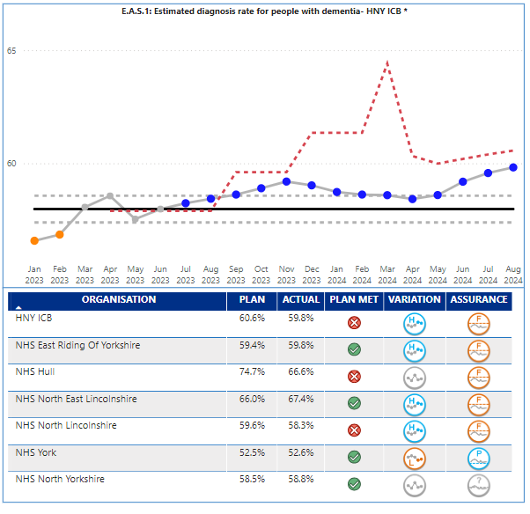
Dementia
Key Indicator: Dementia Diagnosis Rate
Dementia Escalation Points
The dementia diagnosis rate for the ICB in August was 59.8%, which is below the ICB plan target of 60.6%. Performance is consistently at or above the upper control limit and therefore demonstrates special cause variation of an improving nature. However, even with the improved performance, the ICB remains adrift from the national target and planning expectation of 66.7%, and the ICB target for 2024/25 of 62.5% by March 2025.
Performance is variable across the Places within the ICB; NE Lincs 67.4%, Hull 66.6%, East Riding 59.8%, North Yorks 58.8%, North Lincs 58.3%, and Vale of York 52.6%. NE Lincs, North Lincs and East Riding are all showing special cause variation of an improving nature. York did achieve plan, but they are showing special cause variation of a concerning nature and are a national outlier. A detailed understanding at a practice level is available and being worked through, and further information was provided to the September SOAG on how this affects patients and other sectors.
Key Actions
A dementia briefing paper has been completed to support the request for SDF to address diagnosis rates and wait times. This outlines the priority planning intentions and the relevant supporting evidence. Approved by MHLDA Executive Strategic Leadership Group. Awaiting ICB approval. Once approved, NYY/TEWV & HTFT/ER can mobilise plans to address long waits and low DDR.
Current QI project to cleanse the GP registers to resolve coding issues and identify additional possible diagnoses. Continues to progress and searches of York practices have commenced.
5 year dementia strategy ‘Hope of a Live Still to be Lived’ approved by MHHDA Exec 27th Sept. On agenda for ICB chief execs weekly meeting w/c 21st October. Has been fully coproduced and all interventions will support recovery of DDR and improve patient outcomes & experience.
Hull DDR recovering and audit of outlier PCN being undertaken imminently. Expect to be above target by October DDR publication.
One York PCN plans to review all MCI cases to establish potential new diagnoses, will be informed by QI project findings.
Contact being made with the GP Data, Extracts, Specifications and Analysis (GPDESA), Primary and Community Care Analysis team to understand methodology in primary care to MAS referral data due to some potential data errors/inconsistencies.
How does indicator link to long term priorities:
Improving Dementia Diagnosis Rate directly supports the ICB long term ambition of Transforming people’s health and care experiences and outcomes.
Earlier diagnosis of often vulnerable patient’s empowers patients and their families and carers to take control of their situation, leading to better management of the disease, better time to plan and therefore an enhanced quality of life.
Notes:
Table subject to change depending on what detail is needed.
Consider keeping the original table for this slide and change the table header to the dark blue for consistency.

Slide 15

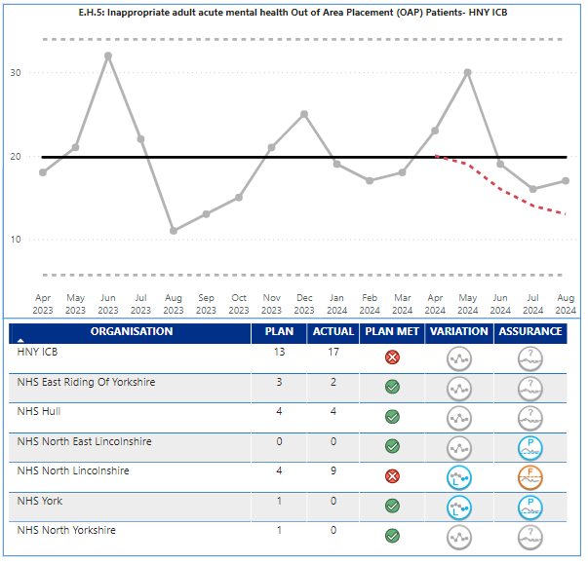
Adult Out of Area Placements
Key Indicator: Inappropriate OOA placements
Mental Health OOA Escalation Points
The target for 2023/24 related to out of area bed days; for 2023/24 the key performance indicator has changed to inappropriate acute out of area placements. The performance in August was 17 against a plan of 13. The performance has shown no significant change in the last twelve months with variation around the midpoint.
There is variation at Place with majority of placements from North Lincs (9) and Hull (4), and at the time of the production of the report there are 2 unassigned patients.
Key Actions
Confirmation for the allocation of Sustainable Development Funding (SDF) has now been received and priorities for the funding have been agreed, these include recruiting additional centralised short term case management capacity, development of a community rehabilitation service in NL and expanding the Hull/ER older adult's community and crisis teams, as well as developing an additional 4 functional beds.
Inpatient oversight & assurance meeting took place 9th Sept
The HNY OOA dashboard is updated with data from providers and Place and shows the monthly updated position for our OOA placements of all types including older adult acute, adult acute, Psychiatric Intensive Care Units (PICU), and rehabilitation.
System wide rehabilitation referral panel introduced to prevent further inappropriate OOA placements – 4 referrals to date, with potential alternative care being identified
Central OOA Audit panel commenced reviewing info provided by Independent Sector on individual placements to drive repatriation and ensure quality oversight
LDA - proposed model in development and being explored to include the full HNY patch
PICU provision under review across the patch
There are 2 patients who had OOA that have not been assigned to a place at the time of production of the report
How does indicator link to long term priorities:
Reducing inappropriate out of area placements directly supports the ICB long term ambition of Transforming people’s health and care experiences and outcomes.
Transporting often vulnerable patient’s long distances out of area can often be poor experience and demonstrates a lack of local capacity and available services. It has also been identified as one of the ten key priorities due to financial impact of having to fund inpatient stays over and above existing contracted provision.
Notes:
Table subject to change depending on what detail is needed.
Consider keeping the original table for this slide and change the table header to the dark blue for consistency.

Slide 16

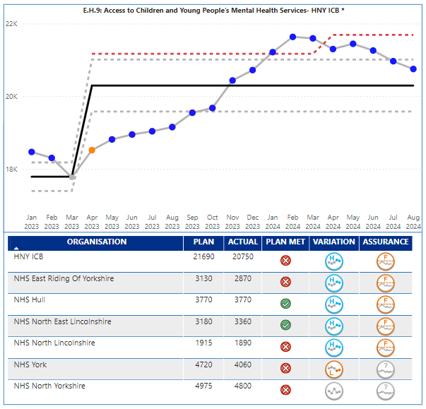
CYP Mental Health Services
Key Indicator: CYP MH Services
Access to Children’s & Young People’s MH Services
ICB actual performance for the number of CYP seen in August was 20,750 against a plan of 21,690, and therefore below target. The provision made available has shown special cause variation of an improving nature; but is below the increased plan for 2024/25 and has seen three consecutive monthly reductions. Apr-24 PCN adjustments for NY and York have not been applied to this submission. TEWV have confirmed this will be rectified by end of September, so we expect corrected data in the next refresh. This does not affect the ICB total.
It is recognised this indicator is only measuring activity, and there are other key measures that are not covered by the operating plan metrics, in particular waiting times and patients waiting over 12 weeks and outcomes e.g. the impact of the interventions. Work is underway to improve outcomes recording.
Key Actions
Develop the new HNY CYP MH strategic plan with improved emphasis on early intervention to increase access, reducing waiting times and improving waiting well initiatives (which will contribute to the CYP MH access target),reducing DNA’s, improving outcomes and addressing inequalities, which prevent early access for those most at risk of poor mental health. The plan will also deliver against the Core20plus5 for CYP. This work is currently underway with partners from health, LA and VCS. The plan will also be in line with the new NHSE CYP intensive MH support guidance to review & reconfigure community provision to reduce crisis/inpatient admissions.
Work underway to improve transition from CYP to adult services in line with NICE quality standards – needs led not age led.
Event undertaken in October with multi agency stakeholders to review whole pathway for CYP Eating disorders (early intervention, community CAMHS/eating disorder services and inpatient). Event was well attended and the actions from the event will be incorporated into the new HNY CYP MH Strategic plan
Finalise sign off on the increased investment in SDF for CYP MH to enable increased capacity in the system to return to the upward trend. The increased activity ambition for 2024/25 Operational Planning relates to national increases in CYP MH funding; this indicates a risk that the new 24/25 Operational Planning target will may not be achievable without the additional investment.
Further progress the work on the CYP MH dashboard to better understand and address the challenges in improving CYP MH access, witing times and outcomes. All currently NHS funded services now correctly flow data and so any increase in access in 24/25 is likely to be very limited without additional investment. Access should not be considered in isolation. Other key indictors to be included in reporting are waiting times and outcomes.
Working with CYP with Lived experience from the Nothing About Us Without Us advisory group and senior leaders across the system to coproduce solutions and implement recommendations from improving access to mental health services consultation. This will improve access and reduce waiting times.
How does indicator link to long term priorities:
Improved access to CYP Mental Health Services supports one of the ICB four big outcomes - enabling mental health resilience, as well as the golden ambition of radically improving the health and wellbeing of children and young people, which in turn helps improve healthy life expectancy.
All national data and evidence suggests that mental health and wellbeing is worsening across all age groups and communities; and that poor mental health can impact on physical health. Improved access to MH services at an early age is vital for the ICB to meet its long-term strategic ambitions.
Notes:
Table subject to change depending on what detail is needed.
Consider keeping the original table for this slide and change the table header to the dark blue for consistency.

Slide 17

Executive Summary
Appendices with further information relating to:
Non Access Indicators (Incl. Workforce)
Children and Young People focus
Full list of operating Plan metrics
Ms Powerpoint Stock Images
Notes:
textbox
No alt text provided
image
No alt text provided
image
No alt text provided
shape
No alt text provided
shape
No alt text provided

Slide 18


The Indicators described in the quadrants below form part of the annual operating plan guidance but are picked up through other reporting routes. A high-level overview is provided on the following slides
Finance The following indicators are discussed at the Finance and Performance Committee, and escalated to the ICB Board via the Chief Finance Officer paper Deliver net system balanced position Reduce agency spend Deliver VWA activity total – Income Target The Board already receives a finance paper and so to avoid duplication, risks to delivery will be made direct to the Board through the finance paper and updates and escalations from the Finance and Performance Committee. | Workforce The following indicators will form part of the update to Finance and Performance Committee along with any necessary escalations to ICB Board from the Director of HR. Key indicators are described below, with further information on the following slides. Reduce workforce turnover – September 13.8% against target of 12.2% Reduce staff absence – September 4.1% against a plan of 4.8% WTE staff in post plan – September 34,017 against a plan of 33,456 Other measures: Improve working lives of doctors Provide sufficient clinical placements and apprenticeships
Prevention and Health Inequalities The following indicators are discussed at the Population Health and Prevention Committee along with a wider number of metrics. The Board will be updated via papers agreed at certain times in the year. Improve vaccination uptake for CYP (WHO) Deliver on the Core20Plus5 approach for adults, CYP | Quality The following indicators are discussed at the Quality Committee along with a wider number of other quality metrics. Updates on the quality agenda and these three operating plan metrics will be escalated to the Board direct from the Quality Committee. Implement 3 year plan for maternity and neonates Develop at least one women’s Health Hub Implement the patient safety incident response framework Papers and updates have been shared direct from Quality Committee and therefore to avoid duplication, risks to delivery will be made direct to Board from the Quality Committee.

Slide 19
Workforce
An assurance update on the Breakthrough HNY system workforce transformation programme is brought forward separately to ICB Board on a regular basis (last report September). In terms of workforce numbers, slides 37-39 provide an overview. Key messages and risks based on September intelligence are as follows:
Agency use continues to run well below plan, showing further improvement in terms of WTE use and in-month delivery under financial plan albeit with reduced saving compared to August (Sept: 151WTE under; £158k under). Year to date spend gap to plan has improved slightly compared to last month (to Sept: £1.48m or 5.18% over, £158k improvement); gap relates mainly to market rates for medical agency running significantly above plan assumptions. Priority work on this issue is ongoing.
Bank use continues to run above plan for WTE but shows WTE use improvement on last month (as at Sept: 270WTE over, 53WTE improvement) but with a deterioration on in month spend gap to plan (as at Sept: £221k over, £198k deterioration) increasing the in-year to date overspend (as at Sept: £123k or 0.43% over; £23k deterioration). In-year to date overspend is driven by overspend on medical and dental (£0.6m) and scientific, therapeutic and technical staff (£0.65m) and infrastructure staff (£0.02m) offset slightly by spend to date under plan in registered nursing and midwifery staff (-£0.17m). Plan profile for bank over Q3/4 is exceptionally challenging in context of winter pressures.
Availability of the PAM dashboard has identified the need for two technical adjustments to planned substantive staff in post, which lifts the starting plan position by a total of 327WTE (212 NLAG; 115 YSFT). Using this adjusted baseline, substantive staff in post are 115WTE or 0.36% above plan as at September. Further work is required to identify the staff groups affected by the technical adjustments, which will enable identification of growth in year to date by staff group. It is not expected that the technical adjustment affects financial reporting. Substantive paybill in year to date is £25.76m or 3.13% over plan.
In total therefore, paybill in year to September is £27.36m or 3.02% over plan

Slide 20
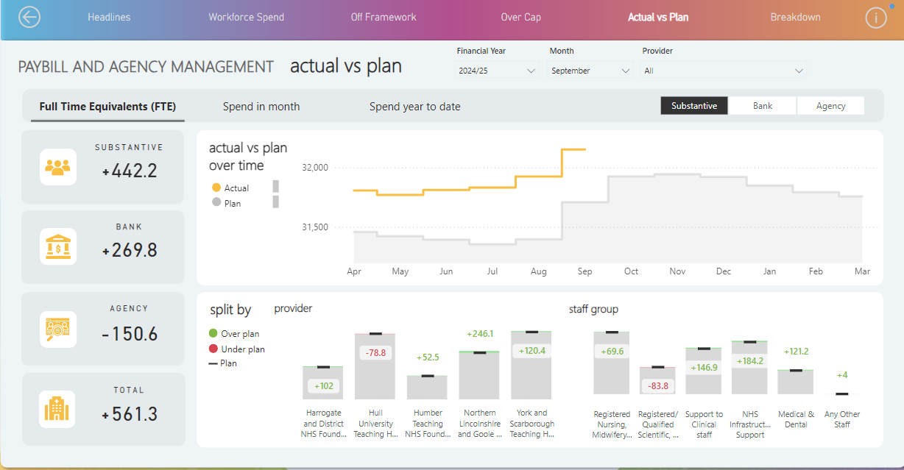
Workforce Summary

Slide 21
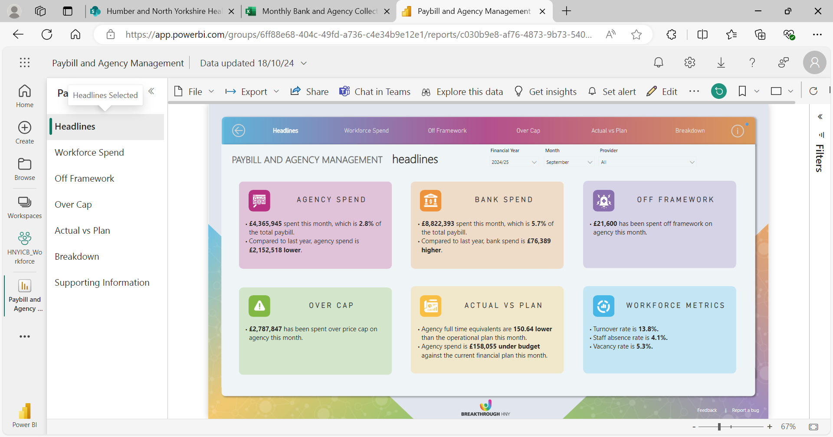
Workforce Summary (Cont.)

Slide 22
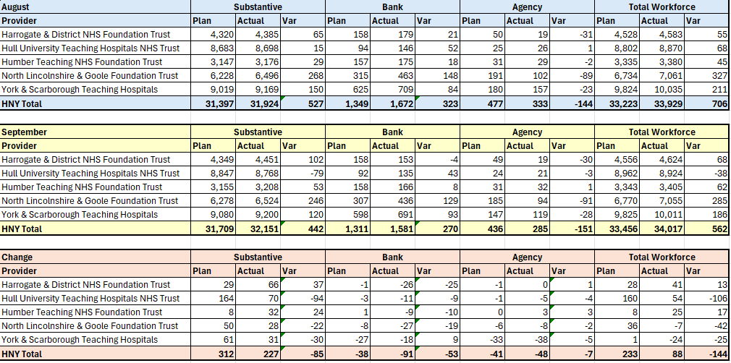
Workforce Summary

Slide 23
The Golden Ambition: Children and Young People
SOAG considered performance in the access targets set out in the annual operating planning guidance through the lens of children and young people to determine in part how they compared to adults and also whether hidden in the overall numbers there was a pattern of concern for access to care for children and young people (CYP).
The following slides were presented at SOAG and discussed by cross sector representation; acute care, community care, primary care, mental health services and place representation.
A summary of the findings of the slides is:
Urgent Care – Demand growth over and above population change for CYP for urgent care. 0-17 year olds have the second highest growth in demand for urgent care over the last 5 years . Demand growth is seen mainly in UTC use. 4 hour Performance is higher than adults.
Planned care – Median waiting times for children are approximately 2-3 weeks lower than adults on referral to treatment times. Areas of concern fall into ENT and Ophthalmology in particular.
Diagnostics - Diagnostic performance for CYP matches overall performance closely, with most performance being very positive across modalities other than Audiology. Performance in audiology has already been raised as an issue but this particularly relates to CYP.
Community care over 52 weeks – This is raised in the main body of the report, that the stand out service that is failing this target is CYP Speech and Language Therapy.
Mental Health CYP – Although provision of access is overall showing an increasing trend, the slides below show growth in the number of CYP waiting over 12 weeks for first contact.
Part of the discussion at SOAG centred on the potential crossover with CYP mental health patients in ED, and also the potential crossover between children waiting for ENT, Audiology, SaLT and potentially Autism Diagnosis services.

Slide 24
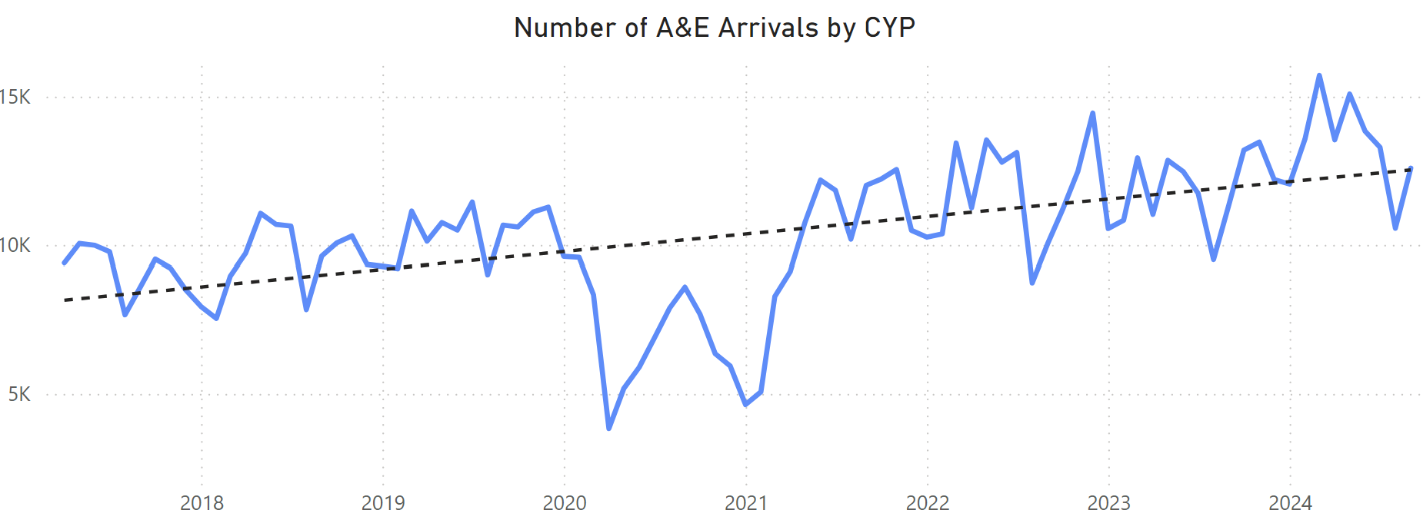
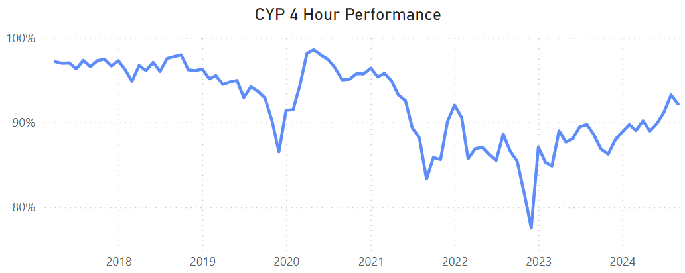
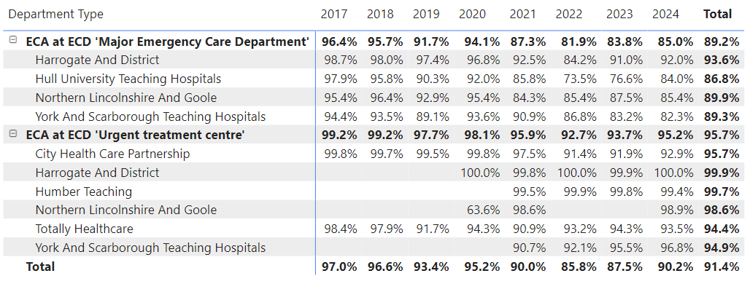
Urgent Care
Golden Ambition: CYP Performance
Demand for CYP has been increasing steadily since 2018, with marked increases over this period of around 40% since 2018. While overall activity has increased wider than CYP, the % overall is higher for this cohort.
While Type 1 activity has increased, this growth is predominantly seen within Type 3.
From a performance perspective, CYP are seen quicker than adults on a consistent basis, with over 90% being seen within 4 hours over the past 3 months, along with triage and time to first clinician being significantly lower for CYP.
Recent increases in performance is directly linked with increased activity in type 3, however performance for all types has increased since 2021.
Notes:
Table subject to change depending on what detail is needed.
Consider keeping the original table for this slide and change the table header to the dark blue for consistency.

Slide 25
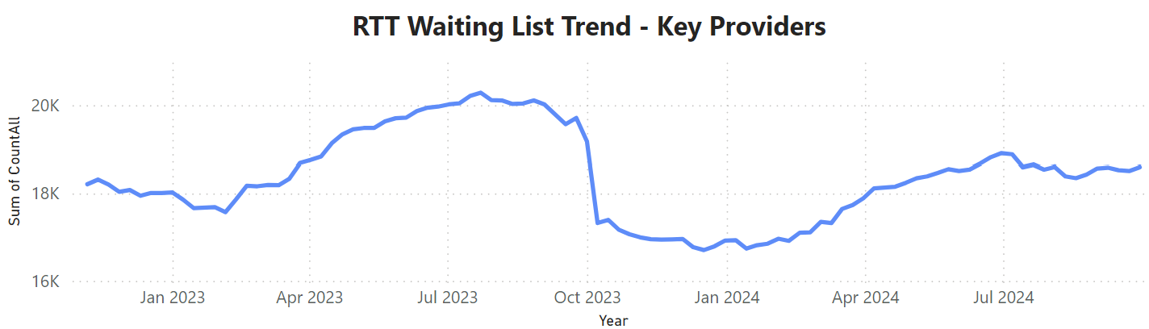
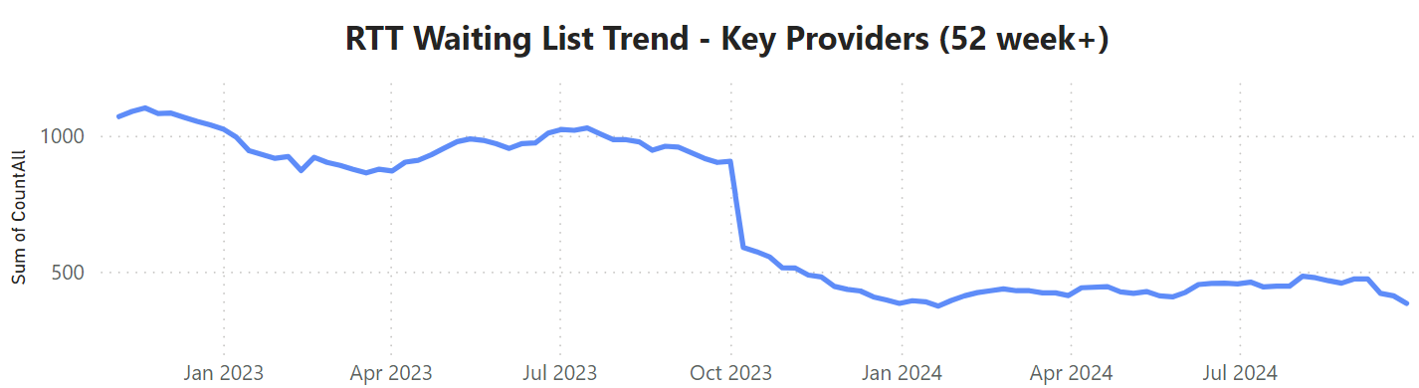
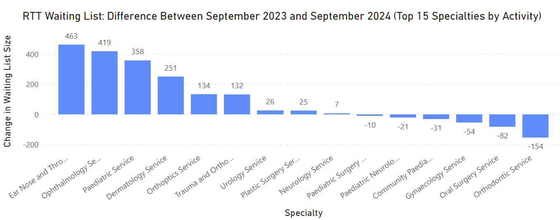
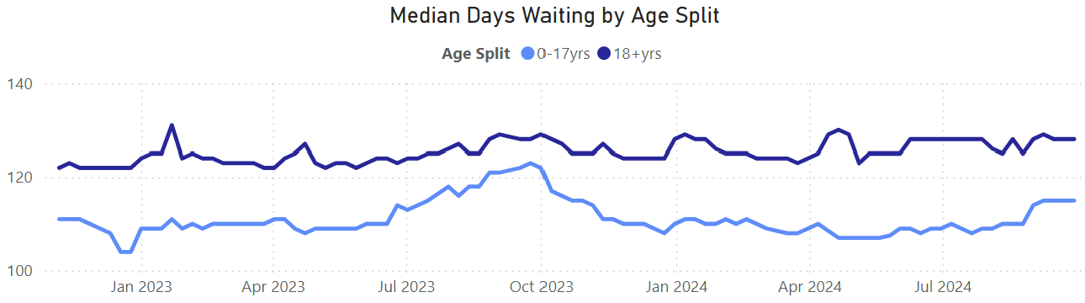
Elective
Golden Ambition: CYP Performance
The waiting list increased in size from Jan-24 to July and has since stabilised in a similar pattern to the overall waiting list. Speciality level change is shown at the bottom of the page.
The overall number of 52 week breaches has recently been less than 400, however does not appear to be decreasing further over the past few months. More patients are tipping over 52 weeks than the beginning of the year.
Median waiting times for children is consistently 2-3 weeks lower than adults, and has followed a very similar pattern.
Notes:
Table subject to change depending on what detail is needed.
Consider keeping the original table for this slide and change the table header to the dark blue for consistency.

Slide 26
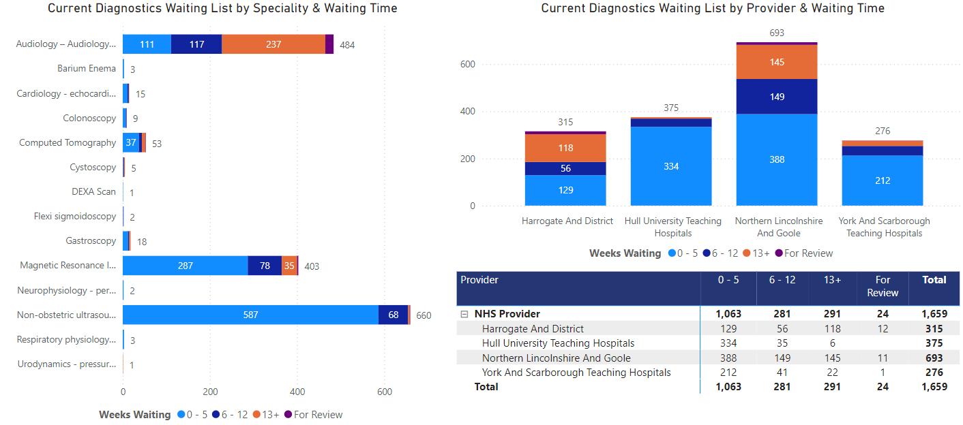
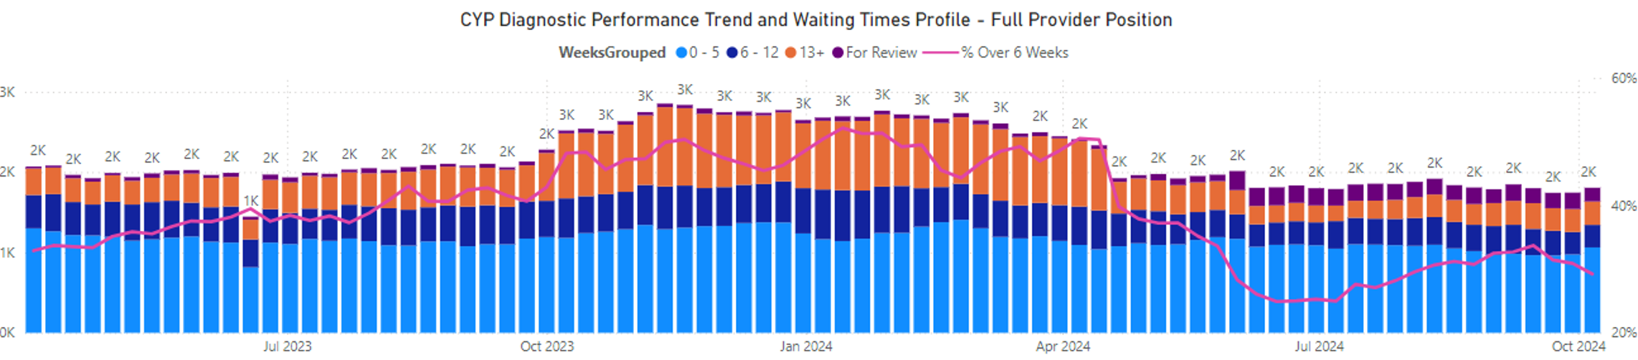
Diagnostics
Golden Ambition: CYP Performance
Diagnostic performance for CYP matches overall performance closely, with most performance being very positive across modalities over than Audiology.
This is evenly split across NLAG and Harrogate.
Notes:
Table subject to change depending on what detail is needed.
Consider keeping the original table for this slide and change the table header to the dark blue for consistency.

Slide 27
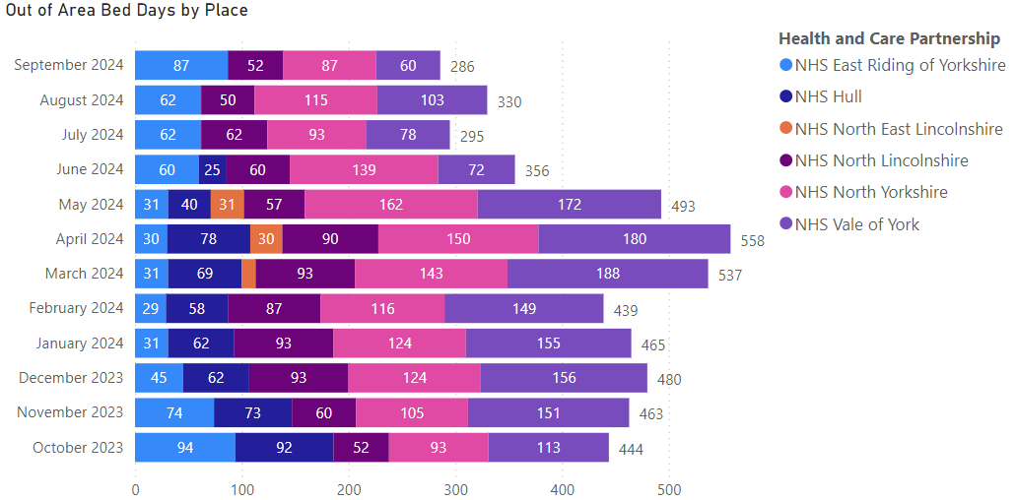
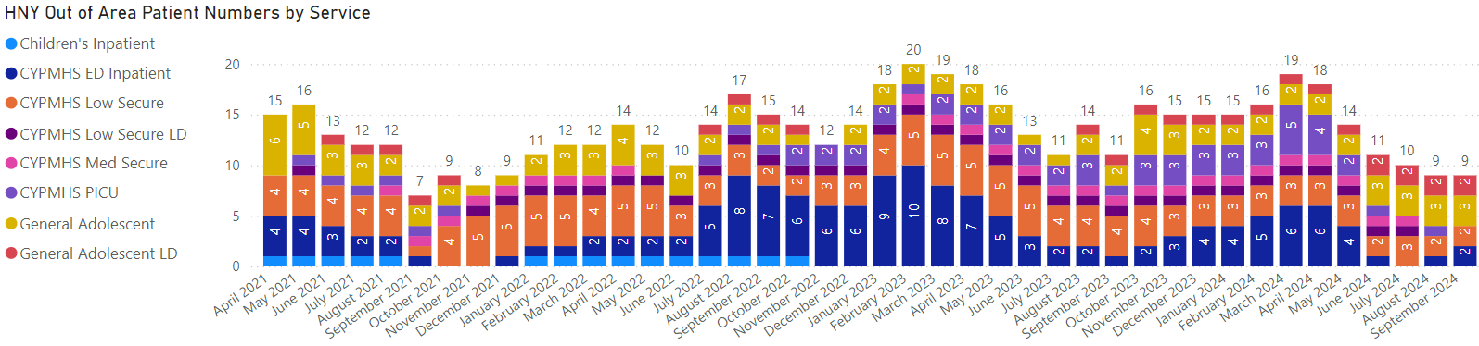
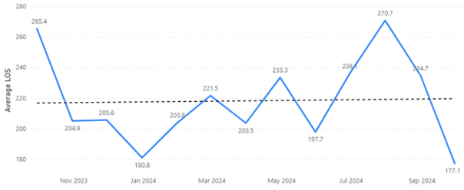
CYP Out of Area Placements
Supporting Indicators and Intelligence: OOA
Average Length of Stay Out of Area - CRFD
CYP Out of Area Placements
In September 2024 there were 9 children and young people on an out of area placement; North Yorkshire 4, York 2, East Riding 2, and North Lincolnshire 1 patient. These 9 children amounted to 286 bed days in September.
The average length of stay for CYP out of area was 177.1 days in September for patients Clinically Ready for Discharge, and 103.2 days for those non-CRFD.
The new draft NHSE guidance on CYP Intensive mental health aims to improve the community CAMHS offer including development of day services to reduce the number of CYP needing admission to inpatient units and ensuring those who do are able to have their needs met without being sent out of area wherever possible. Those currently placed out of area are due to a lack of suitable placements within the ICB to meet complex needs. Also, some secure provision are regionally based and not located in each ICB.
Notes:
Table subject to change depending on what detail is needed.
Consider keeping the original table for this slide and change the table header to the dark blue for consistency.

Slide 28
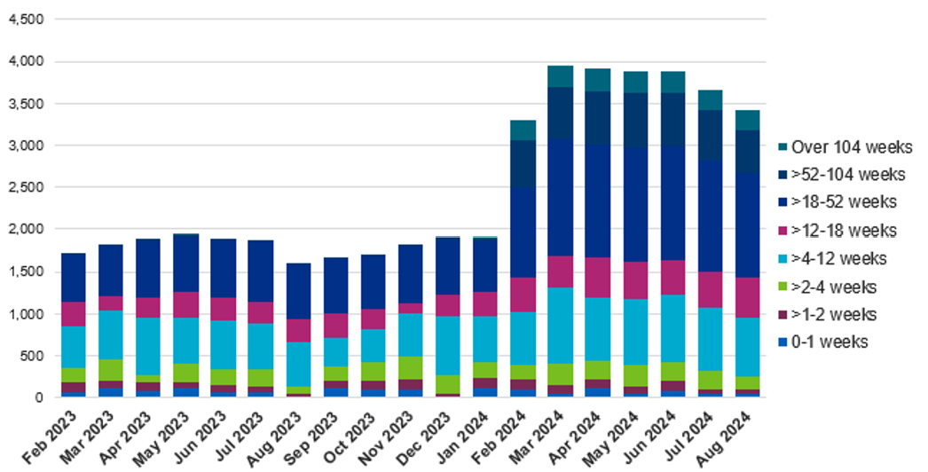
Community Care
Golden Ambition: CYP Performance
CYP list size has dropped overall since April (Adult is rising) however still makes up a sizable proportion of the waiting list within community – more as a proportion than the RTT waiting list. All bands of the waiting list are dropping including the extreme tail.
Long waits are predominantly within SLT services as per previous slide, with performance issues across NE&Y with York having the 2nd largest backlog.
Notes:
Table subject to change depending on what detail is needed.
Consider keeping the original table for this slide and change the table header to the dark blue for consistency.

Slide 29
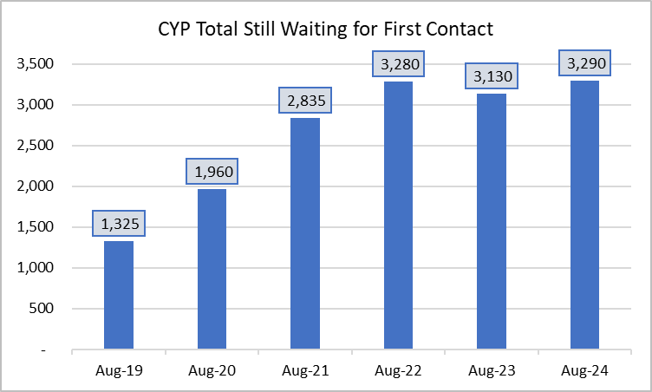
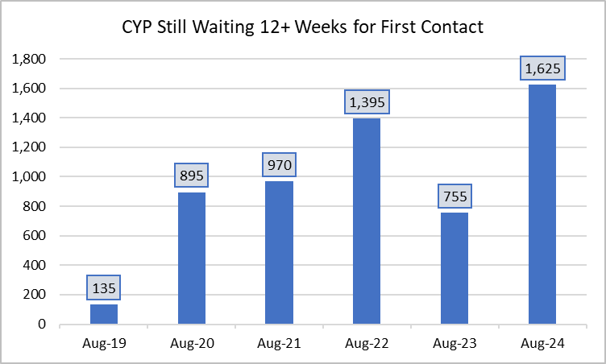
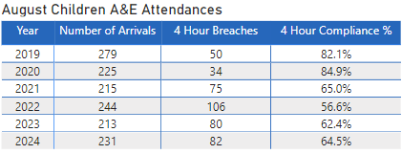
CYP Mental Health Services
Supporting Indicators and Intelligence: CYP
Excludes waiting times for referrals to Autism & ADHD services
August 2024
3,290 patients still waiting for first contact (32% of Open Referrals)
1,625 patients still waiting over 12 weeks for first contact (49% of total waiting list).
9,750 Open Referrals (a count of all referrals, including those waiting to be seen).
These patients have been referred, but do not count towards the Access Metric as they are still awaiting first contact.
The number of Children and Young People (CYP) aged 5-16years with a probable mental disorder rose from 11% in 2017 to 17% in 2021 and 19% in 2023 [all mental health conditions].
Referrals to CYP community mental health services continue to be higher than pre-pandemic 2019/20 levels and while access to services has increased so have waiting times to first contact.
The level of acuity at first presentation has also increased meaning often CYP need to remain in services longer to address their mental health issues and are more likely to need admission to acute paediatrics or MH inpatient
Increased pressure across the system as many CYP presenting at A&E and primary care for poor mental health are not currently in receipt of a mental health service
Based on current trends it is projected that CYP mental health problems will increase 63% by 2030 unless action is taken to intervene early.
Work is underway to review current CYP MH offer across the system including ensuring MH of CYP on waiting lists don’t decline further while waiting. However, key to this would be increasing capacity in early intervention to reduce need in clinical services (this would also contribute to the access target).
From 2025/26 we will not only be measured on CYP MH access but also waiting times and outcomes.
Children’s A&E attendances, for patient with a MH Flag, was at 231 in August 2024. 35.5% of those attendances breached the 4hr waiting time.

Slide 30
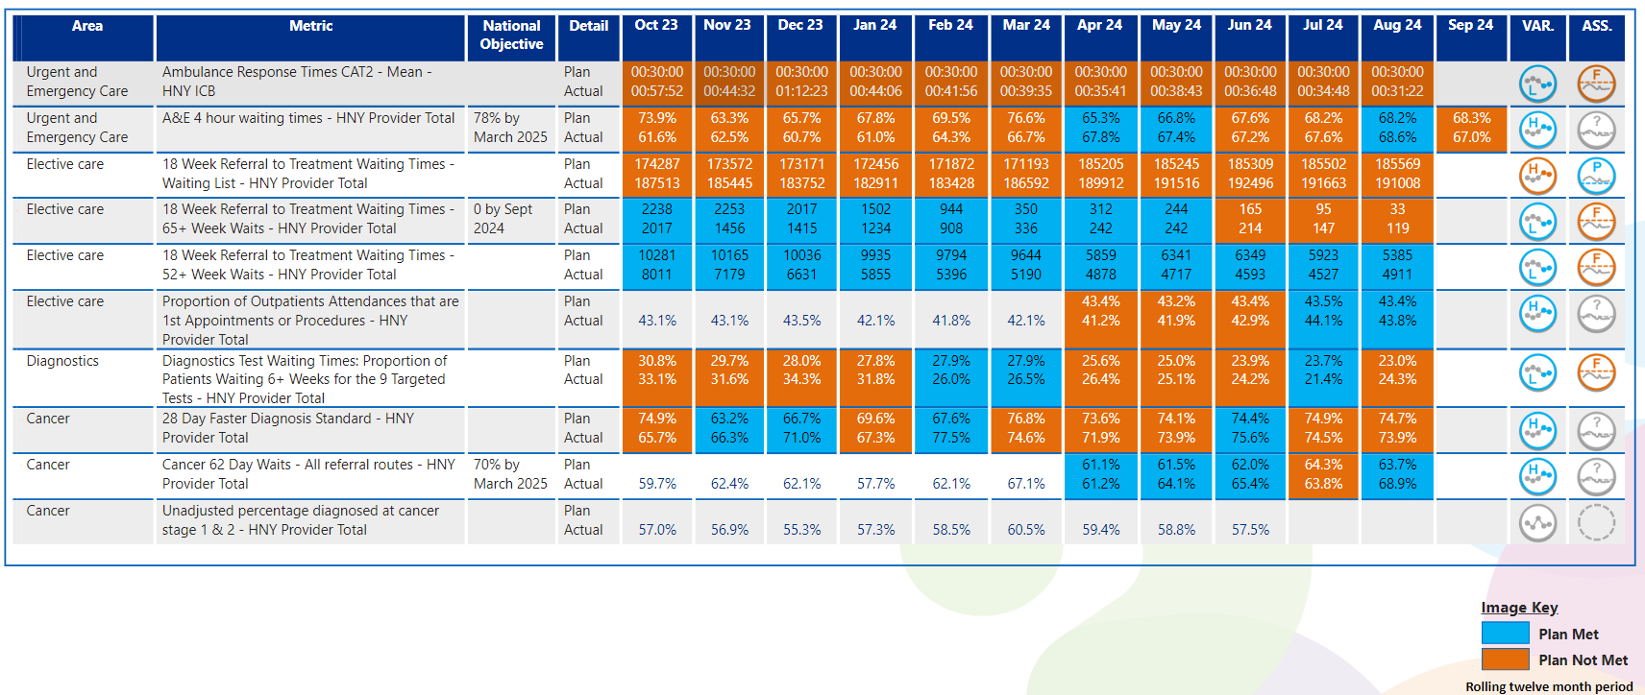
View by Month – Other Operating Plan Indicators
In line with Making Data Count recommendations, blue equals achieving, orange equals failing to achieve.

Slide 31
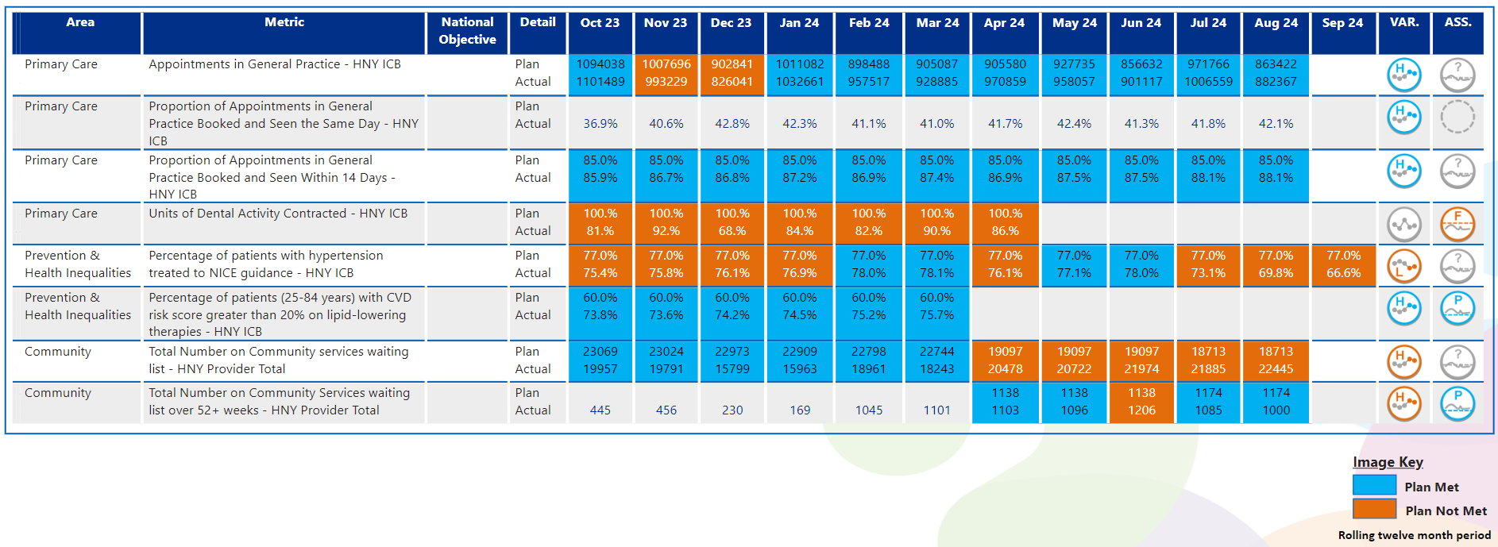
View by Month – Other Operating Plan Indicators
In line with Making Data Count recommendations, blue equals achieving, orange equals failing to achieve.

Slide 32
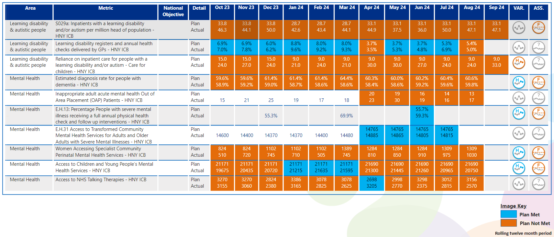

View by Month – Other Operating Plan Indicators
In line with Making Data Count recommendations, blue equals achieving, orange equals failing to achieve.

Slide 33



