Slide 1
Our NHS – the next chapter. We need to talk Interim report (as of 1 November and three weeks into the programme - data subject to change)
.
More than 1,800 survey responses so far…
1.5% of respondents are system partners
75% of respondents are members of the public
More than 500 face-to-face conversations
23.5% of respondents are NHS staff

Slide 2
What are people telling us?
(Data subject to change)
Headline stat:
98.5% of respondents say the NHS needs to change
The top three problems people face that they would like us to prioritise solving are:
There are long waiting times to receive the advice, care or treatment I need (84.7%)
Health services are understaffed (65.5%)
Health services don’t talk to each other and I have to tell my story over and over again (63.6%)

Slide 3
What are people telling us?
(Data subject to change)
The top 5 services people think should be prioritised are:
1 Primary Care (1,298 responses)
2 Emergency Care (1,240)
3 Mental Health Care (774)
4 Critical Conditions Care (691)
5 Social Care (630)
The top 5 answers given to asking people what they think they could do to improve their health and wellbeing are:
1 Increasing exercise (1,050 responses)
2 Reducing anxiety/stress (936)
3 Improving diet (802)
4 Improving mental health (718)
5 Living in a supportive community (479)

Slide 4
What is most important to people?
(Data subject to change)

Slide 5
What is most important to some of our demographically targeted communities?
 | 1st Priority | 2nd Priority | 3rd Priority
Young People (0-24) | I can get the care I need to look after my general health and wellbeing | There are enough staff with the right skills available | My care is centered around my needs, and I am listened to
BAME – (this section will be broken down into finer detail in full report) | I can get the care I need to look after my general health and wellbeing | There are enough staff with the right skills available | My care is centered around my needs, and I am listened to
Disabled (Physical, Visual, Audio, Sensory, Cognitive) | My care is centered around my needs, and I am listened to | I can get the care I need to look after my general health and wellbeing | There are enough staff with the right skills available
Long-Term Health Condition | I can get the care I need to look after my general health and wellbeing | My care is centered around my needs, and I am listened to | There are enough staff with the right skills available
Learning Disability | My care is centered around my needs, and I am listened to | There are enough staff with the right skills available | I can get the care I need to look after my general health and wellbeing
LGBTQ+ | I can get the care I need to look after my general health and wellbeing | There are enough staff with the right skills available | I am treated in a fair and inclusive way, irrespective of who I am
Mental Health | I can get the care I need to look after my general health and wellbeing | My care is centered around my needs, and I am listened to | There are enough staff with the right skills available

Slide 6
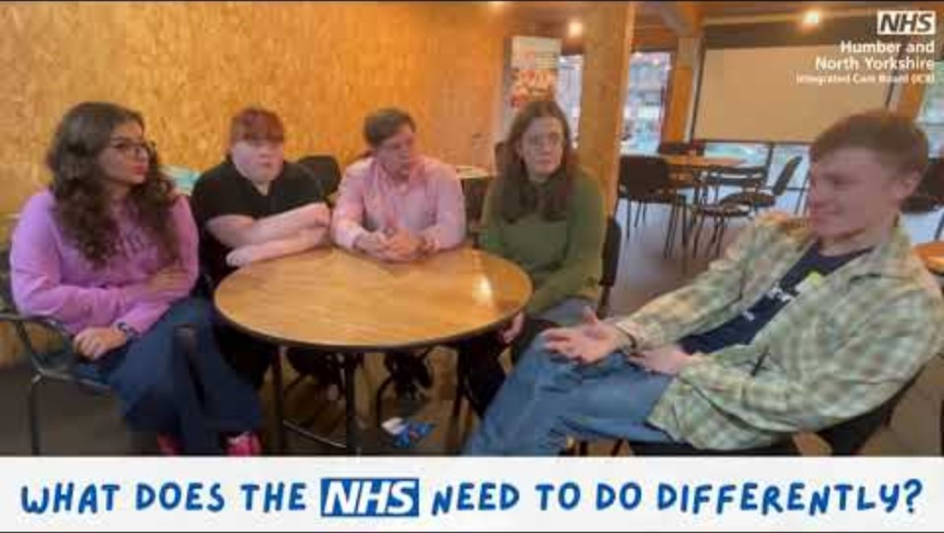
We spoke to a group of young people, from Hull, North Yorkshire and York, to get their thoughts on our NHS…

