Slide 1
The voice of Children and Young People in
Humber and North Yorkshire
Mental Health
Notes:
Aimee introduce film

Slide 2
Setting the scene…
The number of Children and Young People (CYP) aged 5-16years with a probable mental disorder rose from 11% in 2017 to 17% in 2021 and 19% in 2023 (all mental health conditions)
The number of CYP requiring urgent treatment for an eating disorder almost doubled in 2020/21 compared to the year before
Referrals to CYP community mental health services continue to be higher than pre-pandemic 2019/20 levels and while access to services has increased, so have waiting times to first contact
The level of acuity at first presentation has also increased meaning often CYP need to remain in services longer to address their mental health issues
The prevalence of mental ill health is higher amongst vulnerable groups of CYP: e.g. LGBT, young carers, care leavers, neurodivergent, trauma and those living in areas of multiple deprivation
Based on current trends it is projected that CYP mental health problems will increase by 63% before 2030, unless action is taken to intervene early.

Slide 3
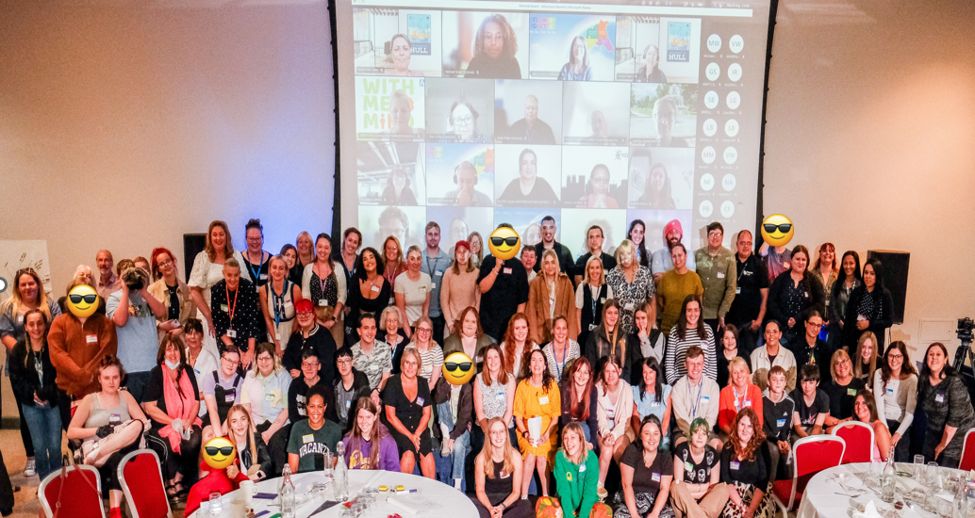
Co-producing and engaging with our young people…
We believe meaningfully engaging and co-producing with our children and young people will help build mental health services fit for the future. As a result, the CYP Mental Health Advisory Group, Nothing About Us Without Us, was launched.
At ICB level, the large group meets every six months. Each sub-system also has its own advisory group which meets more regularly and allows members to help shape their mental health services on a more local footing.
Notes:
Intros from Clair and Aimee

Slide 4
115 Organisations at place supported to improve engagement and co-production 266 Professionals on the network, representing a range of roles, specialisms, services and sectors across all 6 places.
Nothing About Us Without Us – a flourishing and diverse membership
246 Children and Young People with lived experience, representative of a diverse range of needs and communities across Humber and North Yorkshire
CYP aged
10
to
25
CYP from
urban
areas
CYP from rural and remote areas
CYP from all 6 places
CYP
with mental health needs
Young Carers
and
Young
Adult Carers
LGBTQ+
CYP
CYP with
SEND
Care
Experienced
CYP
Neurodivergent CYP
Homeless CYP
Non-verbal CYP
CYP
from
racially
minoritised
groups
CYP involved in / at risk of
entering
Youth Justice System
CYP
with limiting long-term health condition
CYP
from
Armed Forces
families
Notes:
Aimee

Slide 5
You said, we did! The headlines so far…
With our 246 children and young people we have been working together to co-produce:
Improving digital access to mental health support and services
CYP admitted to acute paediatrics with mental health needs
Improving access to mental health support and services
Improving outcome reporting
Our CYP members have formed 50 recommendations and we have been working with partners at place to provide consultancy and advice to support them implement these recommendations. Here are some of the headlines so far…
Working with Mind of My Own to develop an app to ensure improved involvement of children and young people in their own treatment/care plan
We’re working on improved transitions between CYP and adult services – system wide task and finish group to deliver this in line with NICE Quality Standards
We’re producing a suite of animations to embed lived experience of CYP within staff training. Currently developing with LGBT+ CYP and minoritised ethnic CYP
Development of the Trusted Adult campaign aimed at CYP and non mental health staff working with CYP to improve staff confidence in talking about mental health. This was developed in partnership with the Humberside Police and Crime Commissioner and piloted across Humberside but has now also been used in North Yorkshire and York
To achieve clear, accessible, and up-to-date information from a trusted source, each of the 6 places has or is developing and promoting CYP friendly webpages, which have been co-produced with our CYP and partners. Services at place are also developing ‘What to Expect’ videos, co-produced with young people so young people know what will happen at their first appointment with a service and avoid unwanted surprises.
Notes:
Clair and Aimee

Slide 6
The voice – A life backwards
Notes:
Clair and Aimee

Slide 7
Our pledge We will work collaboratively to ensure that all professionals working across the system with children and young people who have experienced trauma, can be supported to respond appropriately, consistently, and compassionately, so that the support these children and young people receive helps them to thrive.
Children and Young People’s Trauma Informed Care Programme Alison Flack, Programme Director Mental Health, Learning Disabilities and Autism Collaborative

Slide 8
1. Improved prevention and early intervention to help young people stay healthy and reduce demand on clinical services 2. Improved/expanded access to Mental Health services for those who need them 3. Systems Approach to Trauma Informed Care 4. Effective management of risk 5. Improved engagement and co-production with CYP 6. Workforce development.
Priorities in our Humber and North Yorkshire
CYP Mental Health Strategic Plan
Notes:
CYP are golden thread running through ICB strategy. CYP mental health and emotional wellbeing is one of the priorities of the ICB Childrens plan (in development by the Start Well Board. The priorities in the CYP plan reflect those in the HNY CYP MH Strategic plan.

Slide 9
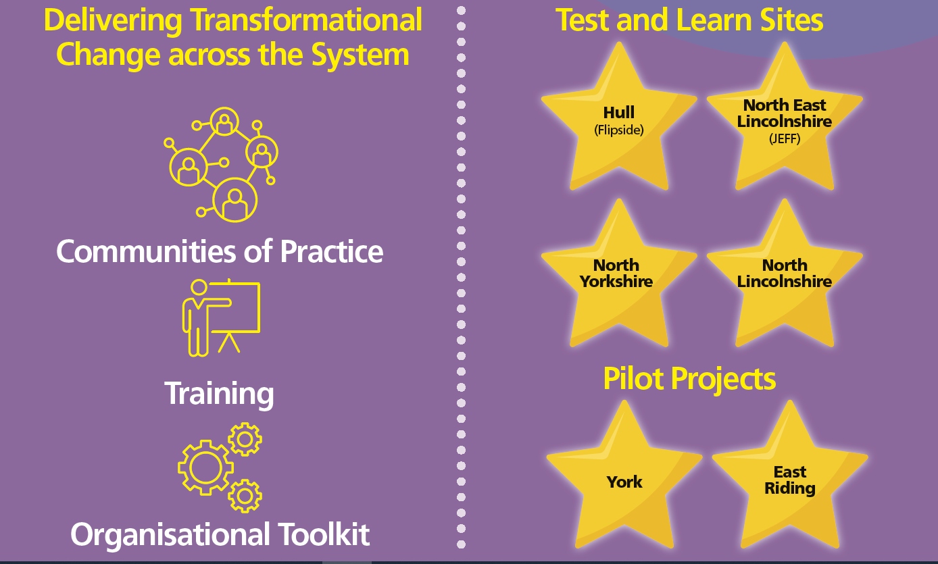
Our programme
Our Children and Young People’s Trauma Informed Care Programme is a collaboration of partners from across our six places within Humber and North Yorkshire. The model aims to build on the existing infrastructure to strengthen pathways and work collaboratively while testing new models of delivery to improve outcomes
Notes:
Shows an overview of the Programme – the 2 sides to it e.g Transformational Change and the Test and Learn Sites. Also shows the target cohort

Slide 10
System Change Work: Training
Stakeholders and Working in Partnership
Developed our Training Offer and Recruited a Framework of Trainers
Kati Taunt
(National ARC trainer)
Notes:
All about our training offer – latest numbers are on the KPI slides that follow

Slide 11
System Change Work:
Communities of Practice and Organisational Toolkit
All facilitated by our Community of Practice Manager
Notes:
This is to show that we don’t just train people and leave them. We have the Communities of Practice and the Toolkit that Katy follows up with people. Also the get an invitation to the NHS Futures page where they can chare resources etc

Slide 12
Core Team KPI Data 2024-2025 (Rolling Total)
Transformational System Change | Mar 2024 | Quarter 1 | Quarter 2 | Quarter 3 | Quarter 4
Number of people who have attended the ARC 2 day training courses | 353 | 388
Number of people who attended the ARC training courses for Senior Leaders (2 half days) | 122 | 165
Number of people who have attended the 1 day Trauma Informed Training | 343 | 502
Number of people who have attended the half day Developmental Trauma Introduction | 395 | 442
Number of people who have engaged with the E-Learning Trauma Informed Training | 1661 | 2712
% of people who say the training has increased their knowledge of Trauma Informed practice | 90% | 91.5%
% of people who say the training has given them the skills and knowledge to identify whether practice is Trauma Informed | 89% | 87.2%
Current number of ARC Champions | 36 | 22
Number of Communities of Practice that have taken place | 16 | 17
Number of people who have attended Communities of Practice | 87 | 127
Number of organisations who have engaged in Communities of Practice | 24 | 44
% of people attending Communities of Practice that say they increase knowledge sharing | 89% | 89%
% pf people attending Communities of Practice that say they help to embed Trauma Informed Care | 78% | 78%
Number of organisations working collaboratively with the Core Team to undertake the Trauma Informed Organisational Toolkit | 11 | 14
Notes:
This is up to date data re the Programme KPIs after Quarter 1 2024-2025

Slide 13
Core Team KPI Data 2024-2025 (Rolling Total) – Continued
Engagement and Coproduction | March 2024 | Quarter 1 | Quarter 2 | Quarter 3 | Quarter 4
Numbers of CYP involved in engagement and Coproduction Advisory Groups | 240 | 246
Number of organisations at place supported to improve engagement and Coproduction | 53 (68 Professionals) | 115 (133 Professionals)
Number of organisations engaging in CYP Coproduction Communities of Practice/networks | 146 (232 Professionals) | 180 (266 Professionals)

Slide 14
Test and Learn Sites KPI Data
Programme Total 2023-2024 KPI Data
Programme Total 2024-2025 KPI Data
KPIs | Total for 2023-2024
Number of new referrals | 578
Number of appropriate referrals (could be split by % within Youth Justice System and % at risk of entry) | 486
Number of new YP taking up the support offer/accessing the service | 456
Number of YP exiting in a planned way | 308
Of the YP exiting in a planned way, the number of YP reporting improved outcomes | 307
KPIs | Quarter 1 | Quarter 2 | Quarter 3 | Quarter 4 | Total
Number of new referrals | 148
Number of appropriate referrals (could be split by % within Youth Justice System and % at risk of entry) | 132
Number of new YP taking up the support offer/accessing the service | 115
Number of YP exiting in a planned way | 92
Of the YP exiting in a planned way, the number of YP reporting improved outcomes | 92
Notes:
This is up to date data re the Test and Learn Sites after Quarter 1 2024-2025

Slide 15
Feedback from those accessing the Programme
“My work with Flipside has taught me a lot about consent and has helped me recognise what is healthy in a relationship. I’ve really enjoyed coming into The Warren doing all the activities. It’s given me stuff to do and I’ve met some nice new people. I see my Flipside worker in school as I’m back in education now and I hope they can help me finish Year 11 and get through the stress with my exams”
“Some people don’t want to get to know me because of my criminal record, they just
see the violence in my past. The PIPA staff and all the others from the Youth Justice Service) have stuck around. They respect
me as a person and have got to know me…I trust you to do what you have said you were
going to do, and I know you have my best interests at heart”
“I haven’t self-harmed in over 8 months, I’m not getting angry as much, I’m not using alcohol and I haven’t been in trouble with the Police. I’ve enjoyed learning about myself, I’m able to be more open with people and having someone to talk to”

Slide 16
Continue to work with our Pilot
Projects: York and East Riding
Moving forward…..
Continue to develop our Training
Offer
Work with CORC (Anna Freud) to support the Independent Evaluation of the
Programme
Sustain the good
work taken place so far and focus on sharing the good practice across the ICB and wider
Work closely with our ARC Champions to sustain our Training Offer
Continue to
work with and support our 4 Test
and Learn
Build on the work
to embed Children
and Young People’s
lived experience to deliver ongoing improvements in services and support
Further develop
Communities
of Practice and work with the
Organisational
Toolkit
Build on the work we have started on delivering Transformational
System Change
across the ICS
Notes:
Our main priorities

Slide 17
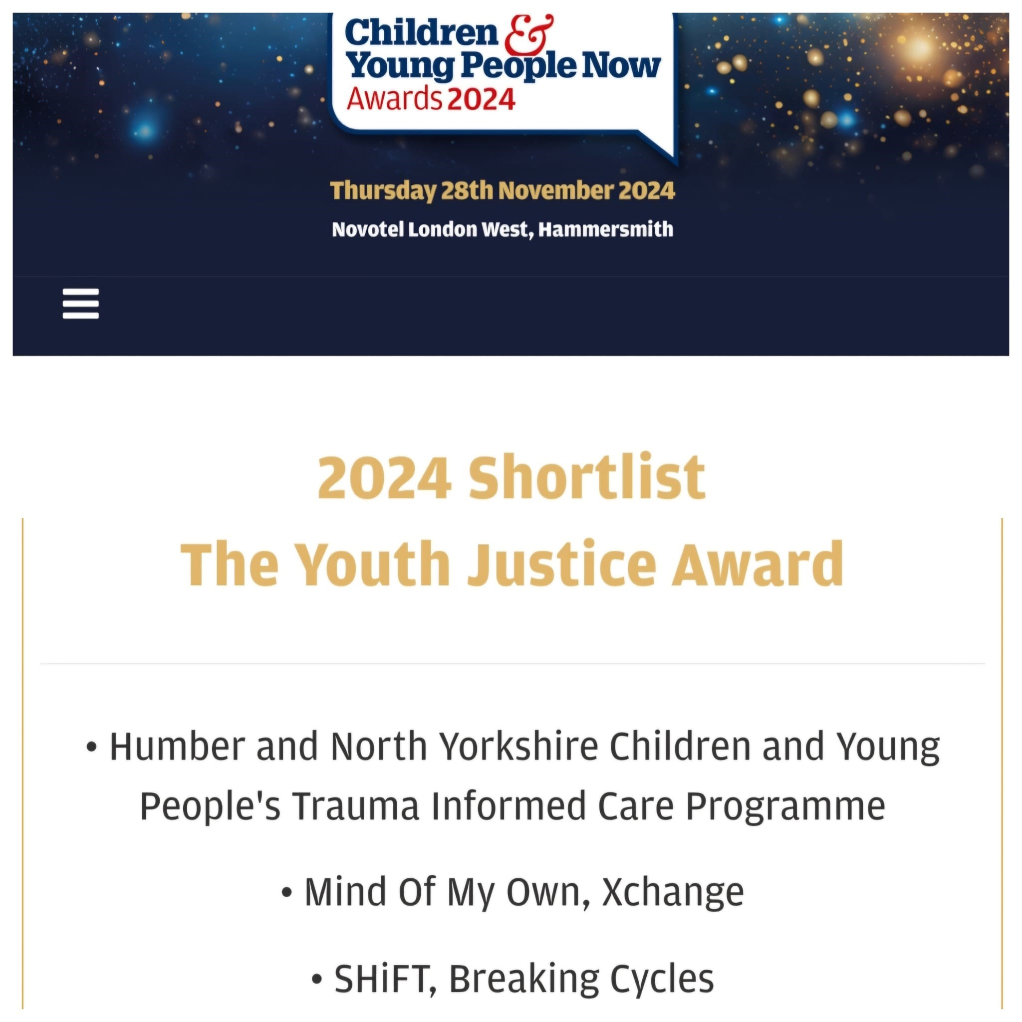
The Humber and North Yorkshire Health and Care Partnership, Children and Young People’s Trauma Informed Care Programme are delighted to have been shortlisted as a finalist in the Youth Justice Award category in the Children and Young People Now Awards 2024:

Slide 18
More information about the HNY CYP Trauma Informed Care programme including our annual reports and case studies can be found here: https://humberandnorthyorkshire.org.uk/children-and-young-peoples-trauma-informed-care-programme/
Video link:
Nothing About Us Without Us

