Slide 1


ICB – Board
Annual Operating Plan - Performance Report
[Date: 11th December 2024]

Slide 2

Executive Summary
Introduction
The monthly ICB operating plan performance report is specifically concerned with the short term annual objectives related to the HNY ICBs Annual Operating Plan 2024/25. The report is a single part of a wider performance management framework across the ICB. The overall framework has width and covers a wide range of aspects of performance relating to themes such as quality of care, patient experience, operating plan access metrics, public health statistics, and health prevention data. It also has depth in that any of these themes are being considered at provider, place, in some cases condition level. The framework also considers time frames in that some performance expectations are measured daily, weekly, monthly whereas others are to be reviewed annually. These different aspects of performance do not sit in isolation; improving access to cancer services this year, goes hand in hand with ICB mid-term ambitions to increase engagement of vulnerable populations with cancer screening programmes, and reduce harm from cancer. Both support the long term aim of increasing healthy life expectancy. The report will demonstrate how these short term annual operating plan indicators support long term aims and ambitions of the ICB. It will describe the full list of indicators in the 2024/25 planning guidance but will focus on areas that have been identified as priorities by NHSE. A small number of indicators are better performance managed through other reporting mechanisms and these are identified in the report also. The report is supported each month with a deep dive into a theme along with Executive Director updates that will describe any escalations from sub committees.
Notes:
textbox
No alt text provided
image
No alt text provided
image
No alt text provided
shape
No alt text provided
shape
No alt text provided

Slide 3
HNY ICB Strategy, Planning and Reporting Framework

Slide 4
HNY ICB Strategy, Planning and Reporting Framework – Priority Indicators

Slide 5

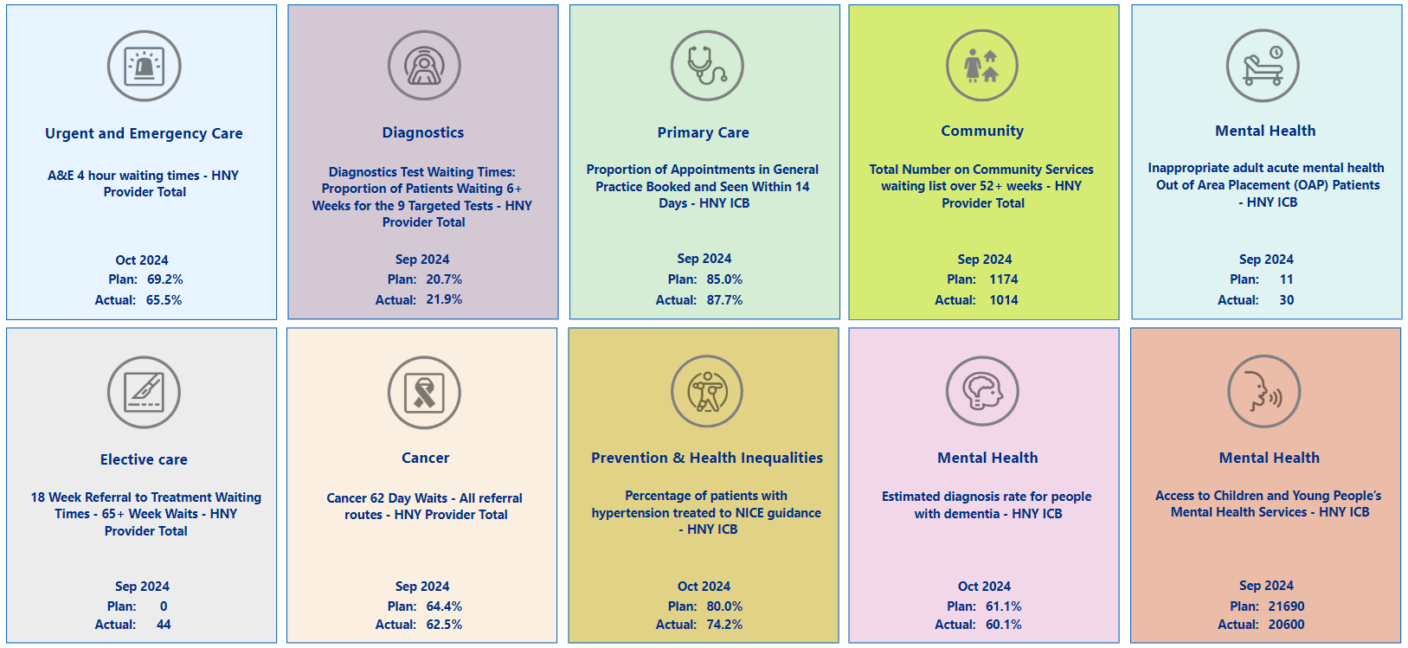
Summary Overview

Slide 6
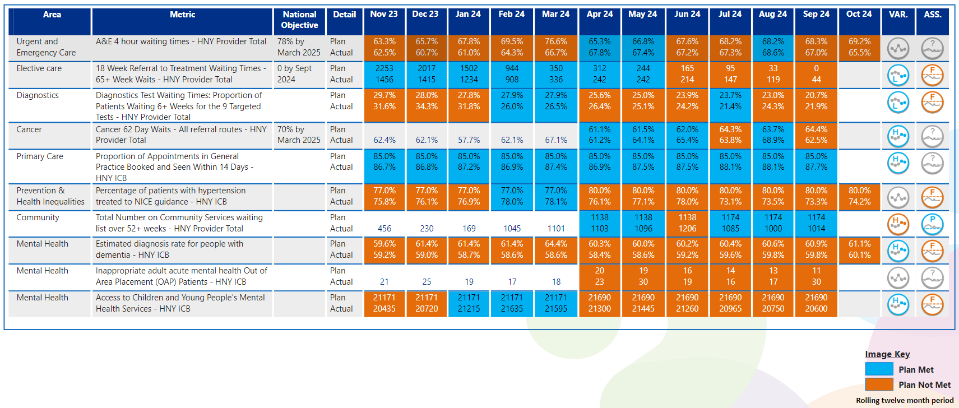
View by Month
In line with Making Data Count recommendations, blue equals achieving, orange equals failing to achieve.
SOAG undertook a mid year review of performance where year end forecasts were discussed. There is currently a potential for 7 indicators achieving their year end target, with 3 indicators not achieving, but potentially still demonstrating progress.

Slide 7

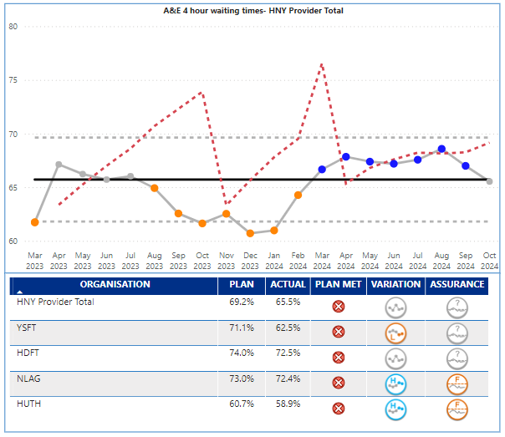
Urgent Care
Key Indicator: Waiting time in ED
Urgent Care Escalation Points
UEC 4-hour performance in October for the overall ICB system worsened from 71.8% (Sept) to 70.5%. The UEC plan being monitored by NHSE is for the acute providers only and was set at 69.2% for October, and delivery was 65.5%. HUTH (58.9%) and Y&SFT (62.5%) were lowest performing Trusts. UEC performance at HNY has been challenged by NHSE and the ICB is in national UEC Tier 2. HNY benchmarks adversely across NEY for other patient experience indicators related to urgent care such as time in department and ambulance handovers. The year end 4 hour target for the acute providers is 73.2% - ICB overall 78%.
4-hour UEC Oct. – No provider achieved their monthly target in October, part of the reason being cited was high levels of demand in October
HUTH and NLAG are showing improving positions, HDFT no change and Y&SFT worsening
Ambulance response time cat 2 ambulances worsened in October to 47:44 minutes against a target of 30:00 minutes. HNY hospital handover performance has been singled out by YAS, EMAS and NHSE as of concern; further improvement is required.
Key Actions
ICC Hubs – East live from 4th November and North from 18th November. Initial focus on reducing dispatch and then conveyance.
Regional Clinical support commenced in York ED with a focus on ED processes and efficiency – reducing time to clinician, ambulance handover and the roles of NIC and EPIC. York have also implemented a continuous flow model and are trialling earlier Board rounds to improve flow.
ICS-wide programme to increase utilisation and effectiveness of UTCs across the ICS – ensuring UTCs meet National standards and are correctly profiled on DOS in line with national minimum profile.
Further refinement of the SDEC exclusion criteria to increase utilisation. Work undertaken to ensure correctly profiled on JRCALC as was identified old criteria was also still on JRCALC as well as the new flow chart, which was reducing utilisation. Just new flow diagram now on JRCALC. Push for implementation of trusted assessor model to SDEC in HUTH with ambition to have in place pre-xmas
New UEC data dashboards developed and now live in HNY, enabling proactive identification of opportunities for improvement and effective analysis/evaluation of impact. Includes new 2UCR dashboard
HIU – HIPLACES model presented to Place Directors and now completing skills gap analysis to determine training needs within existing HIU resources to enable the enhancement of the service to case manage and reduce attendances to ED for the highest service users. Focused work at York on the highest 20 attenders
Regional support being offered into HUTH to develop a plan for 45 minute handover, supported by the ICS UEC team.
A-teds now complete for York, Scarborough and Hull. Awaiting final reports for Scarborough and Hull. Outputs will form part of ongoing improvement plans
How does indicator link to long term priorities:
Patients across HNY use ED services as a way of accessing healthcare, we also know that patients from areas of high deprivation are high users of ED. Improving access to ED will therefore support all of the ICB strategic ambitions including the golden ambition of improving services for CYP.
Evidence suggests the longer patients wait in ED the worse the clinical outcome will be, and congestion in ED can lead to delays to ambulance handovers, meaning ambulances are not freed up to pick up other emergency cases, leading to further clinical risk.
Notes:
Table subject to change depending on what detail is needed.
Consider keeping the original table for this slide and change the table header to the dark blue for consistency.

Slide 8

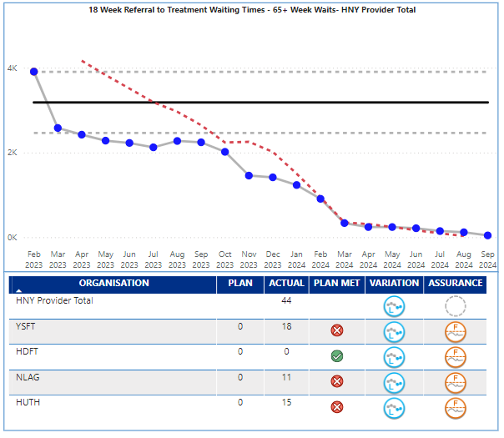
Elective
Key Indicator: RTT 65+ Week Waits
Elective Services Escalation Points
Elective waiting times over 65 weeks reduced to 44 in September against a target of 0. The ICB continues to benchmark well in NEY and is the best performing ICB in the region on elective long wait metrics. Performance is outside expected control limits and demonstrates real cause variation of an improving nature. All providers have demonstrated significant progress, Y&SFT in particular, though they still have the majority of breaches (18 of the 44).
The latest unvalidated data is forecasting the October position to remain at 44 with risks in Neurology, Plastic Surgery and ENT. The accompanying performance target is total waiting list size which has shown a small reduction for the third consecutive month.
Key Actions
ENT – Audits completed to understand the reason for patients staying overnight when listed for a daycase procedure, actions to address the outcome being taken via the network and weekly tactical operations group.
Peri-op clinical network – Standardised risk stratification for Orthopaedics and Urology between Bridlington and Goole surgical hubs.
Eyecare – SPoA business case to be presented to December elective Board. Business case for implementation of stable Glaucoma monitoring in primary care currently being finalised.
Gynaecology – Day case hysterectomy SOP signed off by network.
Orthopaedics – IRIS working with providers to support implementation of post op arthroscopy video. Agreement to use same implants for hips and knees across 3 Trusts from 2027 when current contracts expire.
Urology – Network agreed to standardise Ureteroscopy and TURBT pathways in line with GIRFT guidelines. Commitment to ensure Ureteroscopies and TURBT procedures are listed by default as day case procedures.
Outpatients – Pep bid submitted to extend PKB for another 12 months, unfortunately this was not successful, therefore Trusts are extending independently.
Theatres – Focussing on late starts, early finishes, golden patient and OTD cancellations
How does indicator link to long term priorities:
Access to planned care elective services supports primary care and urgent care as delays can lead to patients seeking alternative routes to treatment or return to primary care to raise concerns. If not managed for risk, delays to elective care can also affect patient outcomes and certainly affect patient experience, if the condition is one that worsens over time. There are also social impacts to delays that may affect patient’s ability to work. Access to elective services affects all of the ICB strategic ambitions and long term aims. The ICB has made significant investment in elective care through ERF and £80m on IS capacity.
Notes:
Table subject to change depending on what detail is needed.
Consider keeping the original table for this slide and change the table header to the dark blue for consistency.

Slide 9

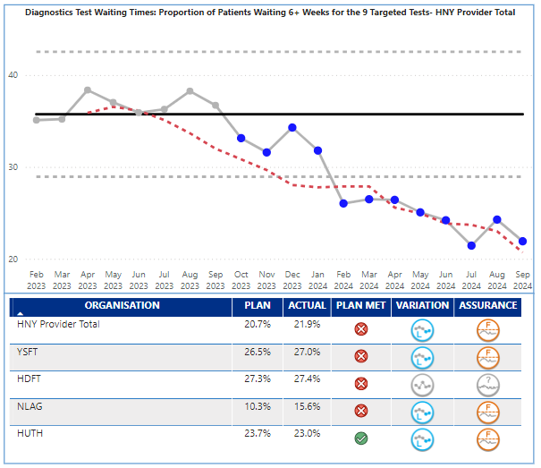
Diagnostics
Key Indicator: Waiting time for tests
Diagnostics Services Escalation Points
Diagnostic 6 week performance was 21.9% in September against a plan of 20.7%; statistically performance is demonstrating special cause variation of an improving nature, and September saw improvement from August.
At September 2024 there were 9,043 patients waiting over 6 weeks for diagnostic tests in total, but the NHSE plan was based on 9 key tests. The number of patients waiting over 6 weeks for the 9 tests was 8,226 in September, a reduction of 695 from August (8,921). 7,117 of the breaches were in the following modalities – Audiology (1,392), NOUS (1,390), CT (1,249), MRI (1,194), Echo (1,041), DEXA (851).
Audiology, DEXA and Echo are of particular concern, as their high volumes of breaches are from smaller waiting list sizes, and their performance is 43.7%, 38.6%, 35.6% respectively against a national target of 5%; although all three have shown improvement in September. From a provider perspective, York have continued to improve performance and now HDFT are the lowest performing Trust at 27.4% and the only provider not identifying as statistically improving.
Key Actions
CDC: programme continues to support activity across HNY and at month 7 has delivered a total of 112,334 tests across all the modalities (this is under plan by 25,138 tests).
Four spoke sites are live (Ripon, Selby, Askham Bar and East Riding Community Hospital (ERCH)). Four more sites (3 hubs in Scunthorpe, Scarborough and Hull and 1 spoke in Grimsby) are under development and although delayed from original dates are planned to go-live between December 2024 and March/April 2025.
The HNY CDC mobiles (CT and MRI) continue to rotate between Askham Bar, Selby, Castle Hill Hospital, ERCH and St Hughs in Grimsby providing additional activity.
2025/26 CDC plans are being developed ahead of Jan 8 submission to NHSE
Robust CDC workforce plans are in place for each site and recruitment is ongoing.
CDC digital workshop – confirmed date 11.12.24
Endoscopy : Network governance and meeting schedules have been redefined. Formation of ERCP Network and delivery of paper on future service. Staff survey distributed to nursing teams. Workforce Review – link with ICB lead to agree next steps. Advertise/Recruit for new clinical lead and launching of the Regional Endoscopy Dashboard planned in December.
Imaging: DDCP acceleration plan approved at Diagnostic board and CAP digital oversight group. DDCP benefits realisation – NHSE benefits surgeries underway to provide support/address queries in the completion of draft benefits surveys.
AI MSK fracture detection procurement evaluation and moderation process completed. Stage gate review meeting scheduled with NHSE 29/11, to discuss contract award, and agree trust deployment timeframe.
Workforce: DRAD: Diagnostic Radiography Course (University of Hull) – HCPC external body accreditation confirmed. 15 student placements allocated; course due to commence 27/01/25
Imaging Network Strategic lead due to commence 2/12/2024.
How does indicator link to long term priorities:
Quick access to diagnostic services supports primary care, urgent care, elective care and cancer service delivery targets. Early supported diagnosis therefore supports all of the ICB strategic ambitions.
longer waits for diagnosis can affect cancer outcomes, as well as added delay to planned care pathways. Patient experience of care can be affected by delays to diagnosis.
Notes:
Table subject to change depending on what detail is needed.
Consider keeping the original table for this slide and change the table header to the dark blue for consistency.

Slide 10

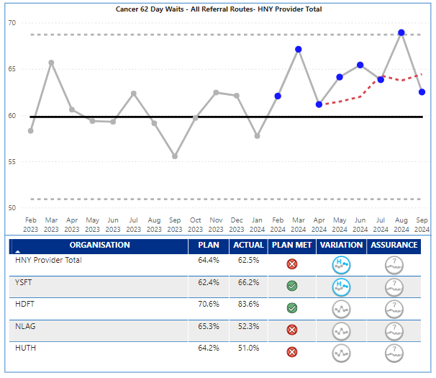
Cancer
Key Indicator: 62 day waits
Cancer Services Escalation Points
In 2024/25, the priority is to deliver a 70% performance on the 62-day cancer wait time target. September performance was 62.5% against a plan of 64.4% and therefore below target. Performance is showing common cause variation of an improving nature which reflects the significant improvement seen since January 24. There is however variation in performance.
HDFT (83.6%) and Y&SFT (66.2%) achieved monthly targets and Y&SFT demonstrated special cause variation of an improving nature. Patients on pathways at NLAG (52.3%) and HUTH (51%) are more likely to wait over 62 days than those at Y&SFT and HDFT. The ICB as a whole and HUTH and NLAG as individual providers, are in NHSE Tier 1 category for Cancer.
Key Cancer Alliance Actions in October 24:
Awareness & Early Diagnosis: Liver Surveillance funding for demand modelling agreed at HUTH. Successful awareness sessions attended: Menopause Hull (organised by Emma Hardy MP) and awareness session delivered to attendees.
Cancer Diagnostics and Innovation: Cancer Alliance Lynch Lead confirmed, and alignment of process agreed with clinical leads
Nursing and AHP: Collaborated with national ACCEND project managers on implementation and delivery.
Comms & Engagement: Breast Cancer Awareness Month: Campaign completed. Media coverage from BBC, ITV, Hits Radio and many other local media outlets. Community engagement events carried out in HNY areas where breast screening is lowest. Two-week radio campaign completed (results to follow).
Health Inequalities: Delivered LGBT+ education session to HNY & Provider colleagues. Continued development of Place Cancer HI Plans.
Lung Health Check: TLHC service launched in North Lincolnshire. York and Scarborough Trust has gained approval of TLHC business case.
Non-Surgical Oncology: Attended various regional and national capacity and demand with trust colleagues.
Treatment, Pathways and Personalised Care: T&F groups formed to progress HNY Urology SOC development. H&N SOC progressing through Trust governance process.
How does indicator link to long term priorities:
Quick access to cancer diagnostic and treatment supports all of the ICB strategic ambitions, in particular reducing harm from cancer, and long term improvement in Healthy Life Expectancy.
longer waits for treatment can affect cancer outcomes, and overall patient experience of care. NHSE will be scrutinising performance in this indicator and it forms part of the NHSE Oversight Framework and Tiering process. Delivery is supported by the Cancer Alliance.
Notes:
Table subject to change depending on what detail is needed.
Consider keeping the original table for this slide and change the table header to the dark blue for consistency.

Slide 11

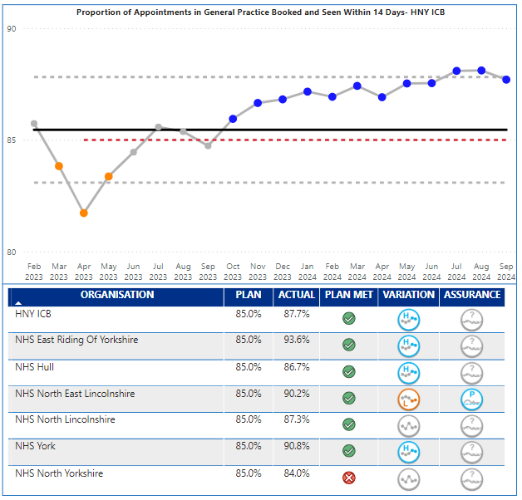
Primary Care
Key Indicator: Booked within 14 days
Primary Care Escalation Points
HNY September performance has delivered 87.7% against the 85% target for 14 day booking. Performance has been closer to and just over the upper control limit and demonstrating special cause variation of an improving nature.
Performance differs by place; East Riding 93.6%, Vale of York 90.8%, NE Lincs 90.2%, North Lincs 87.3%, Hull 86.7%, North Yorks 84.0%. All places delivering the target except North Yorks. East Riding and York are driving the HNY improving position.
Primary care did not meet the September target for appointments delivered. The majority of the last 9 months delivery have all been towards the upper control limit, with the slight seasonal drop in overall appointments in August. Even though the plan was not met the overall trend is showing special cause variation of an improving nature. Only North Lincs met the plan for September.
Expectations in the operating plan are to recover dental levels of provision to pre pandemic levels. April saw a slight reduction from March but statistically numbers have fluctuated between 70-98% over the last 18 months with no consistent trend.
Key Actions
The ICB has agreed a mitigation with GP Practices to extend any LES notice periods to 31st March 2025 whilst the LES review is completed. Local intelligence confirms that nationally there has been a drop of in Locum GPs being booked to cover annual leave due to financial pressures of GP Practices which will impact on the number of appointments delivered during that period.
How does indicator link to long term priorities:
Primary care is singularly, the most used service in healthcare and is the entry point for many other services. It is therefore key to all of the ICB strategic ambitions, and long term aims.
Actual Inability or perceived inability to access primary care (and dental services) can lead to patients either incorrectly using emergency services, adding pressure there, or reluctance to engage with healthcare at early stages of symptoms. Patient experience and outcome can be affected by these delays which is why improved access to primary care is vital.
Notes:
Table subject to change depending on what detail is needed.
Consider keeping the original table for this slide and change the table header to the dark blue for consistency.

Slide 12

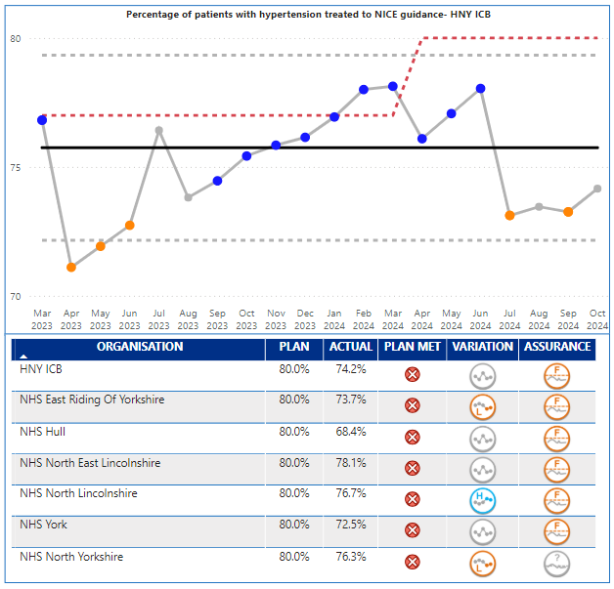
Prevention and Health Inequalities
Prevention Escalation Points
October 2024 performance was 74.2% against a target of 80%. The performance is showing a common cause variation of no significant change. No place achieved their plan in October and there is a range of delivery from 68.4% in Hull to 78.1% in NE Lincs. The overall performance is within the control range. The volume of patients being treated (numerator) is higher than previous years as is the number of diagnosed patients with hypertension (denominator) which has increased at a higher rate and therefore affects the performance. Increasing diagnosed prevalence of hypertension is a key objective of the CVD programme and the metric may be reflecting the success of a number of projects that aim to improve opportunistic testing.
Key Actions
The ICB continues to work with place teams and system partners to deliver several initiatives that seek to improve the detection and management of hypertension across our population. There has been a significant focus on increasing opportunistic blood pressure testing capacity across the ICB, including:
Increased sign up of new optom and dental practices through extended optom and dental hypertension case finding pilots (focus on communities with high deprivation and improving access in areas of rurality.)
Recruitment of Community Pharmacy Engagement Leads across the system to work with GP practices to promote collaborative working regarding hypertension case finding (and Pharmacy First services)
Continued delivery of NHS Health check programme with exploration of opportunities to take a population health management approach. Funding confirmed for Health Check workplace pilots in NY and ER, due for completion March 25. ​
Opportunistic hypertension case finding - implementation HIN led BP Check Train the Trainer Model to partners across the system e.g. LA and VCSE organisations building on MECC approach. This model is currently been expanded across the ICB and will continue over the coming months.
Building on work completed through ‘Know Your Numbers’ national campaign in September to plan for future national and local campaigns in May 25
IP pathfinder hypertension treatment pathway continues across 11 sites across the ICB
Hypertension tool kit and learning package currently being developed to support opportunistic testing in the community and case finding and coding in primary care. ​
NL CVD Outreach project in Scunthorpe (focus on hypertension opportunistic testing) scheduled to go live in December 2024. ​
Working with IRIS, HIN, ICB Place and LA colleagues to scope a ‘case for change’ programme of work in Hull. Hull is one of the most deprived cities in England, with lower-than-expected A,B,C condition prevalence, with improvements needed in treatment to target figures.
Exploring opportunities to better understand the prevalence of complex hypertension in HNY, the scale of any associated issues/ challenges and existing pathways and feed into regional workshop.​
NY – work with LCP’s in areas of deprivation to develop community champion models with a focus on raising awareness of CVD risk factors with a focus on hypertension and BP opportunistic testing. ​
Key Indicator: % Hypertension NICE Guidelines
How does indicator link to long term priorities:
Improved the % of patients with hypertension being treated following NICE Guidelines supports several strategic ambitions and outcomes such as reducing CVD; and enabling wellbeing health and care equity. It also has a direct link to the long-term ambition of improving healthy life expectancy.
1 in 3 adults has hypertension, which in turn can lead to heart disease, stroke and kidney disease, it is also linked to deprivation, and socioeconomic factors can be markers. This suggests that improving the care and treatment and prevention of hypertension could reduce the gap in healthy life as well..
Notes:
Table subject to change depending on what detail is needed.
Consider keeping the original table for this slide and change the table header to the dark blue for consistency.

Slide 13

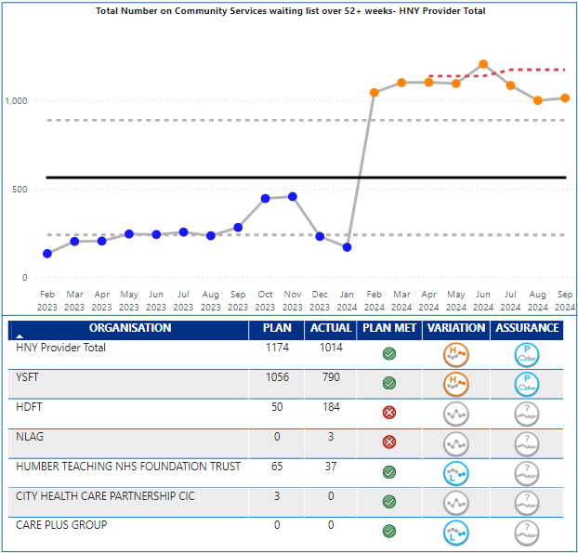
Community Care
Key Indicator: Waiting List over 52+ Weeks
Community Care Escalation Points
The priority indicator for community waiting times in the operating plan is patients over 52 week waits. The latest validated data available is September 2024, which saw 1,014 patients wait over 52 weeks for community services against a plan of 1,174. This is a small increase from August (1000), the data is continuing to show Special Cause variance of a concerning nature. There is variation across providers and services. HDFT and NLAG were over plan, however, Y&SFT (790), HDFT (184) and Humber Teaching FT (37) had the highest number of breaches.
At a service level, 747 (also 747 last month) of the 1,014 patients over 52 weeks are in CYP Speech & Language service – 708 of which are at Y&SFT. HDFT pressures are on Nursing Therapy Support for LTC: Respiratory/COPD service and Rehabilitation Services (integrated). Overall waiting list size stands at 22,006, a decrease of 439 from August. Trend wise, the waiting list size is showing significant change of a worsening nature. The trend is being driven by York.
Key Actions
Multiple community waiting time recovery groups have been established by the regional team focusing on, reducing community waits (adult & CYP), improving data quality and improving against health inequality metrics within our CYP waiting lists.
As a result of these groups being established, a new reporting process will be established with place and provider teams to report transformation initiatives through these routes. A highlight report has been distributed by the regional team for ICB’s to routinely complete.
A stock take of the CYP SLT waiting list has been conducted to help inform the ICB’s CYP team transformation work, however, it has been recognized that more work is required to unpick the commissioning of CYP SLT services which will be sit with the CYP team as SROs to take forward.
Met with the NHSE national team to help inform any 25/26 community planning targets. Reductions will be expected as well as the potential to introduce similar RTT standards to community care.
Reporting inaccuracies in September have been escalated to providers.
The CWL returns will be aligned to the PID 2 Community Baseline exercise to understand if any services are still being omitted into the SitRep.
How does indicator link to long term priorities:
Community services play a key role in delivering several of the ICBs long term ambitions and outcomes; in particular the golden ambition to radically improve the health and wellbeing of children and young people, and outcome measure of living with frailty.
Community services are a key support to patients with long term conditions in particular, they support primary and secondary care by being an alternative provision, but also are key to future innovations in pathway redesign, of which virtual ward is an example. The structure of community services forms part of the ten priorities for 2024/25
Notes:
Table subject to change depending on what detail is needed.
Consider keeping the original table for this slide and change the table header to the dark blue for consistency.

Slide 14

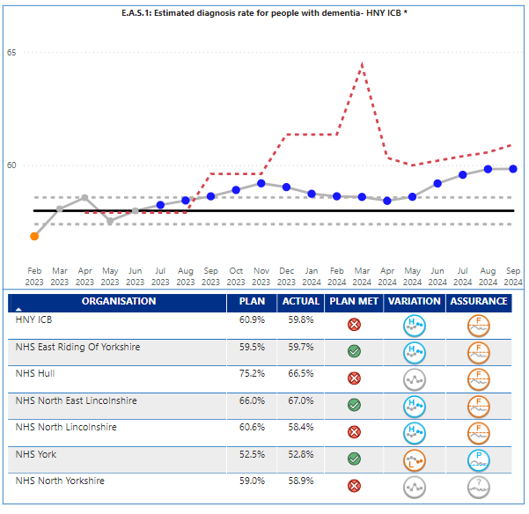
Dementia
Key Indicator: Dementia Diagnosis Rate
Dementia Escalation Points
The dementia diagnosis rate for the ICB in September remained at 59.8%, which is below the ICB plan target of 60.9%. Performance is consistently at or above the upper control limit and therefore demonstrates special cause variation of an improving nature. However, even with the improving performance, the ICB remains adrift from the national target and planning expectation of 66.7%, and the ICB target for 2024/25 of 62.5% by March 2025.
Performance is variable across the Places within the ICB; NE Lincs 67%, Hull 66.5%, East Riding 59.7%, North Yorks 58.9%, North Lincs 58.4%, and York 52.8%. NE Lincs, North Lincs and East Riding are all showing special cause variation of an improving nature. York did achieve plan, but they are showing special cause variation of a concerning nature and are a national outlier. A detailed understanding at a practice level is available and being worked through.
Key Actions
A dementia briefing paper has been completed to support the request for SDF to address diagnosis rates and wait times. This outlines the priority planning intentions and the relevant supporting evidence. Approved by MHLDA Executive Strategic Leadership Group. Now approved. NYY/TEWV & HTFT/ER are now mobilising plans to address long waits and low DDR.
Current QI project to cleanse the GP registers to resolve coding issues and identify additional possible diagnoses. Continues to progress and searches of York practices have commenced.
5 year dementia strategy ‘Hope of a Live Still to be Lived’ approved by MHHDA Exec 27th Sept. On agenda for ICB chief execs weekly meeting w/c 21st October. Has been fully coproduced and all interventions will support recovery of DDR and improve patient outcomes & experience.
Hull DDR recovering and audit of outlier PCN being undertaken imminently. Expect to be above target by October DDR publication.
One York PCN plans to review all MCI cases to establish potential new diagnoses, will be informed by QI project findings.
Contact being made with the GP Data, Extracts, Specifications and Analysis (GPDESA), Primary and Community Care Analysis team to understand methodology in primary care to MAS referral data due to some potential data errors/inconsistencies.
How does indicator link to long term priorities:
Improving Dementia Diagnosis Rate directly supports the ICB long term ambition of Transforming people’s health and care experiences and outcomes.
Earlier diagnosis of often vulnerable patient’s empowers patients and their families and carers to take control of their situation, leading to better management of the disease, better time to plan and therefore an enhanced quality of life.
Notes:
Table subject to change depending on what detail is needed.
Consider keeping the original table for this slide and change the table header to the dark blue for consistency.

Slide 15

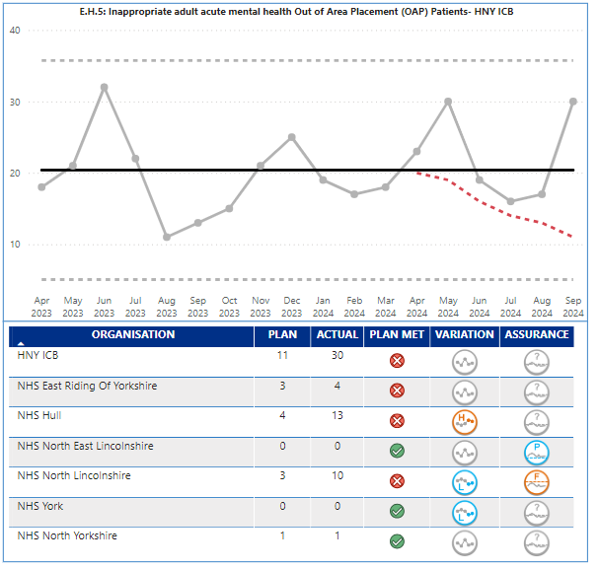
Adult Acute Out of Area
Placements
Key Indicator: Inappropriate OOA placements
Mental Health OOA Escalation Points
The target for 2023/24 related to out of area bed days; for 2023/24 the key performance indicator has changed to inappropriate acute out of area placements. There are other out of area placements that relate to rehabilitation that do not form part of this indicator. The performance in September was 30 against a plan of 11 – this is movement from 17 in August and puts performance back to April levels. The performance has shown no significant change in the last twelve months with variation around the midpoint and no consistent improvement.
There is variation at Place with majority of placements from North Lincs (10) and Hull (13), and at the time of the production of the report there are 2 unassigned patients.
Key Actions
Confirmation for the allocation of Sustainable Development Funding (SDF) has now been received and priorities for the funding have been agreed, these include recruiting additional centralised short term case management capacity, development of a community rehabilitation service in NL and expanding the Hull/ER older adult's community and crisis teams, as well as developing an additional 4 functional beds – this will support preventing older adults accessing adult acute wards.
Deep dive into PICU data and information underway to support a system wide business case to meet demand more locally within HNY
Inpatient oversight & assurance meeting took place 4th November.
The HNY OOA dashboard is updated with data from providers and Place and shows the monthly updated position for our OOA placements of all types including older adult acute, adult acute, PICU, and rehabilitation.
System wide rehabilitation referral panel introduced to prevent further inappropriate OOA placements – 6 referrals to date, 4 have been prevented accessing OOA beds with local solutions found and remaining 2 referrals still open to the panel.
Central OOA Audit panel commenced reviewing info provided by Independent Sector on individual placements – these are being categorised into CRFD in next 6 months- plans in place, CRFD in next 6 months – no plans in place and still in active treatment to prioritise limited clinical capacity.
LDA - proposed model in development and being explored to include the full HNY patch
There are 2 patients who had OOA that have not been assigned to a place at the time of production of the report
How does indicator link to long term priorities:
Reducing inappropriate out of area placements directly supports the ICB long term ambition of Transforming people’s health and care experiences and outcomes.
Transporting often vulnerable patient’s long distances out of area can often be poor experience and demonstrates a lack of local capacity and available services. It has also been identified as one of the ten key priorities due to financial impact of having to fund inpatient stays over and above existing contracted provision.
Notes:
Table subject to change depending on what detail is needed.
Consider keeping the original table for this slide and change the table header to the dark blue for consistency.

Slide 16

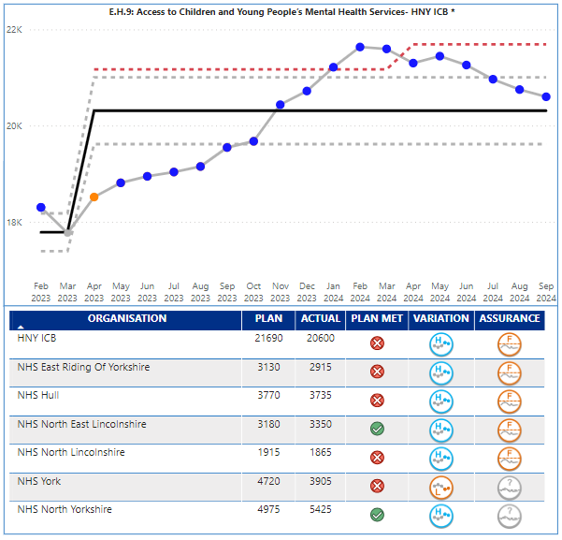
CYP Mental Health Services
Key Indicator: CYP MH Services
Access to Children’s & Young People’s MH Services
ICB actual performance for the number of CYP contacts in September was 20,600 against a plan of 21,690, and therefore below target. The provision made available has shown special cause variation of an improving nature; but is below the increased plan for 2024/25 and has seen consecutive monthly reductions in activity since May. All Places are showing improving positions except York; however, York and North Yorkshire targets need realigning following updates provided by TEWV.
It is recognised this indicator is only measuring activity, and there are other key measures that are not covered by the operating plan metrics, in particular waiting times and patients waiting over 12 weeks and outcomes e.g. the impact of the interventions. Work is underway to improve outcomes recording, and some of this information was shared with SOAG in October.
Key Actions
Develop the new HNY CYP MH strategic plan with improved emphasis on early intervention to increase access, reducing waiting times and improving waiting well initiatives (which will contribute to the CYP MH access target),reducing DNA’s, improving outcomes and addressing inequalities, which prevent early access for those most at risk of poor mental health. The plan will also deliver against the Core20plus5 for CYP. This work is currently underway with partners from health, LA and VCS. The plan will also be in line with the new NHSE CYP intensive MH support guidance to review & reconfigure community provision to reduce crisis/inpatient admissions.
Work underway to improve transition from CYP to adult services in line with NICE quality standards – needs led not age led.
Event undertaken in October with multi agency stakeholders to review whole pathway for CYP Eating disorders (early intervention, community CAMHS/eating disorder services and inpatient). Event was well attended and the actions from the event will be incorporated into the new HNY CYP MH Strategic plan
Finalise sign off on the increased investment in SDF for CYP MH to enable increased capacity in the system to return to the upward trend. The increased activity ambition for 2024/25 Operational Planning relates to national increases in CYP MH funding; this indicates a risk that the new 24/25 Operational Planning target will may not be achievable without the additional investment.
Further progress the work on the CYP MH dashboard to better understand and address the challenges in improving CYP MH access, witing times and outcomes. All currently NHS funded services now correctly flow data and so any increase in access in 24/25 is likely to be very limited without additional investment. Access should not be considered in isolation. Other key indictors to be included in reporting are waiting times and outcomes.
Working with CYP with Lived experience from the Nothing About Us Without Us advisory group and senior leaders across the system to coproduce solutions and implement recommendations from improving access to mental health services consultation. This will improve access and reduce waiting times.
How does indicator link to long term priorities:
Improved access to CYP Mental Health Services supports one of the ICB four big outcomes - enabling mental health resilience, as well as the golden ambition of radically improving the health and wellbeing of children and young people, which in turn helps improve healthy life expectancy.
All national data and evidence suggests that mental health and wellbeing is worsening across all age groups and communities; and that poor mental health can impact on physical health. Improved access to MH services at an early age is vital for the ICB to meet its long-term strategic ambitions.
Notes:
Table subject to change depending on what detail is needed.
Consider keeping the original table for this slide and change the table header to the dark blue for consistency.

Slide 17

Executive Summary
Appendices with further information relating to:
Non Access Indicators
NEY System Heatmap
Full list of operating Plan metrics
Ms Powerpoint Stock Images
Notes:
textbox
No alt text provided
image
No alt text provided
image
No alt text provided
shape
No alt text provided
shape
No alt text provided

Slide 18


The Indicators described in the quadrants below form part of the annual operating plan guidance but are picked up through other reporting routes. A high-level overview is provided on the following slides
Finance The following indicators are discussed at the Finance and Performance Committee, and escalated to the ICB Board via the Chief Finance Officer paper Deliver net system balanced position Reduce agency spend Deliver VWA activity total – Income Target The Board already receives a finance paper and so to avoid duplication, risks to delivery will be made direct to the Board through the finance paper and updates and escalations from the Finance and Performance Committee. | Workforce The following indicators will form part of the update to Finance and Performance Committee along with any necessary escalations to ICB Board from the Director of HR. Key indicators are described below, with further information on the following slides. Reduce workforce turnover – October 12.9% against target of 12.2% Reduce staff absence – October 5.0% against a plan of 4.8% WTE staff in post plan – October 34,396 against a plan of 33,622 Other measures: Improve working lives of doctors Provide sufficient clinical placements and apprenticeships
Prevention and Health Inequalities The following indicators are discussed at the Population Health and Prevention Committee along with a wider number of metrics. The Board will be updated via papers agreed at certain times in the year. Improve vaccination uptake for CYP (WHO) Deliver on the Core20Plus5 approach for adults, CYP | Quality The following indicators are discussed at the Quality Committee along with a wider number of other quality metrics. Updates on the quality agenda and these three operating plan metrics will be escalated to the Board direct from the Quality Committee. Implement 3 year plan for maternity and neonates Develop at least one women’s Health Hub Implement the patient safety incident response framework Papers and updates have been shared direct from Quality Committee and therefore to avoid duplication, risks to delivery will be made direct to Board from the Quality Committee.

Slide 19
Workforce
An assurance update on the Breakthrough HNY system workforce transformation programme is brought forward separately to ICB Board on a regular basis. In terms of workforce numbers, slides 37-39 provide an overview. Key messages and risks based on October intelligence are as follows:
Agency use continues to run well below plan for WTE (123.2WTE / 28.84% under plan) showing only slight deterioration on last month (+19.2 WTE). Cost of agency however is now above plan, driven by slight deterioration on last month (+£0.19m) in the context of a planned step down in spend (-£0.46m), resulting in a net £0.50m or 12.13% overspend in month. In turn this has increased the year-to-date spend gap to plan by £0.49m to £1.97m / 6.04% over plan. Spend gap to plan continues to be driven by market rates for medical agency running significantly above plan assumptions, creating a £5.05m pressure partially offset by significant underspends in some other workforce groups. Priority work on this issue is ongoing.
Bank use has improved in October at 172.3WTE / 13.6% over plan, an improvement of 97.5 WTE on last month. Having run close to plan in Q2, bank spend is £1.37m above plan in October driven by overspends at NLAG (+£0.61m) and Harrogate (+£0.60m). Bank spend above plan in Harrogate is not matched by equivalent growth in WTE and will be explored further. Across all providers, gap to planned spend on medical bank has significantly improved (now £0.10m) but overspends are showing in October across most other staff groups, leading to overall bank spend in year to October at £1.49m / 2.47% over plan. Plan profile for bank over Q3/4 is exceptionally challenging and further risks remain on both WTE use and spend across the winter period.
As previously reported, availability of the PAM dashboard has identified the need for two technical adjustments to planned substantive staff in post, which lifts the starting plan position by a total of 327WTE (212 NLAG; 115 YSFT). Using this adjusted baseline, substantive staff in post are 107.9WTE / 0.34% over plan as at October, an improvement of 7.3WTE on last month. This drives substantive paybill spend in October at £5.48m or 2.99% over plan. Planned spend on substantive paybill is ~£40m higher in October than previous or next month due to anticipated application of pay award; as a result of the higher plan profile the October position represents an improvement on % overspend compared to last month but a £2.29m deterioration in cash terms. Substantive paybill in year to October is £31.24m or 3.10% above plan.
Across all staff groups, WTE staff in post as at October are 485 WTE or 1.4% over plan, and paybill in year to October is £34.70m or 3.15% over plan.

Slide 20
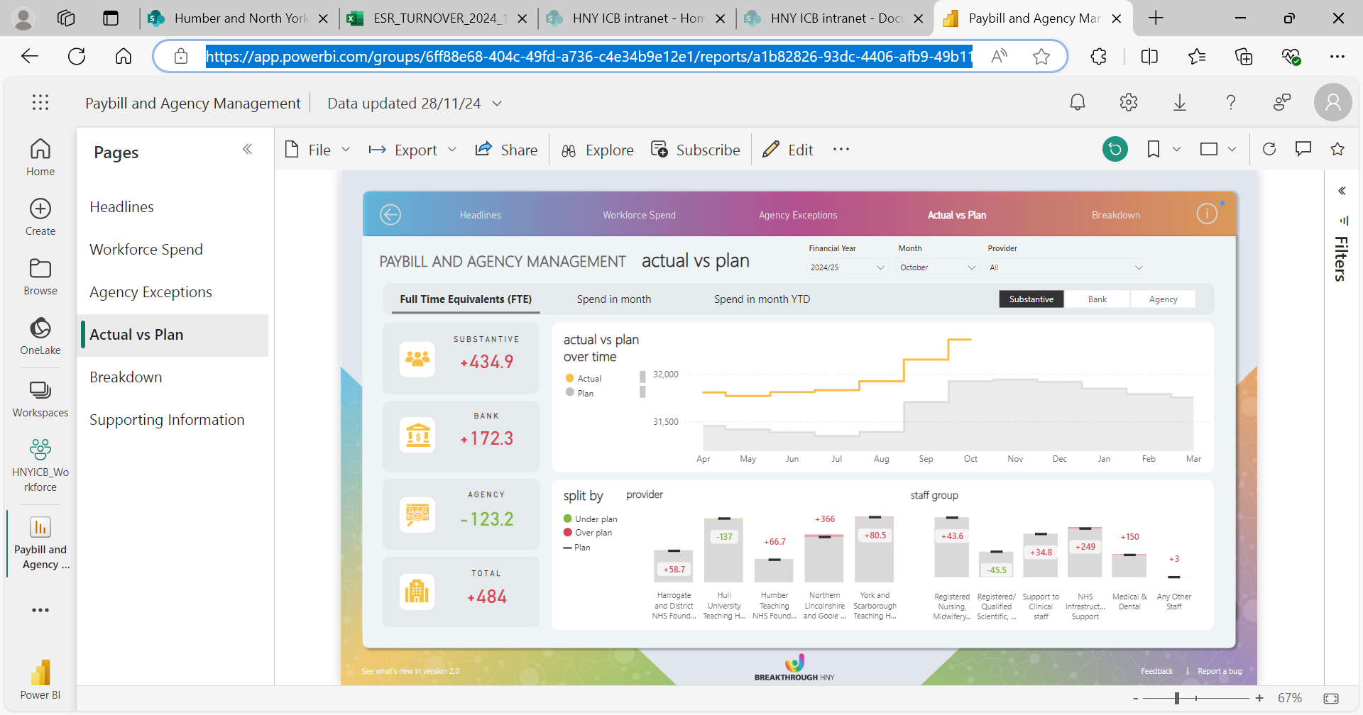
Workforce Summary

Slide 21
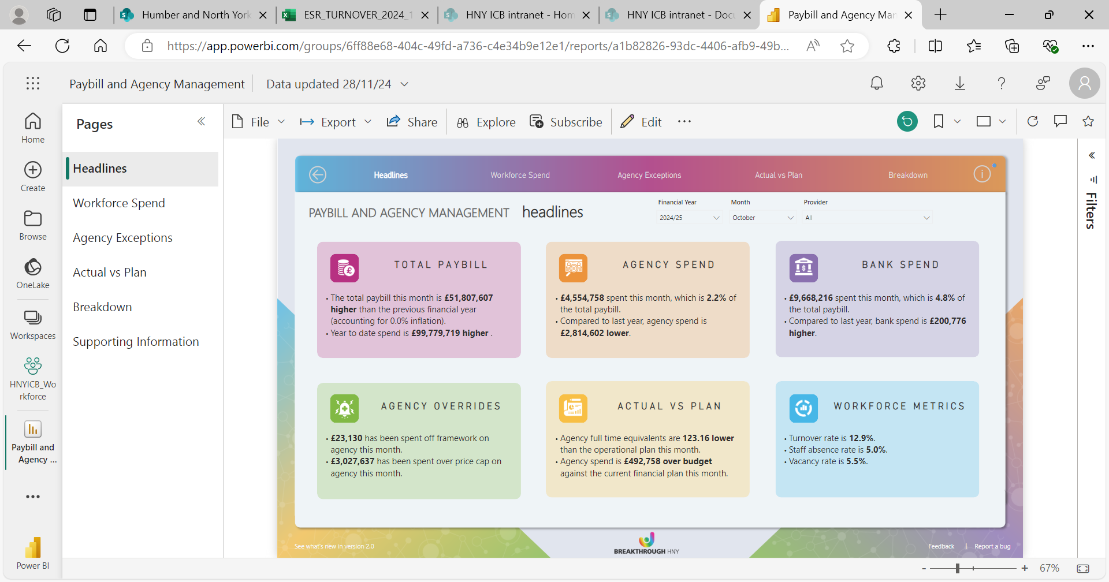
Workforce Summary (Cont.)

Slide 22
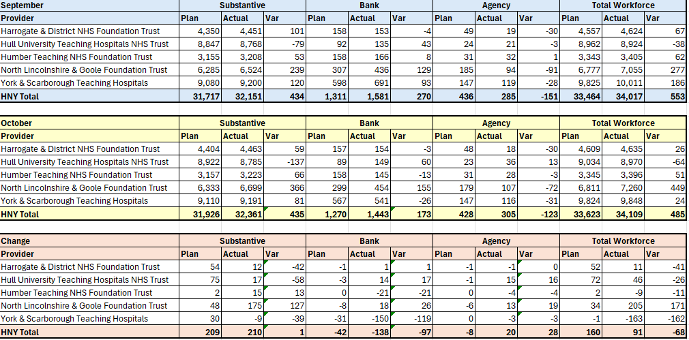
Workforce Summary

Slide 23
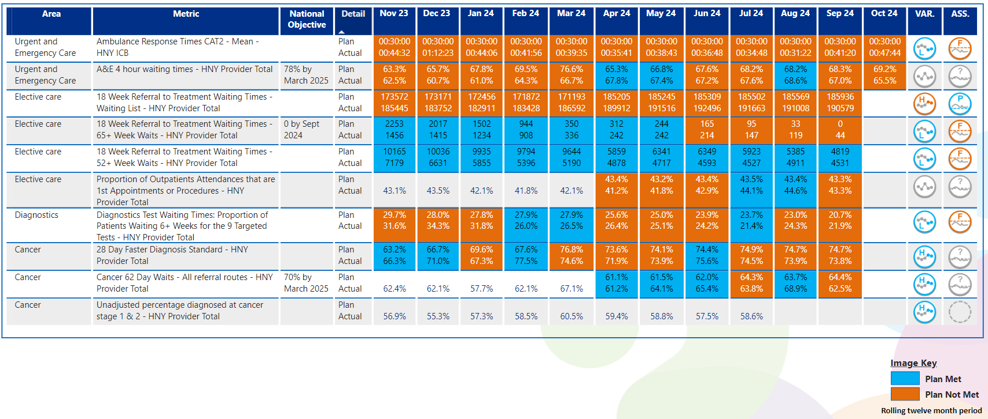
View by Month – Other Operating Plan Indicators
In line with Making Data Count recommendations, blue equals achieving, orange equals failing to achieve.

Slide 24
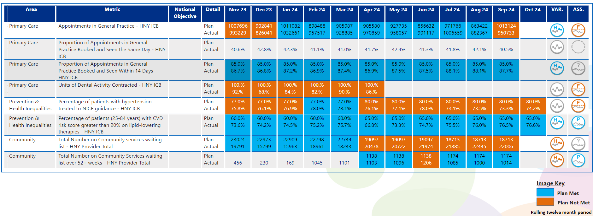
View by Month – Other Operating Plan Indicators
In line with Making Data Count recommendations, blue equals achieving, orange equals failing to achieve.

Slide 25
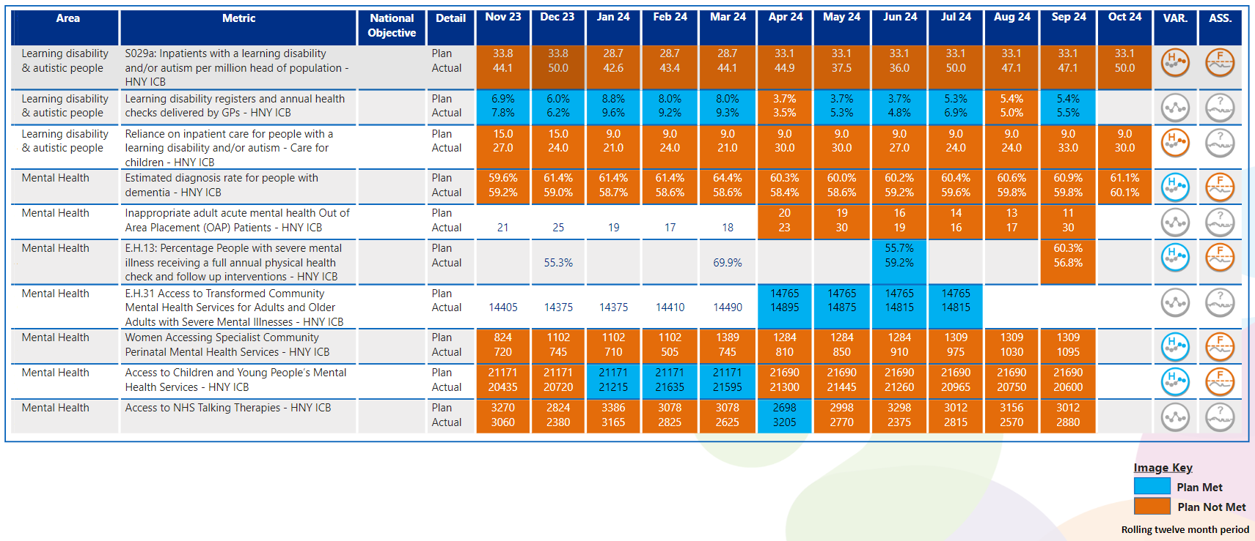

View by Month – Other Operating Plan Indicators
In line with Making Data Count recommendations, blue equals achieving, orange equals failing to achieve.

Slide 26



