Slide 1


ICB – Board
Annual Operating Plan - Performance Report
[Date: 12th March 2025]

Slide 2

Executive Summary
Introduction
The monthly ICB operating plan performance report is specifically concerned with the short term annual objectives related to the HNY ICBs Annual Operating Plan 2024/25. The report is a single part of a wider performance management framework across the ICB. The overall framework has width and covers a wide range of aspects of performance relating to themes such as quality of care, patient experience, operating plan access metrics, public health statistics, and health prevention data. It also has depth in that any of these themes are being considered at provider, place, in some cases condition level. The framework also considers time frames in that some performance expectations are measured daily, weekly, monthly whereas others are to be reviewed annually. These different aspects of performance do not sit in isolation; improving access to cancer services this year, goes hand in hand with ICB mid-term ambitions to increase engagement of vulnerable populations with cancer screening programmes, and reduce harm from cancer. Both support the long term aim of increasing healthy life expectancy. The report will demonstrate how these short term annual operating plan indicators support long term aims and ambitions of the ICB. It will describe the full list of indicators in the 2024/25 planning guidance but will focus on areas that have been identified as priorities by NHSE. A small number of indicators are better performance managed through other reporting mechanisms and these are identified in the report also. The report is supported each month with a deep dive into a theme along with Executive Director updates that will describe any escalations from sub committees.
Notes:
textbox
No alt text provided
image
No alt text provided
image
No alt text provided
shape
No alt text provided
shape
No alt text provided

Slide 3
HNY ICB Strategy, Planning and Reporting Framework

Slide 4
HNY ICB Strategy, Planning and Reporting Framework – Priority Indicators

Slide 5

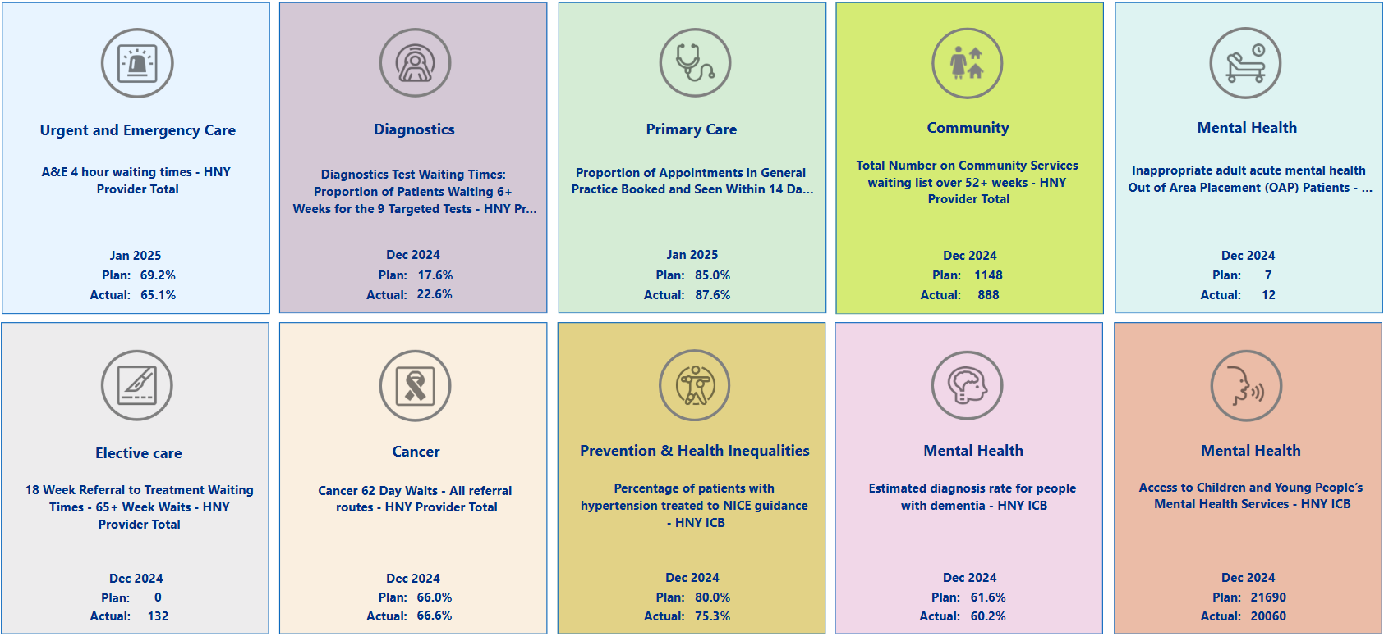
Summary Overview

Slide 6
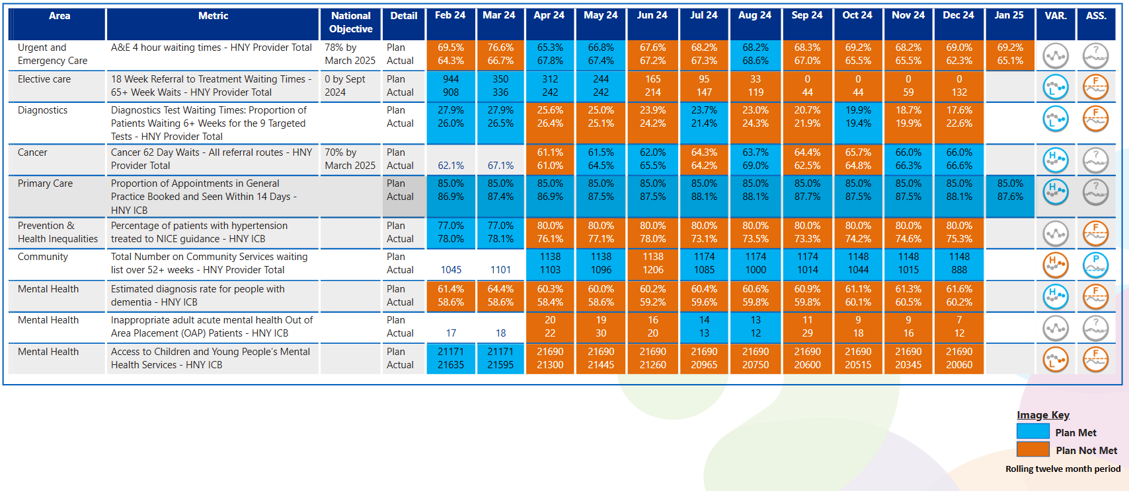
View by Month
In line with Making Data Count recommendations, blue equals achieving, orange equals failing to achieve.

Slide 7

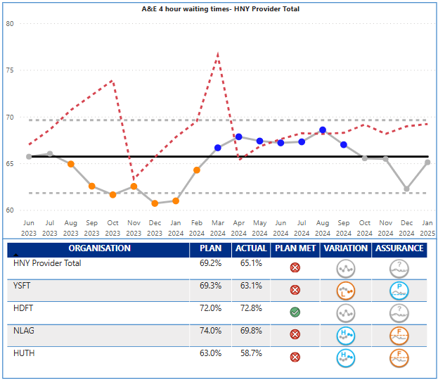
Urgent Care
Key Indicator: Waiting time in ED
Urgent Care Escalation Points
UEC 4-hour performance in January for the overall ICB system improved from 67% (Dec) to 69.9%. The UEC plan being monitored by NHSE is for the acute providers only and was set at 69.2% for December, and delivery was 65.1%. HUTH (58.7%) and Y&SFT (63.1%) were the lowest performing Trusts. UEC performance at HNY has been challenged by NHSE and the ICB is in national UEC Tier 2. HNY benchmarks adversely across NEY for other patient experience indicators related to urgent care such as time in department and ambulance handovers. The year end 4-hour target for the acute providers is 73.2% - ICB overall 78%. Trend is showing common cause variation with no significant change.
4-hour UEC Jan. – HDFT were the only trust to achieve target
All four trusts were showing an improved position in comparison to December
Ambulance response time cat 2 in January was 34:39 minutes compared to 52:07 in the previous month against a target of 30:00 minutes. HNY hospital handover performance has been singled out by YAS, EMAS and NHSE as of concern and as a result has triggered the successful 45-minute handover initiative.
Key Actions
NLAG has now gone live with W45, starting at 80 mins and moving to 60 mins from 26th March. Positive impacts so far but with some teething issues which are being addressed as they arise.
ICC Hubs – Evaluation in train and due to be complete by the end February to advise proposals for model during 2025/26
Active Capital works have commenced at York to reconfigure some areas of the ED and UTC to improve capacity, utilisation of space and flow
HNY now officially in Tier 1 for UEC and fortnightly meetings are now attended by National team. Visits by the national UEC team taking place at York and Hull on 4th and 5th March. Fortnightly meetings will be established with Harrogate
2025/26 UEC Plan in development with focus on the highest impact actions to drive improvement in the key metrics during 2025/26, taking learning from 2024/25. Focus on long waits in ED (reducing 12 hours in department), improving hospital flow and alternative pathways
BI team support to analyse biggest opportunities for performance improvement between January and March, identifying focuses interventions to support the achievement of 78% - Places and providers reviewing the data to identify opportunities for March to maximise performance
How does indicator link to long term priorities:
Patients across HNY use ED services as a way of accessing healthcare, we also know that patients from areas of high deprivation are high users of ED. Improving access to ED will therefore support all of the ICB strategic ambitions including the golden ambition of improving services for CYP.
Evidence suggests the longer patients wait in ED the worse the clinical outcome will be, and congestion in ED can lead to delays to ambulance handovers, meaning ambulances are not freed up to pick up other emergency cases, leading to further clinical risk.
Notes:
Table subject to change depending on what detail is needed.
Consider keeping the original table for this slide and change the table header to the dark blue for consistency.

Slide 8

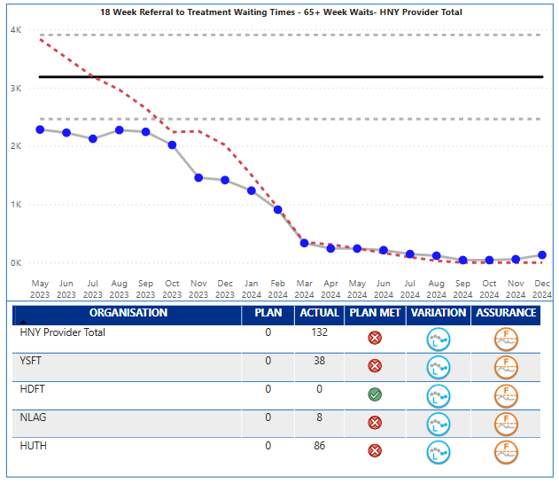
Elective
Key Indicator: RTT 65+ Week Waits
Elective Services Escalation Points
Elective waiting times over 65 weeks increased to 132 in December against a target of 0. The ICB continues to benchmark well in NEY and is the best performing ICB in the region on elective long wait metrics. Performance is outside expected control limits and demonstrates real cause variation of an improving nature. All providers have demonstrated significant progress, however December has seen an increase from the November position (59) and this reversal of trend is being monitored. The latest unvalidated data is forecasting the January position as 183 with risks in Neurology, Plastic Surgery and ENT. The accompanying performance target is total waiting list size which has shown a further reduction from November.
Key Actions
ENT – Day case rate for paediatric tonsillectomy has been achieved for the system. Audiology work has started, looking initially at >18 asymmetric hearing loss, tinnitus and micro suction requirements. Eyecare – Cataract referral SPOA Business Case approved by Elective Board and ICB. Business case for Glaucoma pilot approved by tactical ops, due to commence in March ‘25.
Orthopaedics – Post operative videos will be implemented across HNY for knee arthroscopy by March ‘25, with other specialties trialling, this will reduce need for follow up appointments. All Trusts working to GIRFT standardised pathways for ACL Reconstruction, Bunions, Adult Hand Surgery and Therapeutic Shoulder Arthroscopy. These can now be shared with ISPs for implementation.
Theatres – Trusts continue to work to improve data quality, 3 Trusts now reporting theatre utilisation on model hospital. Golden Patient Project underway to ensure theatres start on time and to improve utilisation, all SOP’s etc to be in place for implementation April ‘25.
Outpatients – Clinical booking rules comparison started across the above specialties. Recruitment of joint medical and clinical lead successful.
Perioperative – OTD cancellations data analysed and actions agreed in the network for improvement. Draft pathway developed to support default to daycase for the 29 HVLC procedures. New clinical Chair appointed.
Coding – A theme running through all of the networks, meeting scheduled to understand issues and request coding colleagues attend some of the clinical networks moving forwards.
How does indicator link to long term priorities:
Access to planned care elective services supports primary care and urgent care as delays can lead to patients seeking alternative routes to treatment or return to primary care to raise concerns. If not managed for risk, delays to elective care can also affect patient outcomes and certainly affect patient experience, if the condition is one that worsens over time. There are also social impacts to delays that may affect patient’s ability to work. Access to elective services affects all of the ICB strategic ambitions and long term aims. The ICB has made significant investment in elective care through ERF and £80m on IS capacity.
Notes:
Table subject to change depending on what detail is needed.
Consider keeping the original table for this slide and change the table header to the dark blue for consistency.

Slide 9

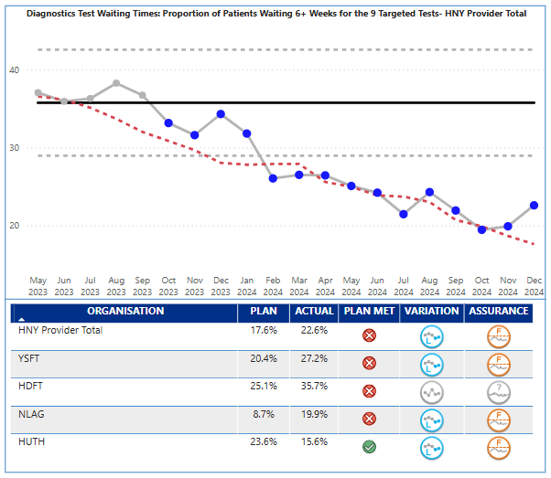
Diagnostics
Key Indicator: Waiting time for tests
Diagnostics Services Escalation Points
Diagnostic 6-week performance was 22.6% in December against a plan of 17.6%; statistically performance is demonstrating special cause variation of an improving nature, however, two consecutive months have shown performance worsening.
The NHSE plan for diagnostic waiting times is based on 9 key tests. The number of patients waiting over 6 weeks for the 9 tests was 8342 in November and rose by 1,531 patients to 9,873 in December. The modalities demonstrating the highest growth were NOUS (745) and MRI (630). The majority of the over 6 week waits are in the following modalities – MRI (2,679), NOUS (2,245), Echo (1,227), Audiology (1,199), Colonoscopy (849), CT (811), DEXA (530). The overall waiting list size has grown as well as the over 6 week position and this will be raised at the Diagnostic programme board. From a provider perspective, only HUTH achieved plan in December.
Key Actions
CDC: Programme continues to support activity across HNY. Whilst activity increased in January and was at record levels, as the plan increases the gap between plan and actual continues to grow.
Meetings with Trust finance leads have taken place to understand Q4 24/25 position.
Scunthorpe CDC opening date has changed and is now 4 March 2025. Grimsby go-live has moved slightly back to 11 March 2025 to avoid a clash with Scunthorpe. Scarborough and Hull are due to open in Q1 25/26 and NHSE are aware.
Overview of revenue allocations for 25/26 received from NHSE and trusts are reviewing.
Trusts are planning to complete C&D exercise by modality for assessment of delivery of 12/7 Elective Reform Plan
Endoscopy: HUTH Capacity remains a concern. 71% of patients across the system >6 weeks sit within HUTH. Position might deteriorate further and presentation delivered at Feb Dx board highlighting the proportion of core-work.
ERCP: Awaiting funding confirmation to appoint ERCP clinical lead. Regional Service development paper updated following national guidance. Presented at Feb Dx board asking to progress to Case for Change upon appointment of Clinical Lead.
Minimally Invasive Service Development – Presented at Feb Dx Board - Request for initial funding to establish service in south of system to provide an alternative for HUTH long-waiting patients. - HNY Clinical Lead for Endoscopy recruited.
Imaging: Revised Governance framework socialised at governance group (14/01). Presented at steering group, with agreement in principle gained (04/02). Approved at Diagnostics Programme Board (07/02).
AI MSK: Contract signed 12/2/25, YSTHFT project deployment on-going. Phase 1 Projected go-live 28/3/25. Risk to Phase 2 deployed within HHP due to stakeholder buy-in.
DDCP: Deliverables by March 31st 2025 (as outlined in MOU) are unlikely. Funding secured for FY25/26. Governance Structure agreed. Trust prioritisation on-going with project stand-ups to follow.
GIRFT Imaging Visit held 23rd January. Shared practice included the HNY procurement collaborative, shared mobile assets & DRAD 2-Year accelerated radiology course, awaiting final feedback report.
Audiology: NLaG data now received and analysis underway. Project resource identified to commence workshop and recovery opportunities aligned to the Elective Reform Plan
Workforce: Ewan Cameron commended as Dx Programme Director
How does indicator link to long term priorities:
Quick access to diagnostic services supports primary care, urgent care, elective care and cancer service delivery targets. Early supported diagnosis therefore supports all of the ICB strategic ambitions.
longer waits for diagnosis can affect cancer outcomes, as well as added delay to planned care pathways. Patient experience of care can be affected by delays to diagnosis.
Notes:
Table subject to change depending on what detail is needed.
Consider keeping the original table for this slide and change the table header to the dark blue for consistency.

Slide 10

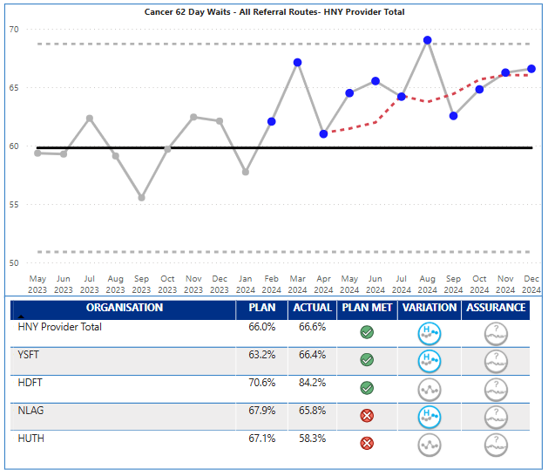
Cancer
Key Indicator: 62 day waits
Cancer Services Escalation Points
In 2024/25, the priority is to deliver a 70% performance on the 62-day cancer wait time target. December performance was 66.6% against a plan of 66.0% therefore just above target. Performance is showing common cause variation of an improving nature which reflects the significant improvement seen since January 24. There is however variation in performance.
HDFT (84.2%), and Y&SFT (66.4%) achieved monthly targets and Y&SFT demonstrated special cause variation of an improving nature. The ICB as a whole and HUTH and NLAG as individual providers, are in NHSE Tier 1 category for Cancer.
Key Cancer Alliance Actions in January 25:
Awareness & Early Diagnosis: Referral Form Optimisation process agreed with ICB Clinical Effectiveness Unit. Primary Care Cervical Screening financial allocations agreed with NHSE PH team. Two PCNs appointed with one actively recruiting for Cancer Care Coordinator Pilot.
Cancer Diagnostics and Innovation: All funding transferred to 11 grant schemes for 2024/25. 15 people screened at HHP with 2 being prepped for trial in Bowel Cancer Vaccine Trial.
Nursing and AHP: Education and Development Infogram built and undergoing design refinement. Quality Report drafted and first amendments made based on feedback from programme teams.
Comms & Engagement: Experience of Care agreement from HHP Trust Lead Cancer Nurse and CNS leads to progress a mini CPES pilot project.
Health Inequalities: Cancer Risk Matrix created for prioritisation of groups most at risk of health inequality and highest cancer risk. ER Place Cancer HI Action Plan launched with ER Place team.
Lung Health Check: Provisional plan for delivery of LHCs at HMP Hull in 2025 developed.
Non-Surgical Oncology: Capacity and demand report findings presented to Oversight and Assurance and NSO CDG, including topline findings.
Treatment, Pathways and Personalised Care: NEY HPB Network launched with good attendance and engaged discussions across specialties. Observed Lung & UGI MDT meetings at YSTHFT as part of MDT Streamlining work.
How does indicator link to long term priorities:
Quick access to cancer diagnostic and treatment supports all of the ICB strategic ambitions, in particular reducing harm from cancer, and long term improvement in Healthy Life Expectancy.
longer waits for treatment can affect cancer outcomes, and overall patient experience of care. NHSE will be scrutinising performance in this indicator and it forms part of the NHSE Oversight Framework and Tiering process. Delivery is supported by the Cancer Alliance.

Slide 11

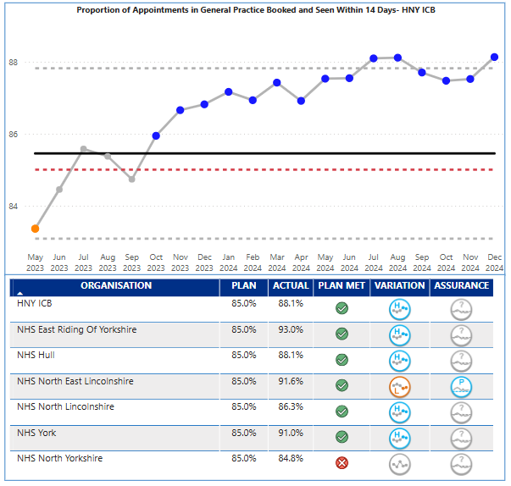
Primary Care
Key Indicator: Booked within 14 days
Primary Care Escalation Points
HNY December performance has delivered 88.1% against the 85% target for 14-day booking. Performance has been closer to and just over the upper control limit and demonstrating special cause variation of an improving nature.
Performance differs by place; East Riding 93%, NE Lincs 91.6%, York 91%, Hull 88.1%, North Lincs 86.3%, North Yorks 84.8%. All places delivering the target except North Yorks.
Primary care met the December target for appointments delivered. The overall trend is showing special cause variation of an improving nature. North-East Lincs, York and North Yorkshire did not meet their individual plans for December.
Expectations in the operating plan are to recover dental levels of provision to pre pandemic levels, this is currently not being achieved.
Key Actions
The ICB has agreed a mitigation with GP Practices to extend any LES notice periods to 31st March 2025 whilst the LES review is completed
How does indicator link to long term priorities:
Primary care is singularly, the most used service in healthcare and is the entry point for many other services. It is therefore key to all of the ICB strategic ambitions, and long term aims.
Actual Inability or perceived inability to access primary care (and dental services) can lead to patients either incorrectly using emergency services, adding pressure there, or reluctance to engage with healthcare at early stages of symptoms. Patient experience and outcome can be affected by these delays which is why improved access to primary care is vital.
Notes:
Table subject to change depending on what detail is needed.
Consider keeping the original table for this slide and change the table header to the dark blue for consistency.

Slide 12

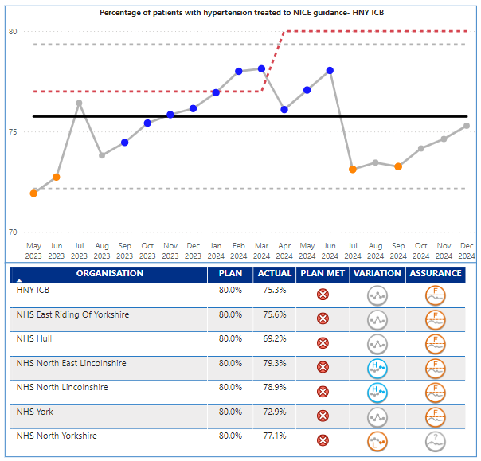
Prevention and Health Inequalities
Key Indicator: % Hypertension NICE Guidelines
December 2024 performance was 75.3% against a target of 80%. The performance is showing a common cause variation of no significant change. No place achieved their plan in December and there is a range of delivery from 69.2% in Hull to 79.3% in NE Lincs. The volume of patients being treated (numerator) is higher than previous years as is the number of diagnosed patients with hypertension (denominator) which has increased at a higher rate and therefore affects the performance. Increasing diagnosed prevalence of hypertension is a key objective of the CVD programme and the metric may be reflecting the success of a number of projects that aim to improve opportunistic testing.
Key Actions
Communication sent to all PCN’s CD and managers with current treatment to target data against previous years attainment to help drive QOF attainment in Q4, with offer of support to practices from the CVD Clinical Leads and programme leads.
CVD prevention sessions delivered through GP PLT’s/ PCN meetings at Place by clinical leads and CVD programme managers.
Optom and dental hypertension case finding pilots (focus on communities with high deprivation and improving access in areas of rurality) continues.
Working with Community Pharmacy Engagement Leads across the system to improve relationships with GP practices promote collaborative working on hypertension case finding (and Pharmacy First services)
IP pathfinder hypertension treatment pathway continues across 11 sites across the ICB
Two workplace health check pilots running in NY and ER, due for completion Mar 25. ​
Opportunistic hypertension case finding - HIN led BP Check Train the Trainer Model continues to be delivered to partners across the system e.g. LA and VCSE organisations building on MECC approach.
Scoping of opportunity to implement CVD community champions model across ICB continues – funding confirmed from NYC to support development of this model alongside improved council led health and wellbeing offer, recruitment into project lead post will start in March 24.
Hypertension primary care toolkits currently being developed to support case finding, coding and management in primary care. ​Scheduled for launch in March 2025.
NL CVD Outreach project in Scunthorpe (focus on hypertension opportunistic testing) implemented, will report on updates on progress. ​
Addressing variation at Place: programme of work underway in Hull in response to Hull being the only ICB Sub Place that didn’t meet the hypertension treated to NICE guidelines in 2023/24.
Exploring opportunities to better understand the prevalence of complex hypertension in HNY, the scale of any associated issues/ challenges and existing pathways and feed into regional workshop.​
Secured £110,000 to undertake behavioural insight work – engagement with VCSE collaborative and provider organisations due to start end of Feb and early March, key lines of enquiry for workshops and surveys under development.
How does indicator link to long term priorities:
Improved the % of patients with hypertension being treated following NICE Guidelines supports several strategic ambitions and outcomes such as reducing CVD; and enabling wellbeing health and care equity. It also has a direct link to the long-term ambition of improving healthy life expectancy.
1 in 3 adults has hypertension, which in turn can lead to heart disease, stroke and kidney disease, it is also linked to deprivation, and socioeconomic factors can be markers. This suggests that improving the care and treatment and prevention of hypertension could reduce the gap in healthy life as well..
Notes:
Table subject to change depending on what detail is needed.
Consider keeping the original table for this slide and change the table header to the dark blue for consistency.

Slide 13

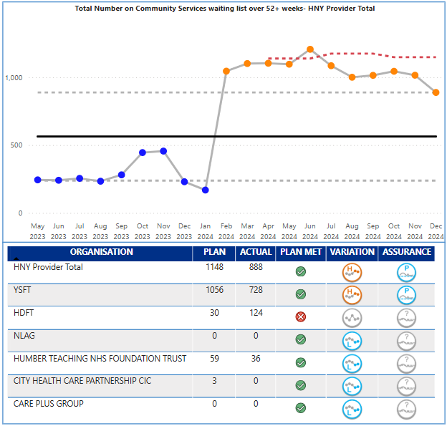
Community Care
Key Indicator: Waiting List over 52+ Weeks
Community Care Escalation Points
The priority indicator for community waiting times in the operating plan is patients over 52 week waits. The latest data available is December 2024, which saw 888 patients wait over 52 weeks for community services against a plan of 1,148. This is an improvement from November (1015), however the data is continuing to show Special Cause variance of a concerning nature. There is variation across providers and services. HDFT were the only provider over plan this month, at 124. Y&SFT (728), HDFT (124) and Humber Teaching FT (36) had the highest number of breaches.
At a service level, 675 (700 last month) of the 888 patients over 52 weeks are in CYP Speech & Language service, 643 of which are at Y&SFT, though an improvement of -3.01% by Y&SFT from the previous month. HDFT pressures are mainly in Nursing Therapy Support for LTC: Respiratory/COPD service, Rehabilitation Services (integrated), Therapy Interventions (Speech & Language, and Dietetics) – 106 in total. Overall waiting list size stands at 18,775, a decrease of 1,371 from November. Trend wise, the waiting list size is showing significant change of a concerning nature.
Key Actions
Work continues with the regional team to validate CHS SitRep data. An exercise has been undertaken to compare CSDS submissions against CHS returns which has been distributed to providers for commentary. Responses will be collated first week of March for presentation back to the regional recovery group and variation worked through.
The community baselining exercise associated with the System Change and Transformation work (PID 2) is due to conclude at the end of February, and the returns will be used as a basis to overlay against the validation exercises.
Development of a regional wide access policy / set of principles is being drafted with input from the HNY Community Collab and the CYP transformation team. An update will be brought to the Collab Board.
To note, NLaG have recognised a 213% reduction in their total MSK community waiting list as a result of Connect Health taking over as the primary contract provider for North Lincs MSK and Pain services from 01 January 2025.
Long wait improvement initiatives within CYP are being monitored via the Start Well Board.
How does indicator link to long term priorities:
Community services play a key role in delivering several of the ICBs long term ambitions and outcomes; in particular the golden ambition to radically improve the health and wellbeing of children and young people, and outcome measure of living with frailty.
Community services are a key support to patients with long term conditions in particular, they support primary and secondary care by being an alternative provision, but also are key to future innovations in pathway redesign, of which virtual ward is an example. The structure of community services forms part of the ten priorities for 2024/25
Notes:
Table subject to change depending on what detail is needed.
Consider keeping the original table for this slide and change the table header to the dark blue for consistency.

Slide 14

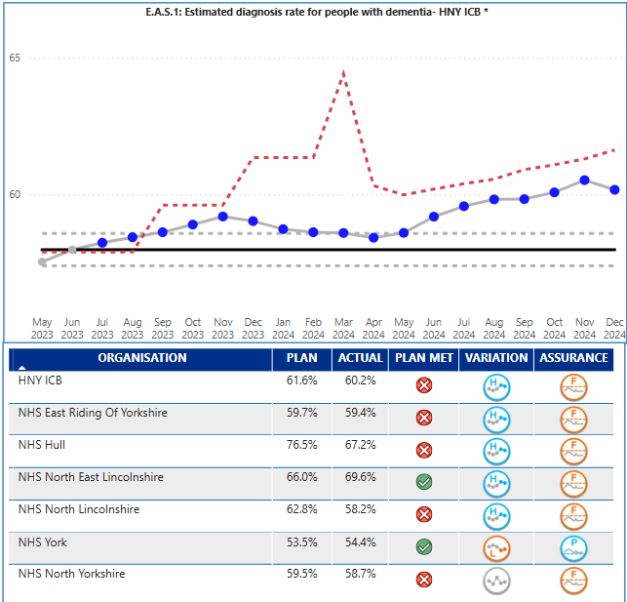
Dementia
Key Indicator: Dementia Diagnosis Rate
Dementia Escalation Points
The dementia diagnosis rate for the ICB in December was 60.2%, which is below the ICB plan target of 61.6%. Performance is consistently at or above the upper control limit and therefore demonstrates special cause variation of an improving nature. However, the ICB remains adrift from the national target and planning expectation of 66.7%, and the ICB target for 2024/25 of 62.5% by March 2025.
Performance is variable across the Places within the ICB; NE Lincs 69.6%, Hull 67.2%, East Riding 59.4%, North Yorks 58.7%, North Lincs 58.2%, and York 54.4%. NE Lincs, North Lincs, Hull and East Riding are all showing special cause variation of an improving nature. York did achieve plan, but they are showing special cause variation of a concerning nature.
Key Actions
NYY/TEWV & HTFT/ER are now mobilising plans to address long waits and low DDR, and Navigo/NEL to reduce backlog of assessments and reviews. HTFT have appointed to their B5 development post which will assist in improving wait times for diagnosis, with a start date of mid-April, and TEWV staff are also expected in post in April.
Quality Improvement Audit of GP registers remains underway to identify barriers to DDR and timely diagnosis – stocktake of current findings planned for late Jan 25.
Work underway to engage with North Yorkshire practices and gain their support for the completion of the audit work.
NL Primary Care MCI-follow up pilot model in partnership with Alzheimer’s Society – aims to identify those with MCI at risk of developing dementia to ensure timely access to assessment, diagnosis and support. New brain health advisor in post who has been meeting with GP surgeries to offer support and reviews for people with existing MCI diagnosis.
High volume of referrals rejected by the MAS teams due to lack of information and/or lack of patient consent for referral (up to 2/3 in Hull & ER – many not then referred back to MAS). Being addressed through review of referral process.
How does indicator link to long term priorities:
Improving Dementia Diagnosis Rate directly supports the ICB long term ambition of Transforming people’s health and care experiences and outcomes.
Earlier diagnosis of often vulnerable patient’s empowers patients and their families and carers to take control of their situation, leading to better management of the disease, better time to plan and therefore an enhanced quality of life.
Notes:
Table subject to change depending on what detail is needed.
Consider keeping the original table for this slide and change the table header to the dark blue for consistency.

Slide 15

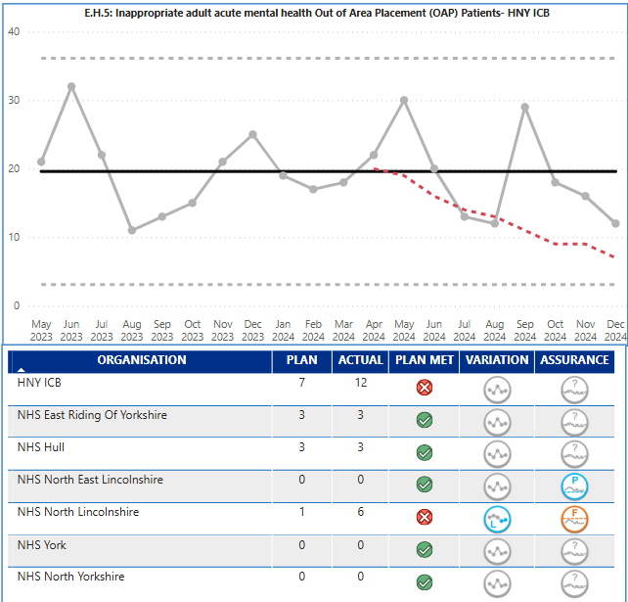
Adult Acute Out of Area
Placements
Key Indicator: Inappropriate OOA placements
Mental Health OOA Escalation Points
The key indicator for out of area placements in 2024/25 is the number of inappropriate adult acute placements (previously bed days). There are other out of area placements that relate to rehabilitation that do not form part of this indicator. The performance in December was 12 against a plan of 7. The performance has shown no significant change in the last twelve months with variation around the midpoint and no consistent improvement.
There is variation at Place with majority of placements from North Lincs (6) and East Riding (3) and Hull (3). North Lincolnshire are the only Place currently not achieving the planned target.
Key Actions
Draft CV developed for community rehab service in NL with 12 individuals identified for repatriation across 25/26.
Deep dive into PICU data and information underway to support a system wide business case to meet demand more locally within HNY
Recruitment to extend Hull/ER’s older adults community and crisis teams underway
National capital funding been made available to systems to support OOA reduction – currently gathering options from providers
Inpatient oversight & assurance meeting to take place 3rd March 2025
The HNY OOA dashboard is updated with data from providers and Place and shows the monthly updated position for our OOA placements of all types including older adult acute, adult acute, PICU, and rehabilitation.
System wide rehabilitation referral panel continues to prevent further inappropriate OOA placements
Newly introduced clinical case discussion forums across HNY to drive facilitation of discharge plans.
Introductory meeting with independent sector taking place 25th February to commence market development work
Reflection and future planning event taking place 6th May with all stakeholders
How does indicator link to long term priorities:
Reducing inappropriate out of area placements directly supports the ICB long term ambition of Transforming people’s health and care experiences and outcomes.
Transporting often vulnerable patient’s long distances out of area can often be poor experience and demonstrates a lack of local capacity and available services. It has also been identified as one of the ten key priorities due to financial impact of having to fund inpatient stays over and above existing contracted provision.
Notes:
Table subject to change depending on what detail is needed.
Consider keeping the original table for this slide and change the table header to the dark blue for consistency.

Slide 16

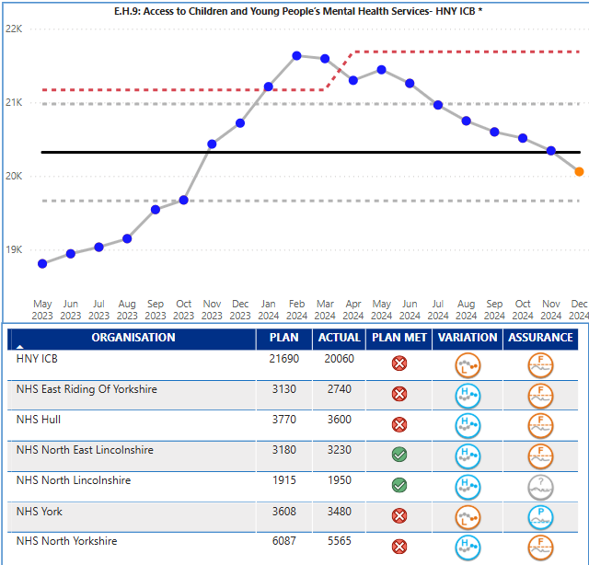
CYP Mental Health Services
Key Indicator: CYP MH Services
Access to Children’s & Young People’s MH Services
ICB actual performance for the number of CYP contacts in December was 20,060 against a plan of 21,690, and therefore below target. The provision made available has shown special cause variation of a concerning nature; CYP access is below the increased plan for 2024/25 and has seen consecutive monthly reductions in activity since May. It is recognised this indicator is only measuring activity, and there are other key measures that are not covered by the operating plan metrics, in particular waiting times and patients waiting over 12 weeks and outcomes e.g. the impact of the interventions. Work is underway to improve outcomes recording.
Key Actions
Deep dive into data - Work is underway with CYP MH place leads and provider BI leads/managers to undertake a deep dive into the data as in a number of areas there are concerns about accuracy of the data flowing to MHSDS. In Hull/East Riding this is due to transfer from Lorenzo to System one. Also, there are still some providers not yet flowing data correctly.
Develop the new HNY CYP MH strategic plan by April 2025 with improved emphasis on early intervention to increase access, reducing waiting times and improving wellbeing while waiting initiatives (which will contribute to the CYP MH access target),reducing DNA’s, improving outcomes and addressing inequalities, which prevent early access for those most at risk of poor mental health. The plan will also deliver against the Core20plus5 for CYP. This work is currently underway with partners from health, LA and VCS. The plan will also be in line with the new NHSE CYP intensive MH support guidance to review & reconfigure community provision to reduce crisis/inpatient admissions.
Mapping of capacity in services to meet need/achieve access target is underway as part of the forward plan development. However, even if the access target is achieved it will only meet the needs of approximately 1/3 of those CYP needing a mental health intervention. Lack of funding for/access to early intervention services means when CYP do access there is higher level of acuity, so CYP stay in services longer. Most services report being at capacity and numbers of CYP waiting for first contact (over 2,500) and those waiting more than 12 weeks to be seen (over 900) are increasing. Also, numbers presenting at A&E remain high with many not already accessing mental health services.
Sign off on the increased investment in SDF for CYP MH to enable increased capacity in the system to return to the upward trend. This has now been signed off however the delay has impacted on access. The funding was due to commence in September 2024 but will now commence in January 2025 for some projects and April 2025 for others where additional recruitment is needed so access data from this increased capacity in the system is unlikely to flow until April 2025 – June 2025. The increased activity ambition for 2024/25 Operational Planning relates to national increases in CYP MH funding which has not been realised. The new forward plan will include a costed plan for improved access with a focus on early intervention so when additional funding becomes available or though revising focus of current funding, we can improve access for CYP at the earliest opportunity with the aspiration that no CYP should wait more than 4 weeks for an intervention.
How does indicator link to long term priorities:
Improved access to CYP Mental Health Services supports one of the ICB four big outcomes - enabling mental health resilience, as well as the golden ambition of radically improving the health and wellbeing of children and young people, which in turn helps improve healthy life expectancy.
All national data and evidence suggests that mental health and wellbeing is worsening across all age groups and communities; and that poor mental health can impact on physical health. Improved access to MH services at an early age is vital for the ICB to meet its long-term strategic ambitions.
Notes:
Table subject to change depending on what detail is needed.
Consider keeping the original table for this slide and change the table header to the dark blue for consistency.

Slide 17

Executive Summary
Appendices with further information relating to:
Non Access Indicators
NEY System Heatmap
Full list of operating Plan metrics
Ms Powerpoint Stock Images
Notes:
textbox
No alt text provided
image
No alt text provided
image
No alt text provided
shape
No alt text provided
shape
No alt text provided

Slide 18


The Indicators described in the quadrants below form part of the annual operating plan guidance but are picked up through other reporting routes. A high-level overview is provided on the following slides
Finance The following indicators are discussed at the Finance and Performance Committee, and escalated to the ICB Board via the Chief Finance Officer paper Deliver net system balanced position Reduce agency spend Deliver VWA activity total – Income Target The Board already receives a finance paper and so to avoid duplication, risks to delivery will be made direct to the Board through the finance paper and updates and escalations from the Finance and Performance Committee. | Workforce The following indicators will form part of the update to Finance and Performance Committee along with any necessary escalations to ICB Board from the Director of HR. Key indicators are described below, with further information on the following slides. Reduce workforce turnover – January 12.8% against target of 12.2% Reduce staff absence – January 5.2% against a plan of 4.8% WTE staff in post plan – January 34,300 against a plan of 33,484 Other measures: Improve working lives of doctors Provide sufficient clinical placements and apprenticeships
Prevention and Health Inequalities The following indicators are discussed at the Population Health and Prevention Committee along with a wider number of metrics. The Board will be updated via papers agreed at certain times in the year. Improve vaccination uptake for CYP (WHO) Deliver on the Core20Plus5 approach for adults, CYP | Quality The following indicators are discussed at the Quality Committee along with a wider number of other quality metrics. Updates on the quality agenda and these three operating plan metrics will be escalated to the Board direct from the Quality Committee. Implement 3 year plan for maternity and neonates Develop at least one women’s Health Hub Implement the patient safety incident response framework Papers and updates have been shared direct from Quality Committee and therefore to avoid duplication, risks to delivery will be made direct to Board from the Quality Committee.

Slide 19
Workforce
An assurance update on the Breakthrough HNY system workforce transformation programme is brought forward separately to ICB Board on a regular basis. In terms of workforce numbers, slides 37-39 provide an overview. Key messages and risks based on January intelligence are as follows:
Agency use continues to run well below plan for WTE (74.9WTE / 18.9% under plan) and showing a reduced position compared to last month (December was 110wte under plan). Cost of agency has fallen below plan from December into January producing an in-month position of £0.3m or 0.1% under plan. Year-to-date spend is remains above plan but with the gap reducing to £2.4m / 5.5% over plan; this continues to be driven by market rates for medical agency running significantly above plan assumptions, showing an increased pressure to £6m for M10, partially offset by a £3m year to date underspend in nursing, midwifery and health visiting staff. Priority work on this issue is ongoing.
Bank use continues to run above plan for WTE with a increased use from December (175wte above plan) into January, M10 (306wte/19.8% above plan. The increase in in-month spend in October due to pay award has stabilised, but reducing plan profile means spend is still £0.46m over plan in month. M10 costs for both Registered Nursing and Medical Staff bank have increased in month from £0.24m to £0.31m, and £0.13m to £0.32m receptively. Overall Total bank spend is £0.22m or 2.6% above plan. This is driven by overspends in medical (£2m), STT (£1.1m) and nursing, midwifery and health visiting (£1m) staff groups, partially offset by underspend in support to clinical staff. Plan profile for bank over Q4 remains exceptionally challenging and further risks remain on both WTE use and spend across the winter period and as we see an increase in staff sickness.
As previously reported, availability of the PAM dashboard has identified the need for two technical adjustments to planned substantive staff in post. One of the issues has now been resolved Taking into account the remaining issue the starting plan position needs to be uplifted by a total of 212WTE (NLAG). Using this adjusted baseline, substantive staff in post are 372.5.4WTE / 1.2% over plan as at January. However, substantive paybill spend in M10, although still above plan, has seen a deteriorating position to £7.8m overspent (as opposed to Decembers £6.7m overspend). Substantive paybill in year to January is £57.5m or 3.8% above plan.
Across all staff groups, WTE staff in post as at January are 816.1WTE or 2.3% over plan, which reduces to 504.1WTE or 1.8% over plan when adjusted for the issue with the baseline for NLAG. The paybill in year to January is £62.7m or 3.8% over plan.

Slide 20
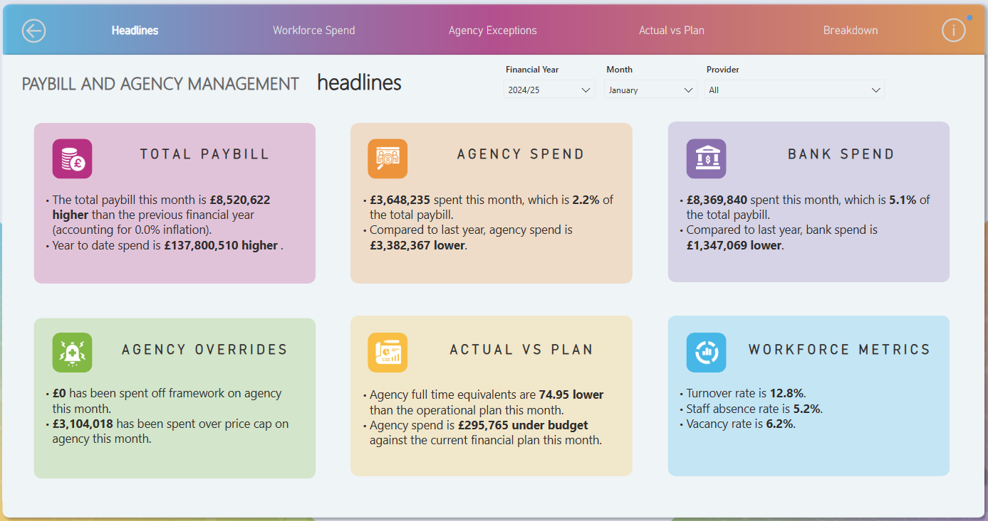
Workforce Summary

Slide 21
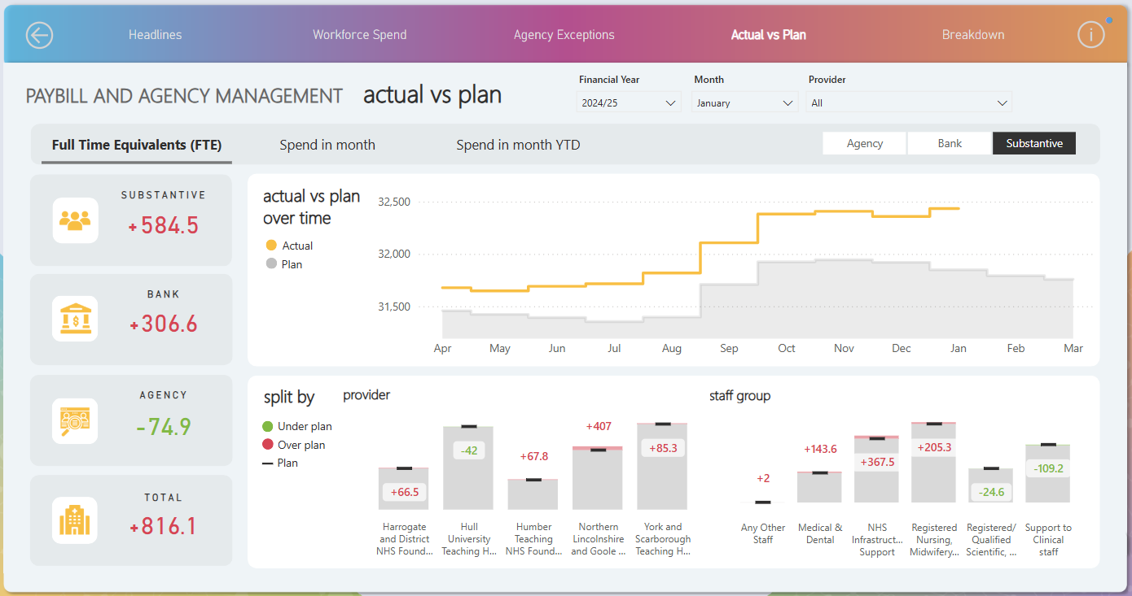
Workforce Summary (Cont)

Slide 22
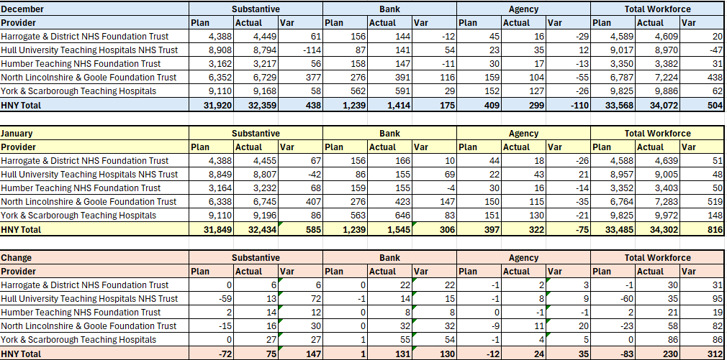
Workforce Summary

Slide 23
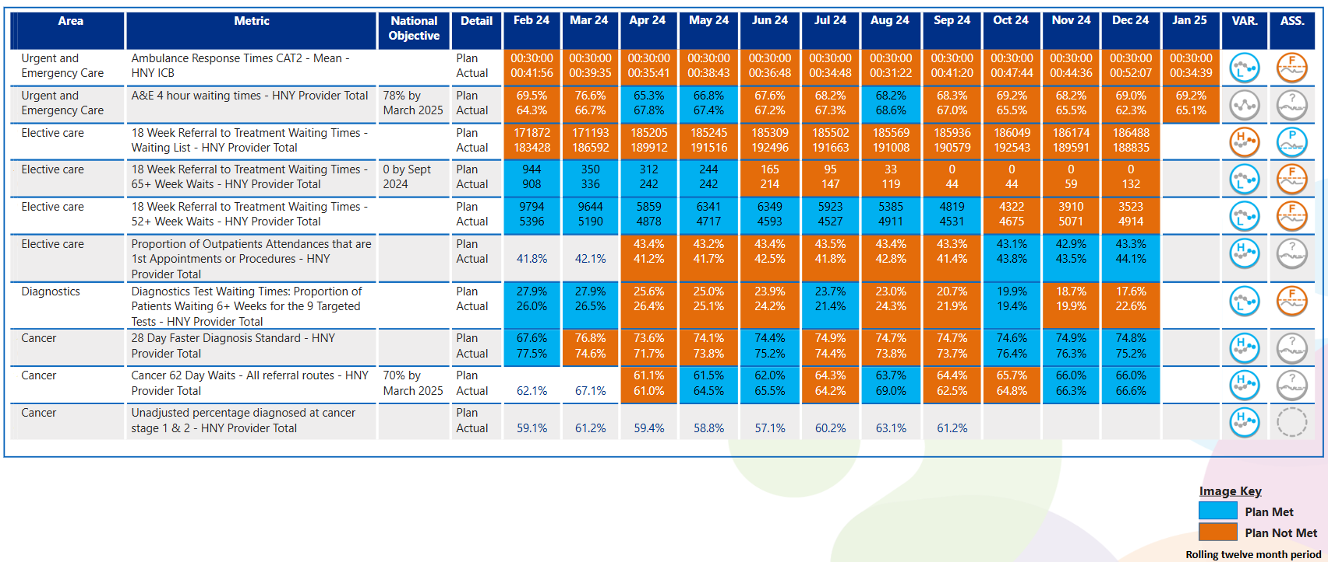
View by Month – Other Operating Plan Indicators
In line with Making Data Count recommendations, blue equals achieving, orange equals failing to achieve.

Slide 24
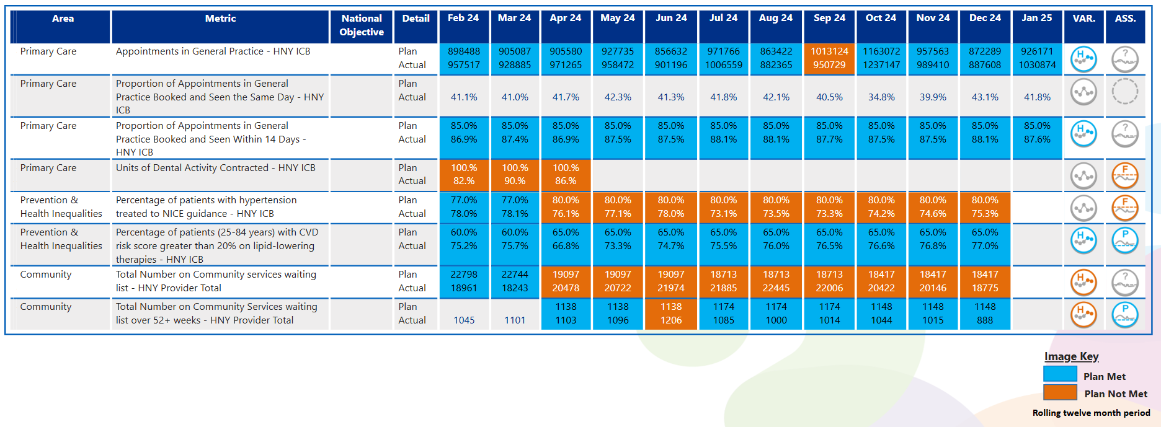
View by Month – Other Operating Plan Indicators
In line with Making Data Count recommendations, blue equals achieving, orange equals failing to achieve.

Slide 25
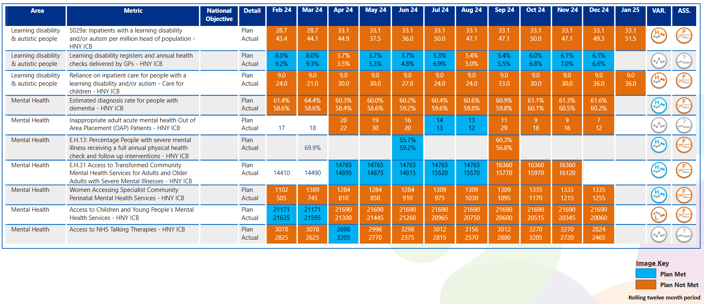

View by Month – Other Operating Plan Indicators
In line with Making Data Count recommendations, blue equals achieving, orange equals failing to achieve.

Slide 26



