Slide 1


Yorkshire and Humber
Mass Media Stop Smoking Campaign
HNY ICB Board
12 March 2025

Slide 2
Tobacco control is a prevention priority
Tobacco smoking is the leading cause of preventable death in the UK.
Smoking rates across Yorkshire and the Humber are some of the highest in the country, with 12.7% of the adult population currently smoking (national average is 11.6%) with long-term people who smoke living in areas of deprivation, contributing to stark health inequalities across the region.
No other consumer product kills up to two-thirds of its users – tobacco is uniquely harmful.
Evidence shows that it takes the average long-term smoker 30 attempts to quit. Most want to quit and expect to be asked about smoking at any healthcare appointment.
Smoking puts huge pressure on the NHS, with almost one hospital admission every minute attributable to smoking and up to 75,000 GP appointments across England each month taken up by smoking-related illness (CRUK)

Slide 3
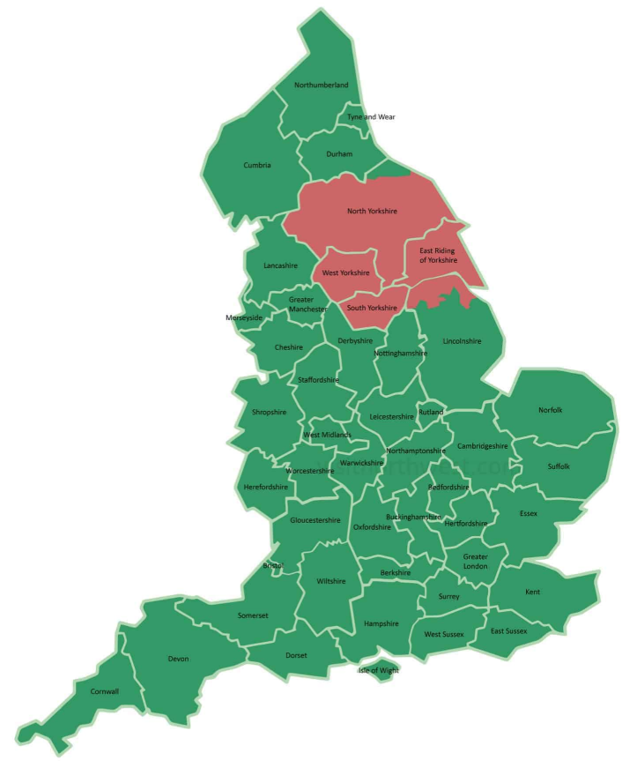
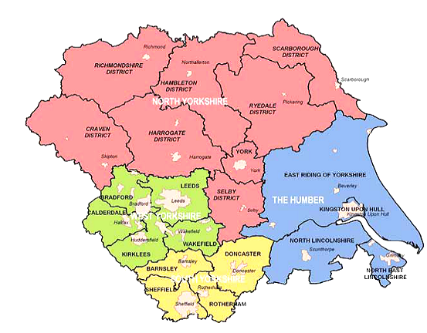
Yorkshire and The Humber
Joint project across 15 local authority areas across West Yorkshire, South Yorkshire and Humber and North Yorkshire
Key outputs
Deliver a regionwide mass media campaign under the ‘Yes’ brand, developed by the Centre for Excellence.
Create a ‘one stop shop’ website which will be the call to action for campaigns
Advanced training for our stop smoking workforce regionwide.
West Yorkshire | South Yorkshire | Humber & North Yorkshire
Wakefield | Sheffield | Hull
Leeds | Doncaster | East Riding
Bradford and Craven | Barnsley | North Yorkshire
Calderdale | Rotherham | York
Kirklees |  | North East Lincolnshire
 |  | North Lincolnshire

Slide 4
Our first, regionwide mass media campaign
Target audience – At population level, this broadly means - all genders, age 35-54, C2DE demographic. TV/radio adverts/out of home advertising with a call to action to visit www.yestoquit.co.uk.
Using an existing and successfully evaluated stop smoking campaign due to time restraints.
Local comms will target specific priority groups, ensuring that the call to action supports those who are digitally excluded. Comms toolkits will be provided to support which can drive directly into local services (rather than the population level website)
Campaign will be delivered from 25th March 2025 and run for 8 weeks

Slide 5

Yes to quit – What Will You Miss Campaign

Slide 6
What will be included within the campaign?
TV advertising
Radio advertising
Bus liner advertising
Digital advertising
Social Media advertising (from YES accounts)
Search engine optimisation
A PR events to raise awareness for the campaign

Slide 7

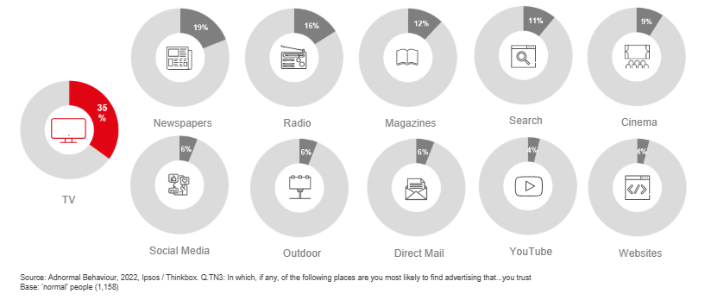
TV advertising is seen as most trustworthy…
The importance of trust for health messages is delivered by TV:

Slide 8
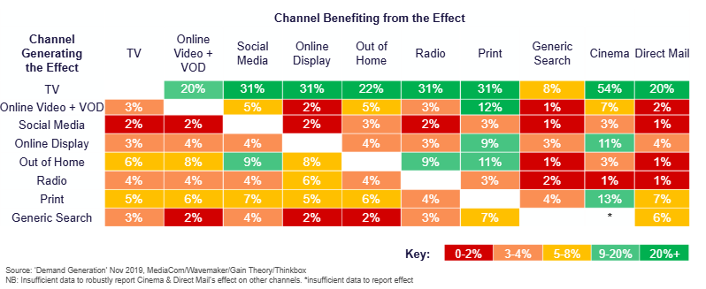
TV multiplies the media output of OOH and Radio by up to 31%...
TV boosts effects of other ad channels by up to 54%:

Slide 9
Campaign Evaluation
Pre-campaign evaluation – 100 people from each local authority (current smokers or quit within past three months) 1500 total
Post campaign evaluation – 100 people from each local authority (current smokers or quit within past three months) 1500 total
Report will analyse pre and post campaign evaluation, comparing against results from Greater Manchester and will be presented to partners upon completion.

Slide 10
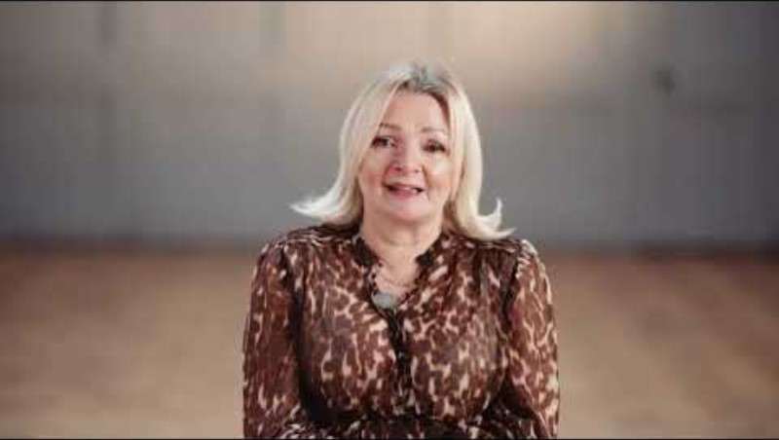
Gillian’s Story

