Slide 2
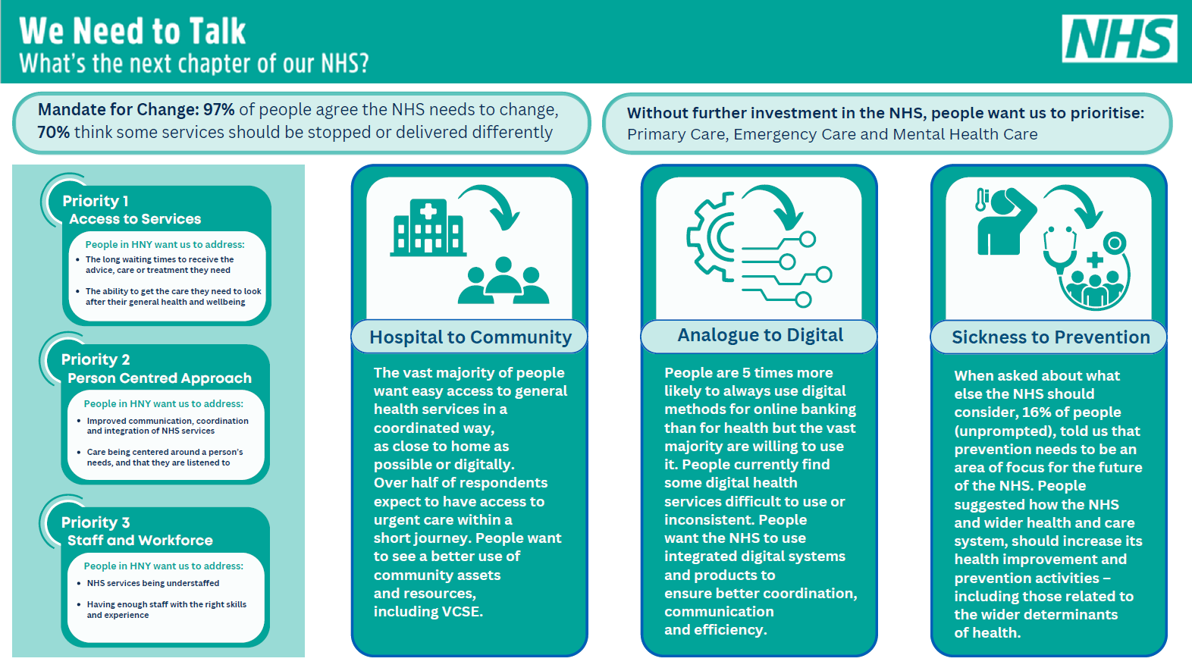

Slide 3
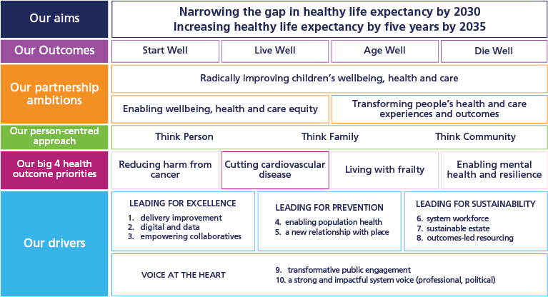

Slide 4
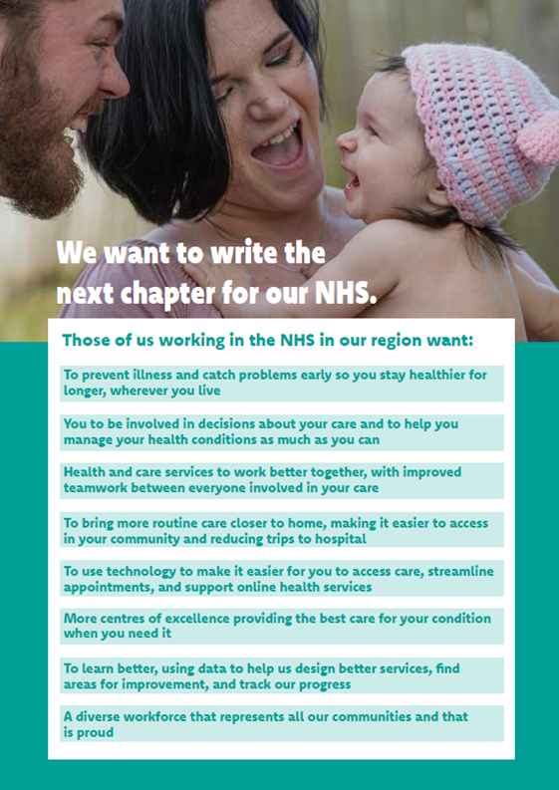
General consensus with the public facing Case for Change

Slide 5
Priority Themes | Key Issues:
NHS Services | Emergency and Primary Care remain the backbone of healthcare priorities for the population More than 70% of respondents who identified as LGBT+ or living with a mental health condition prioritised mental health care above all other services. More than half of respondents aged 0-24 years and those with a learning disability prioritised mental health services as their second biggest priority. End-of-life care is the least prioritised service overall
1. Access to Services | Getting an appointment - Difficulties in contacting services (particularly GP), long wait times (e.g. on the phone) and appointments offered at inappropriate times (e.g. during work hours) cause problems for people. Core/Service Offer - People are concerned about variation in service offer across HNY Long waiting times for tests and treatment – people told us about the wider impacts (physical, emotional, financial) and not knowing where they are in the ‘queue’ Understanding and navigating the NHS - People want simplified public-facing information about how to navigate NHS services and appropriate use of services, having a clear ‘front door’. Need for different service models – people want more one-stop clinics, more GP out of hours services and all services available 7 days a week.

Slide 6
Priority Themes | Key Issues:
2. Person Centred Approach (Communication, Coordination & Integration) – this is the No1 priority for people with a learning disability | Person centred care and communication – People want improved communication and to have care being centred around a person’s needs, and that they are listened to Integration and Collaboration between services - people feel there is a lack of communication, collaboration and integration between different departments and services within the NHS. This creates significant frustration for people in having to repeat their story Self Care – people want the NHS to foster a greater culture of self-care and to support people to ‘wait well’
3. Staff and Workforce | Concerns about staff morale and quality of care – people believe the NHS is understaffed and that staff are under supported. This leads to concerns about morale and quality/continuity of care. People think NHS staff should be better recognised and valued Recruitment and Retention - People think there needs to be a focus on how the NHS retains more of its workforce and recruits new staff to fill existing vacancies. People feel this is critical for frontline staff, including nurses and GPs

Slide 7
Other Themes | Key Issues:
1. Productivity and Efficiency | People want us reduce bureaucracy and management costs, address inefficiencies and duplication and review the allocation of funding/resources.
2. Future Service Provision | Over a quarter (30%) of respondents told us that there should be no reduction in the services the local NHS delivers. The remaining 70% thought some services could be stopped or delivered in a different way, 34% related to specific planned care services; which people felt were related to personal choice – namely, gender affirming care, cosmetic procedures, and fertility/IVF. People often told us that the NHS needs to change how it deals with preventable conditions which they think have been influenced by lifestyle choices; in particular, conditions which are related to diet, alcohol consumption, and smoking.
3. Propensity to Travel | The general expectation is that routine healthcare services (e.g., primary care, pharmacy) should be nearby (within walking distance) or accessible digitally, while more complex or specialised care (e.g., cancer treatment) is understood to require longer travel times due to the specialised nature or location of these services. The inability to afford transportation to an appointment was regarded as either the least or second least important issue to address by all six geographical areas within HNY, and by 90% (9 out of 10) of demographic groups.

Slide 8
National Shifts | Key Issues:
Hospital to Community | The vast majority of people want easy access to general health services in a coordinated way, as close to home as possible or digitally. Over half of respondents expect to have access to urgent and emergency care within a short journey. People want to see better use of community assets and resources, including VCSE. People reference improving primary care, out of hospital support (with social care), better use of community spaces and addressing health inequalities and community health as key priorities.
Analogue to Digital | People are 5 times more likely to always use digital methods for online banking than for health but the vast majority are willing to use it. People currently find some digital health services difficult to use or inconsistent. People remain concerned about those who can’t use digital being ‘left behind’ People want the NHS to use integrated digital systems and products to ensure better coordination, communication and efficiency – this specifically links to the priority identified of people feeling they currently need to keep repeating their story.

Slide 9
National Shifts | Key Issues:
Sickness to Prevention | When asked about what else the NHS should consider, 16% of people (unprompted), told us that prevention needs to be an area of focus for the future of the NHS. People suggested how the NHS and wider health and care system, should increase its health improvement and prevention activities – including those related to the wider determinants of health. Over half of the people we heard from are already taking action to improve their physical and mental health, through a variety of measures including stopping smoking, losing weight, and accessing mental health support. Most commonly, people said that they’re improving their health by living an active lifestyle and taking part in exercise. Only 14% of respondents told us that they felt they’re already doing everything they can to improve their overall health and wellbeing. The top three barriers identified by respondents as hindrances to making positive changes for their overall health and wellbeing are as follows: Motivations and willpower, Time constraints and Habitual behaviours Over a third of people told us that an existing medical condition, in most cases a long-term condition, is a barrier which limits their abilities to take positive steps to improve their overall wellbeing.

Slide 10
Targeted Focus Group: Key Issues
Deaf and hearing impaired people: accessibility of services and communication (making reasonable adjustments)
.
People with a Learning Disability: Not always treated with dignity and respect, not listened to and talked over
People with a mental health condition: Lack of communication/integration between services, NHS services not providing long term support as VCSE does
LGBT+: Referral times for mental health and gender affirming care, concerns about wait times for physio (mobility issues affecting mental health)
Veterans: Need for Mental Health support to be tailored to individual needs

Slide 11
Targeted Focus Group: Key Issues
Parents/Carers: Dental and for those with children on a waiting list, the sense of helplessness (leading to stress and anxiety)
.
BAME: Navigating the NHS and waiting times (some returning to home country for treatment = time and cost)
Long Term Conditions: Being ‘passed around’ and having to repeat their story
Women: Experiences and instincts being dismissed and put down to common issues e.g. Menopause
Young People: Mental Health to be properly prioritised and for issues to be taken seriously

