Slide 1

Humber and North Yorkshire ICB
Board Assurance Framework
HNY ICB: Corporate Affairs Office
Financial Year 2024/2025
V12
The Board Assurance Framework (BAF) sets out the principal risks to the achievement of the ICB’s strategic objectives and is a practical means through which the Board can assesses grip against delivery of these. In so doing, the BAF also a primary source of evidence in describing how the ICB is discharging its responsibility for internal control.
The BAF further sets out the controls in place to manage these risks and the assurances available to support judgements as to whether the controls are having the desired impact. It additionally describes the actions to further reduce each risk.

Slide 2
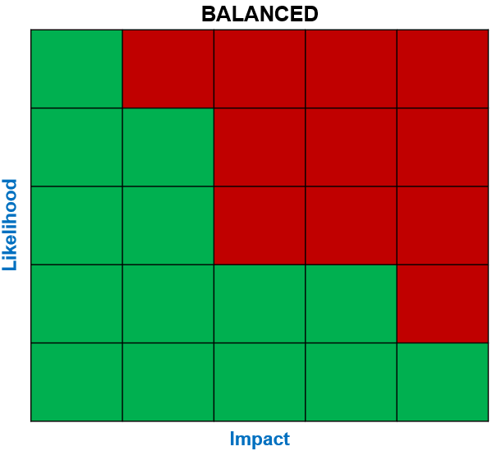
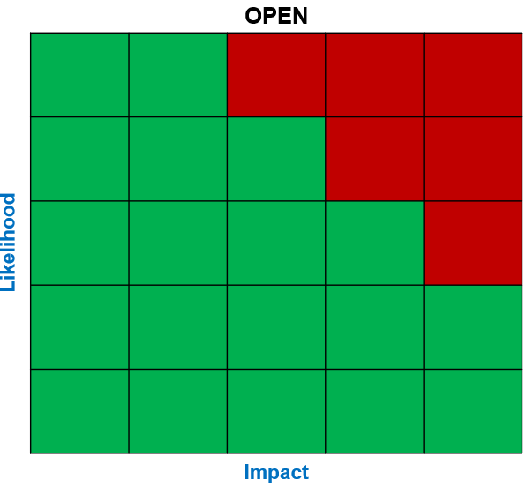
ICB BAF Risk Heat Maps (Based on Risk Appetite)
Strategic Objective | Domain | Risk Appetite | Risks aligned to Strategic Objective
A: Leading for Excellence | Delivery Improvement | BALANCED (8) | A1 (patient safety) | A2 (2024/25 delivery of operational plan)
 | Data and Digital | OPEN (12) | A3 (data and digital maturity)
 | Empowering Collaboratives | OPEN (12) | No risks currently aligned
B: Leading for Prevention | Population Health | OPEN (12) | B1 (partnership vision and priorities)
 | Relationship with Place | OPEN (12) | No risks currently aligned
C: Leading for Sustainability | System workforce | OPEN (12) | C6 (ICB workforce sustainability) | C7 (workforce availability & transformation)
 | Sustainable estates | OPEN (12) | C2 (Estates)
 | Outcomes led resourcing | BALANCED (8) | C3a (2024/25 financial resource - ICB) | C3b (2024/25 financial resource - ICS)
 |  |  | C5a (medium-term financial sustainability – ICB) | C5b (medium-term financial sustainability - ICS)
D: Voice at the Heart | Transformative public engagement | OPEN (12) | D1 (patient and public engagement)
 | System voice and relationships | OPEN (12) | No risks currently aligned
A1
A3
A2
C3b
C7
A1
A1
C5b
C1
C3a
C5a
A3
B1
C2
D1
C2
C6

Slide 3
Summary of Risks
Strategic Objective A: Leading for Excellence
REF | Domain | Principal Risk | Risk Owner | Assurance Committee | Initial Risk Rating (Before Mitigation) |  |  | Current Risk (After Mitigation) |  |  | Risk Appetite | Status (In / Out of Appetite) | Movement from Last Quarter
 |  |  |  |  | I | L | Rating I x L | I | L | Rating I x L
A1 | Delivery Improvement | 1: Failure to effectively recognise, monitor and have mitigating actions to improve standards of local care will impact on patient safety and positive health outcomes for local people and communities. | ED Nursing & Quality | Quality Committee | 5 | 4 | 20 | 5 | 5 | 25 | 8 BALANCED | OUT
REF | Domain | Principal Risk | Risk Owner | Assurance Committee | Initial Risk Rating (Before Mitigation) |  |  | Current Risk (After Mitigation) |  |  | Risk Appetite | Status (In / Out of Appetite) | Movement from Last Quarter
 |  |  |  |  | I | L | Rating I x L | I | L | Rating I x L
A2 | Delivery Improvement | 2: Failure to deliver the ICB Operating plan for 2024/25, and the associated 32 national objectives, may result in patients not being treated in a timely and appropriate manner. | Deputy Chief Executive / COO | Finance, Performance & Delivery Committee | 4 | 5 | 20 | 4 | 4 | 16 | 8 BALANCED | OUT
BAF REF | Domain | Principal Risk | Risk Owner | Assurance Committee | Initial Risk Rating (Before Mitigation) |  |  | Current Risk (After Mitigation) |  |  | Risk Appetite | Status (In / Out of Appetite) | Movement from Last Quarter
 |  |  |  |  | I | L | Rating I x L | I | L | Rating I x L
A3 | Data and Digital | 3: Failure to develop data and digital maturity (including Cyber Security) will prevent the ICS from delivering against its core purposes. | Chief Digital Information Officer | Digital Data and Innovation Committee | 5 | 4 | 20 | 4 | 3 | 12 | 12 OPEN | IN | TBD
Strategic Objective B: Leading for Prevention
BAF REF | Domain | Principal Risk | Risk Owner | Assurance Committee | Initial Risk Rating (Before Mitigation) |  |  | Current Risk (After Mitigation) |  |  | Risk Appetite | Status (In / Out of Appetite) | Movement from Last Quarter
 |  |  |  |  | I | L | Rating I x L | I | L | Rating I x L
B1 | Empowering Collaboratives | 1: Failure of the ICB to align with the wider partnership vision and priorities and therefore not transforming services to achieve enduring improvement to the health & wellbeing of our population & local communities. | Deputy Chief Executive / COO | Population Health & Prevention Committee | 4 | 4 | 16 | 4 | 3 | 12 | 12 OPEN | IN | TBD

Slide 4
Summary of Risks
Strategic Objective C: Leading for Sustainability
REF | Domain | Principal Risk | Risk Owner | Assurance Committee | Initial Risk Rating (Before Mitigation) |  |  | Current Risk (After Mitigation) |  |  | Risk Appetite | Status (In / Out of Appetite) | Movement from Last Quarter
 |  |  |  |  | I | L | Rating I x L | I | L | Rating I x L
C2 | Sustainable Estates | 2: The estates infrastructure of the ICS hinders our ability as an ICB to deliver consistently high-quality care. | ED Finance & Investment | Finance, Performance & Delivery Committee | 4 | 4 | 16 | 4 | 3 | 12 | 12 OPEN | IN | TBD
REF | Domain | Principal Risk | Risk Owner | Assurance Committee | Initial Risk Rating (Before Mitigation) |  |  | Current Risk (After Mitigation) |  |  | Risk Appetite | Status (In / Out of Appetite) | Movement from Last Quarter
 |  |  |  |  | I | L | Rating I x L | I | L | Rating I x L
C3a | Outcomes Led Resourcing | 3: Failure to operate within the ICBs available resources for 2024/25 will cause financial instability leading to poorer outcomes for the population; threaten individual organisation sustainability; undermine confidence in the ICB leadership; risks the system being subject to escalated oversight from regional and national processes that detract from getting on with the required responsibilities and priorities. | ED Finance & Investment | Finance, Performance & Delivery Committee | 5 | 5 | 25 | 3 | 3 | 9 | 8 BALANCED | OUT
REF | Domain | Principal Risk | Risk Owner | Assurance Committee | Initial Risk Rating (Before Mitigation) |  |  | Current Risk (After Mitigation) |  |  | Risk Appetite | Status (In / Out of Appetite) | Movement from Last Quarter
 |  |  |  |  | I | L | Rating I x L | I | L | Rating I x L
C3b | Outcomes Led Resourcing | 3: Failure to operate within the ICSs available resources for 2024/25 will cause financial instability leading to poorer outcomes for the population; threaten individual organisation sustainability; undermine confidence in the leadership; risks the system being subject to escalated oversight from regional and national processes that detract from getting on with the required responsibilities and priorities. | ED Finance & Investment | Finance, Performance & Delivery Committee | 5 | 5 | 25 | 4 | 5 | 20 | 8 BALANCED | OUT
REF | Domain | Principal Risk | Risk Owner | Assurance Committee | Initial Risk Rating (Before Mitigation) |  |  | Current Risk (After Mitigation) |  |  | Risk Appetite | Status (In / Out of Appetite) | Movement from Last Quarter
 |  |  |  |  | I | L | Rating I x L | I | L | Rating I x L
C5a | Outcomes Led Resourcing | 5: Failure to deliver a medium-term financial plan for the ICB, that achieves financial sustainability and recovery, leading to poorer outcomes for the population; threatens ICB sustainability; undermines confidence in the ICB and ICS leadership, as part of the system. | ED Finance & Investment | Finance, Performance & Delivery Committee | 5 | 5 | 25 | 4 | 3 | 12 | 8 BALANCED | OUT
REF | Domain | Principal Risk | Risk Owner | Assurance Committee | Initial Risk Rating (Before Mitigation) |  |  | Current Risk (After Mitigation) |  |  | Risk Appetite | Status (In / Out of Appetite) | Movement from Last Quarter
 |  |  |  |  | I | L | Rating I x L | I | L | Rating I x L
C5b | Outcomes Led Resourcing | 5: Failure to deliver a medium-term financial plan for the system, that achieves financial sustainability and recovery, leading to poorer outcomes for the population; threatens individual organisations sustainability; undermines confidence in the ICB, ICS leadership and System leaders. | ED Finance & Investment | Finance, Performance & Delivery Committee | 5 | 5 | 25 | 4 | 4 | 16 | 8 BALANCED | OUT

Slide 5
Summary of Risks
Strategic Objective C: Leading for Sustainability
REF | Domain | Principal Risk | Risk Owner | Assurance Committee | Initial Risk Rating (Before Mitigation) |  |  | Current Risk (After Mitigation) |  |  | Risk Appetite | Status (In / Out of Appetite) | Movement from Last Quarter
 |  |  |  |  | I | L | Rating I x L | I | L | Rating I x L
C6 | System Workforce | 6: Failure to recruit and retain staff of the right calibre and with the right values will prevent the ICB organisation delivering its core purposes. Lack of effective succession planning will reduce the leadership capability of the ICB and limit the impact and effectiveness of the organisation in leading the improvement and transformation of the HNY health and care system. | ED People | Workforce Board (Workforce Committee) | 4 | 3 | 12 | 4 | 2 | 8 | 12 OPEN | IN
REF | Domain | Principal Risk | Risk Owner | Assurance Committee | Initial Risk Rating (Before Mitigation) |  |  | Current Risk (After Mitigation) |  |  | Risk Appetite | Status (In / Out of Appetite) | Movement from Last Quarter
 |  |  |  |  | I | L | Rating I x L | I | L | Rating I x L
C7 | System Workforce | 7: Failure to recruit and retain staff of the right calibre and with the right values will prevent the ICB organisation delivering its core purposes. Lack of effective succession planning will reduce the leadership capability of the ICB and limit the impact and effectiveness of the organisation in leading the improvement and transformation of the HNY health and care system. | ED People | Workforce Board (Workforce Committee) | 4 | 5 | 20 | 4 | 4 | 16 | 12 OPEN | OUT
Strategic Objective D: Voice at the Heart
BAF REF | Domain | Principal Risk | Risk Owner | Assurance Committee | Initial Risk Rating (Before Mitigation) |  |  | Current Risk (After Mitigation) |  |  | Risk Appetite | Status (In / Out of Appetite) | Movement from Last Quarter
 |  |  |  |  | I | L | Rating I x L | I | L | Rating I x L
D1 | Transformative Public Engagement | 1: Failure to effectively engage and deliver our legal duty to involve patients and the public in decision making and service development will prevent the ICS from providing integrated, coordinated and quality care. | ED Communications, Marketing & MR | Quality Committee | 4 | 4 | 16 | 4 | 3 | 12 | 12 OPEN | IN | TBD

Slide 6
Ref A1 Risk Analysis (SLIDE 1 OF 2)
Ref: A1 | Strategic Objective A: Leading for Excellence | PRINCIPAL RISK 1: Failure to effectively recognise, monitor and have mitigating actions to improve standards of local care will impact on patient safety and positive health outcomes for local people and communities. | Risk Domain: Delivery Improvement | Risk Score: 25
Executive Risk Owner: Executive Director of Nursing & Quality | Assurance Committee: Quality Committee | Date Added to BAF: October 2022
Initial/Inherent Risk (Before Mitigation) |  |  | Current Risk (After Mitigation) |  |  | Risk Appetite | Status: In or Out of Appetite
I | L | Rating I x L | I | L | Rating I x L | OPEN | (RAG)
5 | 4 | 20 | 5 | 5 | 25 | 8 (BALANCED) | OUT OF APPETITE
Risk Analysis | Q1 (2024/25) | Q2 (2024/25) | Q3 (2024/25) | Q4 (2024/25)
Current Risk Rating | 15 | 15 | 25 | TBD
Risk Appetite | 8 (BALANCED) | 8 (BALANCED) | 8 (BALANCED) | 8 (BALANCED)
Positive Assurance and Key Controls in Place | Gaps in Control and/or Assurance
Committee established: Quality Committee which includes key VSM members across the system and providing assurance to the Board. Places are establishing Quality Place Groups, providing assurance to the Quality Committee Quality and equality impact assessments Getting It Right First Time (GIRFT) programme supporting improvements in medical care within the NHS by reducing unwarranted variations Quality dashboards and data assurance Internal audits on quality related issues The new Patient Safety Incident Response Framework (PSIRF) will come online for all providers, including acute, ambulance, mental health, and community healthcare providers Review of ICB formal governance framework and arrangements Quality Assurance and Improvement Framework received by the Quality Committee and the Board for endorsement 45-minute handover policy in place, but required performance to be measured (see gaps) Series of escalated actions put in to reflect additional focus and scrutiny, including a UEC summit. These are subject to weekly review and monitoring through the x3 Place UEC Boards. UEC Clinical Leadership Summit took place on 15 August 2024 and a number of next steps have been agreed. Exec to Exec UEC site visits, in York, Scarborough, Hull, Grimsby, Scunthorpe took place between August and September 2024. Business Intelligence, Quality Improvement Group (QIG) for all acute trust York and Scarborough Teaching Hospitals, Hull University Teaching Hospital NHS Trust, and Northern Lincolnshire & Goole NHS Foundation Trust. Assurance paper collating all Temporary Escalation Spaces (TES) Standard Operating Procedures, risk assessment, records of use of and any recorded harm to date is being submitted to the Quality Committee in Feb 2025. | Reconsideration of Urgent and Emergency Care (UEC) Board governance arrangements Continuous development and iterations of Quality assurance improvement framework (QAIF). Clinical leadership Reduction in waiting times National Guidance re : sharing Clinical risk – implications and applications locally to be determined Clinical Suitability of Space Staffing Levels and Competency Patient Acuity and Cohort Monitoring and Supervision Infection Prevention and Control Environmental and Physical Risks
See next slide for mitigating actions

Slide 7
Ref A1 Risk Analysis (SLIDE 2 OF 2)
Ref: A1 | Strategic Objective A: Leading for Excellence | PRINCIPAL RISK 1: Failure to effectively recognise, monitor and have mitigating actions to improve standards of local care will impact on patient safety and positive health outcomes for local people and communities. | Risk Domain: Delivery Improvement | Risk Score: 25
Ref: A1 | Strategic Objective A: Leading for Excellence | PRINCIPAL RISK 1: Failure to effectively recognise, monitor and have mitigating actions to improve standards of local care will impact on patient safety and positive health outcomes for local people and communities. | Risk Domain: Delivery Improvement | Risk Score: 25
Executive Risk Owner: Executive Director of Nursing & Quality | Assurance Committee: Quality Committee | Date Added to BAF: October 2022
Initial/Inherent Risk (Before Mitigation) |  |  | Current Risk (After Mitigation) |  |  | Risk Appetite | Status: In or Out of Appetite
I | L | Rating I x L | I | L | Rating I x L | OPEN | (RAG)
5 | 4 | 20 | 5 | 5 | 25 | 8 (BALANCED) | OUT OF APPETITE
Risk Analysis | Q1 (2024/25) | Q2 (2024/25) | Q3 (2024/25) | Q4 (2024/25)
Current Risk Rating | 15 | 15 | 25 | 25
Risk Appetite | 8 (BALANCED) | 8 (BALANCED) | 8 (BALANCED) | 8 (BALANCED)
Mitigating Actions To Address Gaps | Target Date | Action Lead | Update on mitigations
Refresh of governance arrangements for Urgent and Emergency Care (UEC) Boards with additional weekly executive UEC Oversight meetings in place for w/c 5/8 | Check point: April 25 | Deputy Chief Executive / COO | Next update due at the May Board
Clinical Network would take a lead role in cascade and support for improvement from a clinical leadership perspective | Check point: April 25 | ED of Clinical & Professional | Next update due at the May Board
Acute providers would target reducing time waiting for a clinical review and reducing time waiting for a bed by focus on criteria lead discharge, estimated date for discharge, and no criteria to reside /pathway zero patients. These actions are supported by the role out of Optica. | Check point: March 25 | ED of Nursing and Quality | Update due at the April Board
National Guidance re : sharing Clinical risk – implications and applications locally to be determined | Check point: March 25 | ED of Nursing and Quality | Update due at the April Board
Review of provider operating procedures and risk assessments for Temporary Escalation Spaces(TES) across acute services | Check point: March 25 | ED of Nursing & Quality / Deputies | Update due at the April Board

Slide 8
Ref A2 Risk Analysis
Ref: A2 | Strategic Objective A: Leading for Excellence | PRINCIPAL RISK 2: Failure to deliver the ICB Operating plan for 2024/25, and the associated 32 national objectives, may result in patients not being treated in a timely and appropriate manner. | Risk Domain: Delivery Improvement | Risk Score: 16
Executive Risk Owner: Acting Deputy Chief Executive / Chief Operating Officer | Assurance Committee: Finance, Performance & Delivery Committee | Date Added to BAF: May 2024
Initial/Inherent Risk (Before Mitigation) |  |  | Current Risk (After Mitigation) |  |  | Risk Appetite | Status: In or Out of Appetite
I | L | Rating I x L | I | L | Rating I x L | OPEN | (RAG)
4 | 5 | 20 | 4 | 4 | 16 | 8 (BALANCED) | OUT OF APPETITE
Risk Analysis | Q1 (2024/25) | Q2 (2024/25) | Q3 (2024/25) | Q4 (2024/25)
Current Risk Rating | 16 | 16 | 16 | 16
Risk Appetite | 8 (BALANCED) | 8 (BALANCED) | 8 (BALANCED) | 8 (BALANCED)
Positive Assurance and Key Controls in Place | Gaps in Control and/or Assurance
System Oversight and Assurance Group, that includes all Place Directors and Collaborative Directors and report to the Finance, Performance and Delivery Committee. Providers and places working collaboratively to share learning Detailed monthly performance report and dashboard to the ICB Board. Oversight of risk by the Chief Operating Officer and the Board Speciality level reports at Elective Care and Urgent Care Boards Refreshed Urgent and Emergency Care (UEC) Board Recovery plans are in place for all Places Revised Corporate Performance report format giving greater emphasis on main delivery priorities and key areas of focus Establishment of ‘monthly Deep Dive’ supplementary performance reports giving real and additional insight into risk delivery areas for board scrutiny – progress updates will be brought to the Board. Board sited on the approach to winter planning Recovery plans are in place at Place Stepping up of focused prioritisation of UEC and Financial Plan delivery priorities with weekly governance arrangements established to ensure tighter grip and control Reporting of ‘monthly Deep Dive’ supplementary performance reports giving real and additional insight into risk delivery areas for board scrutiny | Operational pressures and priorities impact on our ability to target resources effectively to deliver against the plan Not measuring and assessing performance across the system in a timely and meaningful way impacts on our ability to respond quickly as issues arise and widens variation across our footprint.
Mitigating Actions To Address Gaps | Target Date | Action Lead | Update on mitigations due this month
The Executive team, supported by the Planning and Performance team, keeps a close eye on the 32 objectives in the 24/25 plan in terms of delivery and associated risks, supporting Exec leads and the appropriate governance routes as required. Particular focus is on the UEC delivery, 65ww elective waits and cancer delivery to optimise the end of year delivery. All of these are subject to tight NHSE oversight. With the recent publication of the 25/26 Planning guidance and a smaller number of priorities, this will be a further area of focus. | Check point: March 25 | Deputy Chief Executive / COO | Next update due at the April Board

Slide 9
Ref A3 Risk Analysis
Ref: A3 | Strategic Objective A: Leading for Excellence | PRINCIPAL RISK 3: Failure to develop data and digital maturity (including Cyber Security) will prevent the ICS from delivering against its core purposes. | Risk Domain: Data and Digital | Risk Score: 12
Executive Risk Owner: Chief Digital Information Officer | Assurance Committee: Digital Data and Innovation Committee | Date Added to BAF: October 2022
Initial/Inherent Risk (Before Mitigation) |  |  | Current Risk (After Mitigation) |  |  | Risk Appetite | Status: In or Out of Appetite
I | L | Rating I x L | I | L | Rating I x L | OPEN | (RAG)
5 | 4 | 20 | 4 | 3 | 12 | 12 (OPEN) | IN APPETITE
Risk Analysis | Q1 (2024/25) | Q2 (2024/25) | Q3 (2024/25) | Q4 (2024/25)
Current Risk Rating | 12 | 12 | 12 | 12
Risk Appetite | 12 (OPEN) | 12 (OPEN) | 12 (OPEN) | 12 (OPEN)
Positive Assurance and Key Controls in Place | Gaps in Control and/or Assurance
Finalised and approved Integrated Care Strategy, allowing for focused delivery across system partners Approved Digital Strategy National digital maturity assessment framework Operation Plan approved by the ICB Board and submitted to NHS England SIRO, Caldicott Guardian and Data Protection Officer in Place Data Security and Protection Toolkit completed - no improvement plan required ICS Infrastructure steering group in place with links to cyber expertise Dedicated ICS Cyber Security Group Established chaired by NHSE Regional Cyber security lead, rapidly improving the position and developing a strategy Sharepoint risks mitigated providing a secure collaborative space Cyber event taken place with Board (09/08/2023) Overarching Steering Group and Programme Group have been set up to ensure Electronic Patient Record replacement programme success BI, analytics and reporting wrt populational health to be developed through population health management programme Working with NHSE Cyber Lead on an appendix to the ICB Digital Strategy outlining our approach to cyber. Recruitment to begin for a programme lead to focus on the ICS-wide cyber programme. | Evidence of sustained improvement in trends to reduce health inequalities Align digital priorities with the ICP strategy and develop an action plan to deliver Electronic Patient Record replacement to be developed across the ICB to support harmonisation of pathways, information to be shared more easily and more simplified reporting. Increasing awareness of cyber security risks across the organisation and wider system
Mitigating Actions To Address Gaps | Target Date | Action Lead | Update on mitigations due this month
Align digital priorities with the ICP strategy and develop an action plan to deliver | Check point: April 25 | Chief Digital Information Officer | Next update due at the May Board
Electronic Patient Record replacement to be developed across the ICB to support harmonisation of pathways, information to be shared more easily and simplified reporting. | Next update due April 25 (part of 4-year plan) | Chief Digital Information Officer | Next update due at the May Board
Development of decision intelligence model | Check point: April 25 | Executive Director of Corporate Affairs | Next update due at the May Board

Slide 10
Ref B1 Risk Analysis
Ref: B1 | Strategic Objective B: Leading for Prevention | PRINCIPAL RISK 1: Failure of the ICB to align with the wider partnership vision and priorities and therefore not transforming services to achieve enduring improvement to the health & wellbeing of our population & local communities. | Risk Domain: Empowering Collaboratives | Risk Score: 12
Executive Risk Owner: Deputy Chief Executive / Chief Operating Officer | Assurance Committee: Population Health & Prevention Committee | Date Added to BAF: October 2022
Initial/Inherent Risk (Before Mitigation) |  |  | Current Risk (After Mitigation) |  |  | Risk Appetite | Status: In or Out of Appetite
I | L | Rating I x L | I | L | Rating I x L | OPEN | (RAG)
4 | 4 | 16 | 4 | 3 | 12 | 12 (OPEN) | IN APPETITE
Risk Analysis | Q1 (2024/25) | Q2 (2024/25) | Q3 (2024/25) | Q4 (2024/25)
Current Risk Rating | 12 | 12 | 12 | 12
Risk Appetite | 12 (OPEN) | 12 (OPEN) | 12 (OPEN) | 12 (OPEN)
Positive Assurance and Key Controls in Place | Gaps in Control and/or Assurance
ICB Board includes representation from partners across the health and care spectrum and voluntary, community and social enterprise sectors within Humber and North Yorkshire Integrated Care Partnership (ICP) is well established and draws its membership from partner organisations across the ICS. Integrated Care Strategy supported by ICP at its meeting in December 2022 System response to recovery planning and winter planning Senior Leadership Executive Committee (ICB) providing assurance to the ICB Board System Oversight and Assurance Group providing assurance on system performance and delivery Six Places’ priorities / strategic intents developed with associated Place Risk Registers Five Sector Collaboratives’ priorities / strategic intents Transitional operational agreements with Places/Collaboratives ICB Communications and engagement strategy Integrated Care Strategy now approved by ICP and approved by constituent partners across Humber and North Yorkshire Operation Plan approved by the ICB Board and submitted to NHS England All Places (x6) have Place plans Maturity of ICB – Internal controls and governance (key controls – s75 etc) BI, analytics and reporting wrt populational health to be developed through population health management programme | Embedded approach to planning and delivering transformation, developments and change (to establish single system engine room – Q1 - action) BI, analytics and reporting at Place and Population Health Management
Mitigating Actions To Address Gaps | Target Date | Action Lead | Update on mitigations due this month
Development of decision intelligence model | Check point: April 25 | Executive Director of Corporate Affairs | Next update due at the May Board

Slide 11
Ref C2 Risk Analysis
Ref: C2 | Strategic Objective C: Leading for Sustainability | PRINCIPAL RISK 2: The estates infrastructure of the ICS hinders our ability as an ICB to deliver consistently high-quality care. | Risk Domain: Sustainable Estates | Risk Score: 12
Executive Risk Owner: Executive Director of Finance and Investment | Assurance Committee: Finance Performance and Delivery Committee | Date Added to BAF: November 2023
Initial/Inherent Risk (Before Mitigation) |  |  | Current Risk (After Mitigation) |  |  | Risk Appetite | Status: In or Out of Appetite
I | L | Rating I x L | I | L | Rating I x L | OPEN | (RAG)
4 | 4 | 16 | 4 | 3 | 12 | 12 (OPEN) | IN APPETITE
Risk Analysis | Q1 (2024/25) | Q2 (2024/25) | Q3 (2024/25) | Q4 (2024/25)
Current Risk Rating | 12 | 12 | 12 | 12
Risk Appetite | 12 (OPEN) | 12 (OPEN) | 12 (OPEN) | 12 (OPEN)
Positive Assurance and Key Controls in Place | Gaps in Control and/or Assurance
ICB Infrastructure Plan work has commenced, and all providers engaged, data collection and validation taking place to provide a comprehensive overview of the Estates, Sustainability and Infrastructure position. ICB corporate estates review commenced, with ad hoc projects already taking place Options for identifying underutilised estate and potential disposals identified as part of the QEP Primary Care Estates group in place and operating well, with the PCN toolkit work nearing completion linking clinical strategy and infrastructure Capital and estates group recommenced HNY sustainability steering group EPRR in place, to support any critical infrastructure failures Mature Provider estates planning forums to manage risk and capital planning oversight This risk will form part of the ICB infrastructure plan. Appointed consultancy to support for Delivery of the Health Infrastructure Plan Working with exec director and governance team to establish clear reporting and governance arrangements | Links into the Provider risk reporting where it makes sense for the ICB to be sighted, this should be addressed as the Capital and Estates Group matures in new format. Board Reporting on Net Zero targets. This is being addressed by development of standard set of matrix to be included into the suite of Board reports. Wider overview of impact on challenged capital position on backlog maintenance. Lack of reporting on TIF/major reconfiguration schemes on Benefits Realisation
Mitigating Actions To Address Gaps | Target Date | Action Lead | Update on mitigations due this month
Continue to prioritise in line with agreed risk prioritises reflecting the emerging themes of the ICB Infrastructure Strategy and the Design for the Future principles. | End Quarter 4 2024/25 | Executive Director of Finance & Investment / Assistant Director of Estates | Next update due at the May Board

Slide 12
Ref C3a Risk Analysis *Risk C3 split into C3a (ICB focus) and C3b (system focus)*
Ref: C3a | Strategic Objective C: Leading for Sustainability | PRINCIPAL RISK 3a: Failure to operate within the ICBs available resources for 2024/25 will cause financial instability leading to poorer outcomes for the population; threaten individual organisation sustainability; undermine confidence in the ICB leadership; risks the system being subject to escalated oversight from regional and national processes that detract from getting on with the required responsibilities and priorities. | Risk Domain: Outcomes Led Resourcing | Risk Score: 9
Executive Risk Owner: Executive Director of Finance and Investment | Assurance Committee: Finance, Performance & Delivery Committee | Date Added to BAF: April 2024
Initial/Inherent Risk (Before Mitigation) |  |  | Current Risk (After Mitigation) |  |  | Risk Appetite | Status: In or Out of Appetite
I | L | Rating I x L | I | L | Rating I x L | OPEN | (RAG)
5 | 5 | 25 | 3 | 3 | 9 | 8 (BALANCED) | OUT OF APPETITE
Risk Analysis | Q1 (2024/25) | Q2 (2024/25) | Q3 (2024/25) | Q4 (2024/25)
Current Risk Rating | 16 | 20 | 20 | 9
Risk Appetite | 8 (BALANCED) | 8 (BALANCED) | 8 (BALANCED) | 8 (BALANCED)
Positive Assurance and Key Controls in Place | Gaps in Control and/or Assurance
Appointed (independent) Non-Executive Chair for FPD Recently appointed highly experienced retained members to work with the committee from September 2024 Refinement of a robust FPD workplan to oversee 1) the ICB statutory performance and 2) ICS system delivery. Establishment of the monthly ICS DOF meeting as a formal sub group of FPD. Weekly reporting on delivery through NHS England at Regional and National Level. Third party independent firm contracted to assess impact of the grip and control mechanisms within the organisations of HNY. Weekly documented meetings with Directors of Finance (and HRDs) across the ICB and ICS to 1) review run rate of expenditure 2) review the bridge back to plans and 3) align resource prioritisation (investment and disinvestment). Monthly ICB Finance Contracting and Procurement meeting with the entire team. Widespread finance contracting and procurement team representation throughout the ICB’s operations ensure any financial/procurement risk or concerns are picked up and mitigating action taken. Oversight from the Quality Committee and Quality Impact Assessment on finance decisions. Full range of NHS England expenditure controls being monitored and in place by all individual organisations. Updated and approved Scheme of Reservation and Delegation and Operational Scheme of Delegation. Internal audit and external audit reviews on financial systems, budgetary control and financial management, contract management and procurement processes Professional standards and regulatory frameworks. Third party independent firm contracted to assess impact of the grip and control mechanisms within the organisations of HNY. The System Leader Forum continues to convene monthly with representation across providers and local government, providing transparency and system view on the anticipated impact of macro-level restrictions on discretionary spend. Amendments have been made to the financial reporting to incorporate the systematic review of run rate and bridge analysis. Updates from Third party independent firm contracted to assess impact of the grip and control mechanisms within the organisations of HNY. Review of all spend areas and Balance Sheet has concluded | Significant level of non-recurrent (as opposed to recurrent) efficiencies Ability to contain and reduce cost in the context of the operational and quality challenges. Organisation financial performance being prioritised over the system.
Mitigating Actions To Address Gaps | Target Date | Action Lead | Update on mitigations due this month
Developing/enhancing an/organisation list of Efficiency and Productivity Opportunities | Checkpoint: March 25 | Interim ED of Finance & Investment | Update to be received as part of the Finance report to the Board.
Working up and delivering actions to deliver improved financial results | Checkpoint: March 25 | Interim ED of Finance & Investment | Update to be received as part of the Finance report to the Board.
Developing a Recovery Plans should the year-end result not be delivered | Checkpoint: March 25 | Interim ED of Finance & Investment | Update to be received as part of the Finance report to the Board.

Slide 13
Ref C3b Risk Analysis *Risk C3 split into C3a (ICB focus) and C3b (system focus)*
Ref: C3b | Strategic Objective C: Leading for Sustainability | PRINCIPAL RISK 3b: Failure to operate within the ICSs available resources for 2024/25 will cause financial instability leading to poorer outcomes for the population; threaten individual organisation sustainability; undermine confidence in the leadership; risks the system being subject to escalated oversight from regional and national processes that detract from getting on with the required responsibilities and priorities. | Risk Domain: Outcomes Led Resourcing | Risk Score: 20
Executive Risk Owner: Executive Director of Finance and Investment | Assurance Committee: Finance, Performance & Delivery Committee | Date Added to BAF: April 2024
Initial/Inherent Risk (Before Mitigation) |  |  | Current Risk (After Mitigation) |  |  | Risk Appetite | Status: In or Out of Appetite
I | L | Rating I x L | I | L | Rating I x L | OPEN | (RAG)
5 | 5 | 25 | 5 | 4 | 20 | 8 (BALANCED) | OUT OF APPETITE
Risk Analysis | Q1 (2024/25) | Q2 (2024/25) | Q3 (2024/25) | Q4 (2024/25)
Current Risk Rating | 16 | 20 | 20 | 20
Risk Appetite | 8 (BALANCED) | 8 (BALANCED) | 8 (BALANCED) | 8 (BALANCED)
Positive Assurance and Key Controls in Place | Gaps in Control and/or Assurance
Appointed (independent) Non-Executive Chair for FPD Recently appointed highly experienced retained members to work with the committee from September 2024 Refinement of a robust FPD workplan to oversee 1) the ICB statutory performance and 2) ICS system delivery. Establishment of the monthly ICS DOF meeting as a formal sub group of FPD. Weekly reporting on delivery through NHS England at Regional and National Level. Third party independent firm contracted to assess impact of the grip and control mechanisms within the organisations of HNY. Weekly documented meetings with Directors of Finance (and HRDs) across the ICB and ICS to 1) review run rate of expenditure 2) review the bridge back to plans and 3) align resource prioritisation (investment and disinvestment). Monthly ICB Finance Contracting and Procurement meeting with the entire team. Widespread finance contracting and procurement team representation throughout the ICB’s operations ensure any financial/procurement risk or concerns are picked up and mitigating action taken. Oversight from the Quality Committee and Quality Impact Assessment on finance decisions. Full range of NHS England expenditure controls being monitored and in place by all individual organisations. Updated and approved Scheme of Reservation and Delegation and Operational Scheme of Delegation. Internal audit and external audit reviews on financial systems, budgetary control and financial management, contract management and procurement processes Professional standards and regulatory frameworks. Third party independent firm contracted to assess impact of the grip and control mechanisms within the organisations of HNY. The System Leader Forum continues to convene monthly with representation across providers and local government, providing transparency and system view on the anticipated impact of macro-level restrictions on discretionary spend. Amendments have been made to the financial reporting to incorporate the systematic review of run rate and bridge analysis. Updates from Third party independent firm contracted to assess impact of the grip and control mechanisms within the organisations of HNY. Review of all spend areas and Balance Sheet has concluded. | Significant level of non-recurrent (as opposed to recurrent) efficiencies Ability to contain and reduce cost in the context of the operational and quality challenges. Organisation financial performance being prioritised over the system. Some organisations have high levels if risk that suggests they may not achieve their financial target
Mitigating Actions To Address Gaps | Target Date | Action Lead | Update on mitigations due this month
Developing/enhancing a system/organisation list of Efficiency and Productivity Opportunities | Checkpoint: March 25 | Interim ED of Finance & Investment | Update to be received as part of the Finance report to the Board.
Assurance review process being conducted by NHSE/ICB | Checkpoint: March 25 | Interim ED of Finance & Investment | Update to be received as part of the Finance report to the Board.
All organisations developing Recovery Plans should the year-end result not be delivered | Checkpoint: March 25 | Interim ED of Finance & Investment | Update to be received as part of the Finance report to the Board.
All organisations working up and delivering actions to deliver improved financial results | Checkpoint: March 25 | Interim ED of Finance & Investment | Update to be received as part of the Finance report to the Board.

Slide 14
Ref C5a Risk Analysis *Risk C5 split into C5a (ICB focus) and C5b (system focus)*
Ref: C5a | Strategic Objective C: Leading for Sustainability | PRINCIPAL RISK 5a: Failure to deliver a medium-term financial plan for the ICB, that achieves financial sustainability and recovery, leading to poorer outcomes for the population; threatens ICB sustainability; undermines confidence in the ICB and ICS leadership, as part of the system. | Risk Domain: Outcomes Led Resourcing | Risk Score: 12
Executive Risk Owner: Executive Director of Finance and Investment | Assurance Committee: Finance, Performance & Delivery Committee | Date Added to BAF: April 2024
Initial/Inherent Risk (Before Mitigation) |  |  | Current Risk (After Mitigation) |  |  | Risk Appetite | Status: In or Out of Appetite
I | L | Rating I x L | I | L | Rating I x L | OPEN | (RAG)
5 | 5 | 25 | 4 | 3 | 12 | 8 (BALANCED) | OUT OF APPETITE
Risk Analysis | Q1 (2024/25) | Q2 (2024/25) | Q3 (2024/25) | Q4 (2024/25)
Current Risk Rating | 16 | 16 | 16 | 12
Risk Appetite | 8 (BALANCED) | 8 (BALANCED) | 8 (BALANCED) | 8 (BALANCED)
Positive Assurance and Key Controls in Place | Gaps in Control and/or Assurance
System Leaders Forum accountability for outcome led resources and a “no deficit” culture. Creation of the design for the future from which the financial strategy can become the financial interpretation of. Refresh of the Medium Term Financial Plan in September 2024. An external accounting firm have supported the ICS to review the draft MTFP including reviewing the underlying financial challenge and produce a medium term sustainable financial strategy involving all system partners. Identified 10 high impact areas for recovery. Development of a comprehensive productivity and efficiency framework for the HNY system. Re-focus of the Quality Efficiency and Productivity Board into a System Engine Room as a mechanism for delivering the ambitions of the medium term financial plan as set out in September 2023 and the work with the external firm in March 2024 Plethora of productivity and efficiency toolkits available through regional and national NHS England teams. Extensive triangulation tools especially linked to workforce. MTFP and the outcome led resourcing piece presented at the Board Development session on 8 October. | Leadership time is focussed on managing today rather than the longer term. Focus on process and reporting rather than action, delivery and so what. Capability, capacity and cultural barriers to delivering a large scale and ambitious programme of change. Focus on small scale activities rather than high impact interventions. Lack of true “system working” and continued focus on delivering individual organisation position rather than system wide value for money
Mitigating Actions To Address Gaps | Target Date | Action Lead | Update on mitigations due this month
Organisational Development work with teams | Checkpoint: March 25 | Interim ED of Finance & Investment | Next update due at the April Board
Potential mitigations will be assessed after the 2025/26 Planning Round. | Checkpoint: March 25 | Interim ED of Finance & Investment | Next update due at the April Board

Slide 15
Ref C5b Risk Analysis *Risk C5 split into C5a (ICB focus) and C5b (system focus)*
Ref: C5b | Strategic Objective C: Leading for Sustainability | PRINCIPAL RISK 5b: Failure to deliver a medium-term financial plan for the system, that achieves financial sustainability and recovery, leading to poorer outcomes for the population; threatens individual organisations sustainability; undermines confidence in the ICB, ICS leadership and System leaders. | Risk Domain: Outcomes Led Resourcing | Risk Score: 16
Executive Risk Owner: Executive Director of Finance and Investment | Assurance Committee: Finance, Performance & Delivery Committee | Date Added to BAF: April 2024
Initial/Inherent Risk (Before Mitigation) |  |  | Current Risk (After Mitigation) |  |  | Risk Appetite | Status: In or Out of Appetite
I | L | Rating I x L | I | L | Rating I x L | OPEN | (RAG)
5 | 5 | 25 | 4 | 4 | 16 | 8 (BALANCED) | OUT OF APPETITE
Risk Analysis | Q1 (2024/25) | Q2 (2024/25) | Q3 (2024/25) | Q4 (2024/25)
Current Risk Rating | 16 | 16 | 16 | 16
Risk Appetite | 8 (BALANCED) | 8 (BALANCED) | 8 (BALANCED) | 8 (BALANCED)
Positive Assurance and Key Controls in Place | Gaps in Control and/or Assurance
System Leaders Forum accountability for outcome led resources and a “no deficit” culture. Creation of the design for the future from which the financial strategy can become the financial interpretation of. Refresh of the Medium Term Financial Plan in September 2024. An external accounting firm have supported the ICS to review the draft MTFP including reviewing the underlying financial challenge and produce a medium term sustainable financial strategy involving all system partners. Identified 10 high impact areas for recovery. Development of a comprehensive productivity and efficiency framework for the HNY system. Re-focus of the Quality Efficiency and Productivity Board into a System Engine Room as a mechanism for delivering the ambitions of the medium term financial plan as set out in September 2023 and the work with the external firm in March 2024 Plethora of productivity and efficiency toolkits available through regional and national NHS England teams. Extensive triangulation tools especially linked to workforce. MTFP and the outcome led resourcing piece presented at the Board Development session on 8 October. | Leadership time is focussed on managing today rather than the longer term. Focus on process and reporting rather than action, delivery and so what. Capability, capacity and cultural barriers to delivering a large scale and ambitious programme of change. Focus on small scale activities rather than high impact interventions. Lack of true “system working” and continued focus on delivering individual organisation position rather than system wide value for money
Mitigating Actions To Address Gaps | Target Date | Action Lead | Update on mitigations due this month
Organisational Development work with teams | Checkpoint: March 25 | Interim ED of Finance & Investment | Next update due at the April Board
Potential mitigations will be assessed after the 2025/26 Planning Round. | Checkpoint: March 25 | Interim ED of Finance & Investment | Next update due at the April Board

Slide 16
Ref C6 Risk Analysis
Ref: C6 | Strategic Objective C: Leading for Sustainability | PRINCIPAL RISK 6: Failure to recruit and retain staff of the right calibre and with the right values will prevent the ICB organisation delivering its core purposes. Lack of effective succession planning will reduce the leadership capability of the ICB and limit the impact and effectiveness of the organisation in leading the improvement and transformation of the HNY health and care system. | Risk Domain: System Workforce | Risk Score: 8
Executive Risk Owner: Executive Director of People | Assurance Committee: Workforce Board / Committee | Date Added to BAF: August 2023
Initial/Inherent Risk (Before Mitigation) |  |  | Current Risk (After Mitigation) |  |  | Risk Appetite | Status: In or Out of Appetite
I | L | Rating I x L | I | L | Rating I x L | OPEN | (RAG)
4 | 3 | 12 | 4 | 2 | 8 | 12 (OPEN) | IN APPETITE
Risk Analysis | Q1 (2024/25) | Q2 (2024/25) | Q3 (2024/25) | Q4 (2024/25)
Current Risk Rating | 8 | 8 | 8 | 8
Risk Appetite | 12 (OPEN) | 12 (OPEN) | 12 (OPEN) | 12 (OPEN)
Positive Assurance and Key Controls in Place | Gaps in Control and/or Assurance
Organisation redesign completed successfully, and organisation-wide learning captured. Ongoing work to assess requirements for further change linked to organisational purpose and emerging national requirements Staff Partnership Forum in place, supporting effective staff side engagement Staff surveys in place providing insight into colleague experience and perception Statutory and mandatory training in place; training and development policy and panel in operation, supporting staff development linked to PDR process Monthly staff briefings in place; staff roadshows effective in engaging staff in ICB organisational purpose and will be repeated as required Colleague support offer including EAP, occupational health and access to further support for more complex needs in place ICB-facing HR team fully populated ICB organisational values in development via dedicated project with Executive level support, with connectivity to wider system leadership group values and opportunities to develop into system-level values recognised and to be pursued in due course ICB Talent Management and Succession project underway with Executive level support ICB intersectional Inclusion Network in place, with connectivity to system-level intersectional Inclusion Assembly Risks specific to organisational workforce captured separately from system workforce risk at BAF level Flexible working and wider benefits published in the Staff handbook promoted in regular staff update: https://humberandnorthyorkshire.pagetiger.com/ICB-staff-handbook/1 Intranet developed by Comms, Marketing and MR, with HR team input OD&T implementation plan coordinated through an OD&T Engine Room overseen by Executive Directors. A health and wellbeing offer for staff has been identified. | ICB organisation flexible working and wider benefits offer to be developed Staff handbook in development but not yet launched HR team capacity is significantly less than NHS average per head of workforce (current ICB ratio 1/100; NHS average ratio 1:70), reducing the ability of the team to support proactive organisational development, creating risk at points of significant change and increasing the risk of burnout or failure to retain key HR staff Communications to ICB colleagues on identified organisational development actions (as shown left)
Mitigating Actions To Address Gaps | Target Date | Action Lead | Update on mitigations due this month
Update for staff on range of actions forming ICB organisational People Plan to be shared via staff briefing and other appropriate channels | Next due End Q4 2024/25 | ED of People | Next update due in April 2025

Slide 17
Ref C7 Risk Analysis
Ref: C7 | Strategic Objective C: Leading for Sustainability | PRINCIPAL RISK 7: Immediate term financial pressures, employment relations challenges and increasing workload lead to reductions in the availability of workforce across the system. This increases the likelihood of failure in delivery or capitalisation on priority workforce transformation initiatives, leading to worsening workforce recruitment and retention challenges system-wide in coming years. Population health outcomes, health inequalities and those choosing to enter training in health and care careers will also be affected. | Risk Domain: System Workforce | Risk Score: 16
Executive Risk Owner: Executive Director of People | Assurance Committee: Workforce Committee (Workforce Board) | Date Added to BAF: September 2023
Executive Risk Owner: Executive Director of People | Assurance Committee: Workforce Board / Committee | Date Added to BAF: August 2024
Initial/Inherent Risk (Before Mitigation) |  |  | Current Risk (After Mitigation) |  |  | Risk Appetite | Status: In or Out of Appetite
I | L | Rating I x L | I | L | Rating I x L | OPEN | (RAG)
4 | 5 | 20 | 4 | 4 | 16 | OPEN | OUT OF APPETITE
Risk Analysis | Q1 (2024/25) | Q2 (2024/25) | Q3 (2024/25) | Q4 (2024/25)
Current Risk Rating | N/A | 16 | 16 | 16
Risk Appetite | N/A | 12 (OPEN) | 12 (OPEN) | 12 (OPEN)
Positive Assurance and Key Controls in Place | Gaps in Control and/or Assurance
Workforce Board established, including VSM Members with accountability spanning system-wide priorities, providing assurance to the Board People Strategy with broad System ownership Phased approach to transformation is achieving wide engagement from system community; methodology is attracting national recognition for innovation, providing immediate and long-term assurance on engagement and effectiveness People governance clarified and developed to include six key forums for strategic medium-term change, with shared system leadership: ground-breaking intersectional system-level Inclusion Assembly Health and Wellbeing Sub-Committee; Education and Training Sub-Committee; Ethical International Recruitment Sub-Committee; People Story Sub-Committee Paybill and Agency Management Committee ICB Board awareness of People agenda, partnership response and key risks; opportunities taken for lobbying and engagement at national level Effective staff side engagement directly via Workforce Board and via HNY Union Partnership Forum Executive Director of People and People team in post, including roles focused on system workforce transformation Strong and growing reputation of HNY Partnership for leading edge response to workforce transformation challenge Immediate workforce risks considered by Workforce Board and located appropriately in BAF Careers transformation activity promoting health and care careers among people of all ages. The HNY Education and Training Committee has been established, which in future years will manage METIP responses. Flexible working and wider benefits published in the Staff handbook promoted in regular staff update: https://humberandnorthyorkshire.pagetiger.com/ICB-staff-handbook/1 Response to workforce transformation challenge | Potential for ongoing or worsening disparity in pay across health and care system, for which our only lever is continued national lobbying Potential for health and care national funding to fail to keep pace with inflation National funding allocations sometimes calculated to HNY’s detriment, particularly where CICs are excluded from funding streams Industrial action is having a significant and wide-ranging impact on workforce in terms of availability, morale and future attraction Immediate term financial pressure driving limitation on workforce growth in context of increasing demand, affecting retention and morale
Mitigating Actions To Address Gaps | Target Date | Action Lead | Update on mitigations due this month
National lobbying on whole system finance, including position of social care | End Q4 2024/25 | ED of People | Next update due at the April Board

Slide 18
Ref D1 Risk Analysis
Ref: D1 | Strategic Objective D: Voice at the Heart | PRINCIPAL RISK 1: Failure to effectively engage and deliver our legal duty to involve patients and the public in decision making and service development will prevent the ICS from providing integrated, coordinated and quality care. | Risk Domain: Transformative Public Engagement | Risk Score: 12
Executive Risk Owner: Executive Director of Communications, Marketing & Media Relations | Assurance Committee: Quality Committee | Date Added to BAF: October 2022
Initial/Inherent Risk (Before Mitigation) |  |  | Current Risk (After Mitigation) |  |  | Risk Appetite | Status: In or Out of Appetite
I | L | Rating I x L | I | L | Rating I x L | OPEN | (RAG)
4 | 4 | 16 | 4 | 3 | 12 | 12 (OPEN) | IN APPETITE
Risk Analysis | Q1 (2024/25) | Q2 (2024/25) | Q3 (2024/25) | Q4 (2024/25)
Current Risk Rating | 12 | 12 | 12 | 12
Risk Appetite | 12 (OPEN) | 12 (OPEN) | 12 (OPEN) | 12 (OPEN)
Positive Assurance and Key Controls in Place | Gaps in Control and/or Assurance
Working with People and Communities: Engagement Strategy approved by the ICB Board and submitted to NHS England Executive Director of Communications, Marketing and PR in place working at a strategic level with Executive Directors and Place Directors Any key service development/change does include a good level of engagement Review of ICB formal governance framework and arrangements underway Board ‘Deep Dive’ of risk in December 2023 (see additional mitigating actions) Cross directorate working group est. to progress actions with priorities being mapped of existing intelligence, and development of Voice of the Lived Experience Improved position across ICB in terms of engagement, ie walk in centre Hull, NY ADHD/Autism Voice of lived experience at every Board meeting in public Women's health intelligence tool and Insight Bank developed Integrated Impact Assessment (IIA) Tool in place First full consultation (HAS) received Good Practice Award from the Consultation Institute IIA documents updated online. Engagement in Care Group lead by Nursing and Quality Directorate, established Jan 2024 An engagement and consultation assurance framework has been developed Communications, Marketing and Engagement Strategy approved by the Board in October 2024. The tools and process for integrated impact assessment has been reviewed and updated | Maturity of ICB – Internal controls and governance Action plans from people engagement strategy and cross directorate /Healthwatch to be monitored Data and business intelligence / digital solutions to help understand our population/demographics better and triangulate this with quality intelligence to better inform transformational change. Robust Integrated Impact Assessments that are developed by skilled and knowledgeable individuals that have a true understanding of our statutory duty to involve our population in decision making, giving particular consideration to health inequalities and protected characteristics. Level of non-pay investment agreed Executive Committee, however, given the current financial challenge, its use is on hold.
Mitigating Actions To Address Gaps | Target Date | Action Lead | Update on mitigations due this month
Integrated Impact Assessment processes reviewed, identification of training and development for colleagues' where appropriate required | End Q4 24/25 | ED of Corporate Affairs | Next update due at the April Board
To establish clear governance processes – thinking through the lens of the ICB’s duty to involve and engage. An engagement and consultation assurance framework has been developed Further discussion to take place with the Executive Director of Corporate Affairs to develop mechanisms to embed the framework within project management processes | End Q4 24/25 | ED Comms, Marketing & MR & ED of Corporate Affairs | Next update due at the April Board

Slide 19
Supplementary Information
Risk Domains mapped to Strategic Objectives 2024-25 and Risk Appetites
HNY ICB Strategic Objectives 2024/25
Risk Appetite Descriptors
Likelihood Levels
Impact Levels
Closed Risks 2024-25

Slide 20
Risk Domains mapped to Strategic Objectives 2024-25 and Risk Appetites
Strategic Objective | Domain (10 agreed drivers) | Risk Appetite | Descriptors
Leading for Excellence | Delivery Improvement | Balanced (8) | Quality Improvement Patient Safety Innovation & Research Upscaling Digital Solutions / Cyber-Security Data Quality / BI and real time decision making Resource shift across sectors Embed accountabilities and delegated authority
 | Data and Digital | Open (12)
 | Empowering Collaboratives | Open (12)
Leading for Prevention | Population Health | Open (12) | Outcomes through transformation and service improvement Pop health & inequalities, targeting most deprived communities Focus on cancer, CVD, MH and elderly/frail and H&WB of children HNY centre for excellence for tobacco control
 | Relationship with Place | Open (12)
Leading for Sustainability | System workforce | Open (12) | Workforce breakthrough programme Leadership development Productivity, including use of technology Service provision blueprint (productivity and efficiency plans, incl estate)
 | Sustainable Estate | Open (12)
 | Outcomes Led Resourcing | Balanced (8)
Voice at the Heart | Transformative public engagement | Open (12) | Meaningful engagement and co-production Engagement for prevention, focussed on health inequalities Stakeholder management
 | System Voice and Relationships | Open (12)

Slide 21
HNY ICB Strategic Objectives 2024/25
A
C
LEADING FOR EXCELLENCE
Embed at pace our Innovation, Research, Improvement System (IRIS) to support our commitment to be a transformational ICS. Drive digital innovation at pace to ensure that the ICS is at the leading-edge by scaling up digital solutions to deliver our vision system priorities, and system wide operations. Ensure rapid progress in the use of data to provide high quality business intelligence and to support real time decision making. Take every opportunity to shift resources from acute services to community, primary and social care settings. Sustain a high-performance culture in the ICB and ensure a high-quality leadership cadre. Model our vision and values (including the values in the new Leadership framework for Board members) and message to our staff, our partners, and the wider community. Personally champion the delivery of the HNY ICB Equality, Diversity and Inclusion improvement plan 2024/5 Practice excellent people interventions including high personal visibility, brilliant communications, high expectations of individuals and effective rigorous performance appraisal. Ensure that ICB/ICP governance arrangements are of the highest standard and are focused on safety of service users, oversight of risk, avoiding unnecessary bureaucracy and enabling clear decision making.
LEADING FOR SUSTAINABILITY
Create a blueprint for future service provision and associated organisational form by September 2024 for implementation from April 2025 Deliver a quality financial and productivity programme in 24/25, based on the Grant Thornton review, that delivers measurable quality improvements, financial balance and increased productivity including reducing the overall pay bill of the ICB and the wider NHS in HNY. Deliver financial and efficiency plans of 4.2%, applying the principle of no deficits; whilst making investment decisions which will enable the ICS to achieve its ambitions. Accelerate the workforce breakthrough programme including measurable improvements 24/25, 25/ 26, 26/27 in all workstreams. Implement world class systems for nurturing and growing leadership potential across the ICS including effective succession planning, both in the ICB and across our partnership. Rapidly embed the accountabilities and delegated authority of provider collaboratives and places to ensure the ICS operating model delivers system and organisational goals and plans. Ensure significant improvements in ICB productivity in 24/25 by effective application of flexible working policies and use of technology.
B
D
LEADING FOR PREVENTION
Measurably improve outcomes for patients and communities by transforming and improving services Deliver a population health and inequalities programme in 24/25 that measurably moves towards the long-term aim of improving the life chances and quality of life for people who live in HNY. Act as an Anchor network to exploit the collective potential of the System, including partner organisations, wider public service, the Further Education sector, and local business to address health and wider inequalities in the most deprived communities in Humber and North Yorkshire. Deliver plans for 24/25 that specifically improve Cancer, Coronary Vascular Disease, Mental Health and Elderly Frail Services. Deliver plans for 24/25 that continue to reduce smoking through the ongoing development of the HNY Centre of Excellence for Tobacco control. Deliver phase 1 of the plan to deliver a generational change in the health and wellbeing of children who live in HNY.
VOICE AT THE HEART
Lead and manage effectively upwards (into NHSE and DHSC), outwards (Our 4+1 regional model) and horizontally across our 28 partner organisations and partners the voluntary, education and business sectors. Establish leading edge approaches to understanding the views of the people we serve and seek to co-produce plans and actions that respond effectively to their needs. Develop programmes of engagement that promote health ensuring that over time health really is everyone’s business, particularly in those areas where health inequality is life limiting.

Slide 22
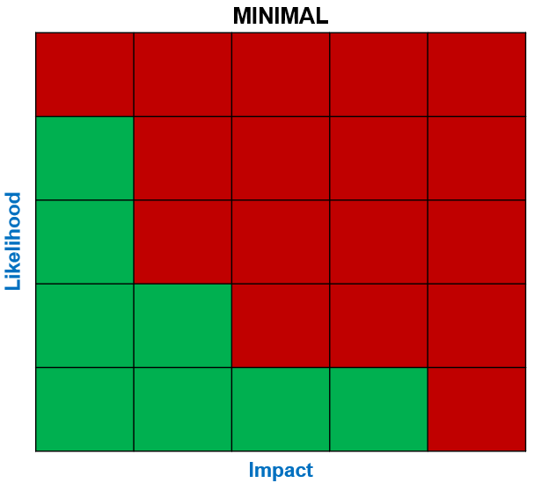
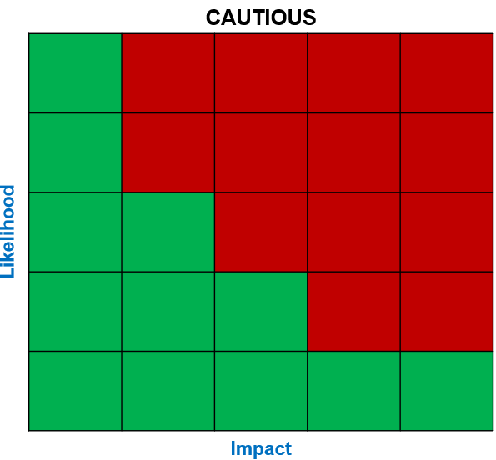
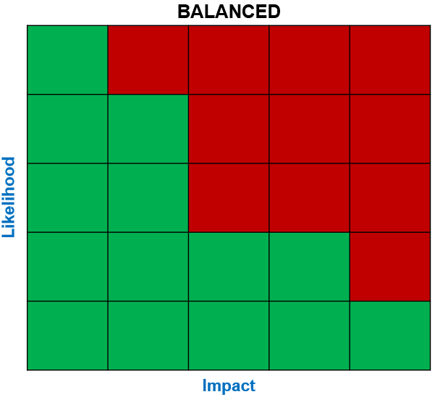
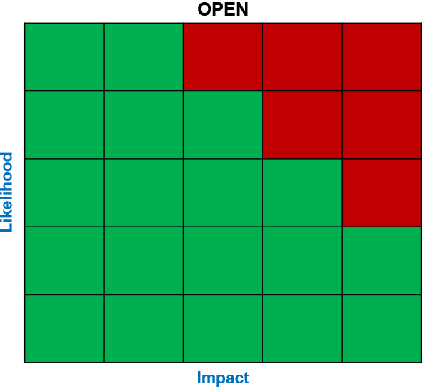
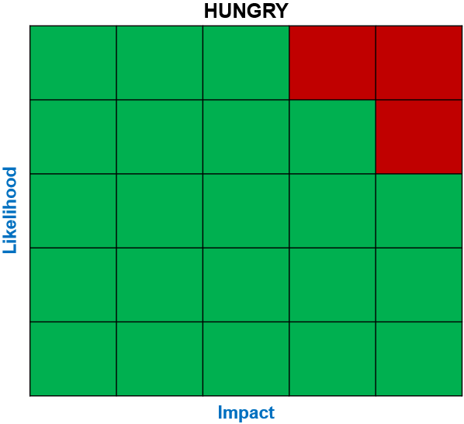
Risk Appetite Descriptors
Heat Map | Tolerance Level | Risk Appetite | Description
 | Very low | Minimal (4) | Avoidance of any risk or uncertainty. Every decision will be to terminate the risk.
 | Low | Cautious (6) | Preference for the safe option but is able to tolerate low level risk and uncertainty. Every decision will be to mitigate the level of risk.
 | Medium | Balanced (8) | Will seek to mitigate all risks and take actions to minimise harm or adverse clinical outcomes, while considering all options and tolerating a modest amount of risk if the benefit is clearly demonstrated. There is an acceptance that some impact may occur in pursuit of the outcome.
 | High | Open (12) | Open to consider all options and take a greater amount of risk and uncertainty to achieve a bigger reward. Likely to choose an option that has a greater reward and accepts some impact.
 | Very high | Hungry (16) | Eager to take on risk to achieve objectives. Will choose the option with greater reward and will accept any impact for the price of reward.

Slide 23
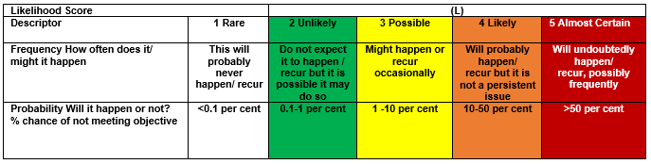
Likelihood Levels

Slide 24
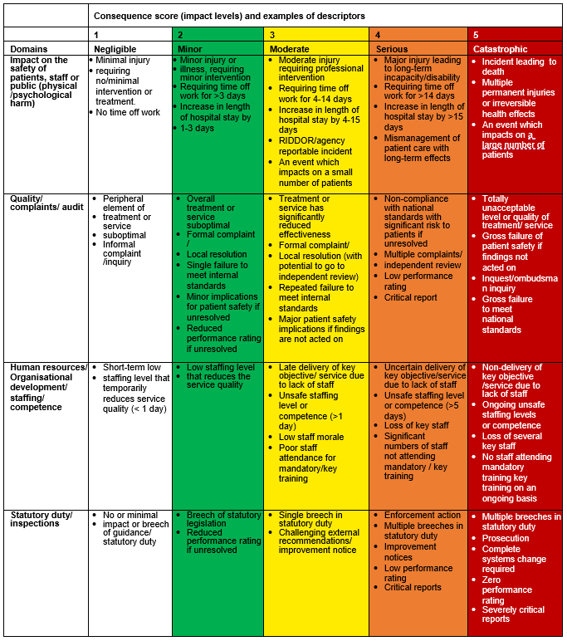
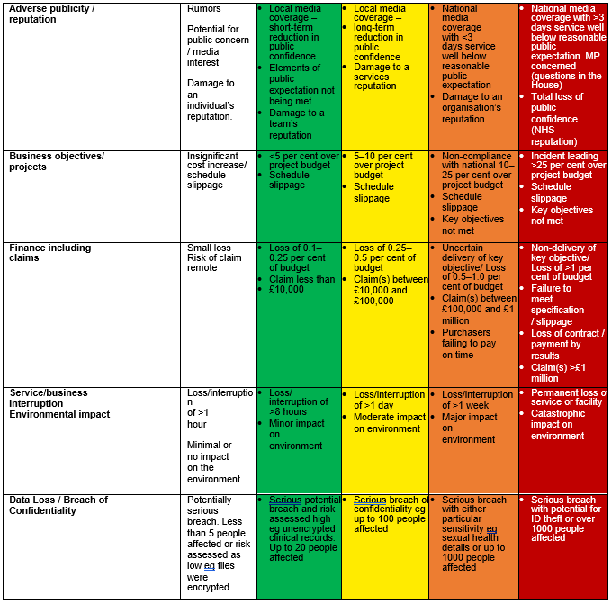
Impact Levels

Slide 25
CLOSED RISKS 2024/25 (old reference system)
BAF Ref: B2 (old reference system) | STRATEGIC OBJECTIVE B: Managing Tomorrow | Executive Risk Owner: Executive Director of Finance & Investment | Assurance Committee: Population Health & Prevention Committee
Principal Risk: Failure to connect and build relationships with all partners and stakeholders around meeting the wider needs to the population will lead to fragmentation and reduce the impact on wider determinants that affects the population.
Reason for Closure: Risk score met risk appetite and became part of business as usual
Closure Recommended by: Executive Committee / Population Health & Prevention Committee
Date Approved for Closure by the ICB Board: 10 April 2024
BAF Ref: C2 (old reference system) | STRATEGIC OBJECTIVE B: Enabling the effective operation of the organisation | Executive Risk Owner: Executive Director Corporate Affairs | Assurance Committee: Executive Committee
Principal Risk: Failure to ensure the ICB maintains robust governance processes and effective control mechanisms will prevent the ICB meeting regulatory and compliance standards and threaten organisational sustainability and undermining confidence in the ICS leadership
Reason for Closure: Risk score met risk appetite and became part of business as usual
Closure Recommended by: Executive Committee
Date Approved for Closure by the ICB Board: 10 April 2024
BAF Ref: A6 (old reference system) | STRATEGIC OBJECTIVE B: Managing Today | Executive Risk Owner: Deputy Chief Executive / Chief Operating Officer | Assurance Committee: Executive Committee
Principal Risk: Failure to deliver the ICB Operating plan for 2023/24, and the associated 31 national objectives, may result in patients not being treated in a timely and appropriate manner.
Reason for Closure: Risk specific to 2023/24 – New risk opened for 2024/25
Closure Recommended by: Executive Committee
Date Approved for Closure by the ICB Board: 8 May 2024
BAF Ref: A3 (old reference system) | STRATEGIC OBJECTIVE B: Managing Today | Executive Risk Owner: Executive Director of Finance and Investment | Assurance Committee: Finance, Performance & Delivery Committee
Principal Risk: Failure to operate within the ICB’s available resources for 2023/24 will cause financial instability leading to poorer outcomes for the population and threaten organisational sustainability undermining confidence in the ICS leadership.
Reason for Closure: Risk specific to 2023/24 – New risk opened for 2024/25
Closure Recommended by: Finance, Performance & Delivery Committee
Date Approved for Closure by the ICB Board: 8 May 2024

Slide 26
CLOSED RISKS 2024/25 (new reference system)
BAF Ref: C1 | STRATEGIC OBJECTIVE C: Leading for Sustainability | Executive Risk Owner: Executive Director of People | Assurance Committee: Workforce Board / Committee
Principal Risk: Immediate term financial pressure, employment relations challenges and increasing workload lead to reductions in the availability of workforce across the system and in the numbers of people who choose to start training this year for future health and care careers, negatively affecting service user experience and individual outcomes.
Reason for Closure: Previously, risks C1 and C4 were identified within the "today" and "tomorrow" risk domains on the Balanced Assessment Framework (BAF). Subsequent to the revision of risk domains to incorporate "leading for sustainability," the Workforce Board/Committee determined that a single consolidated risk, C7, adequately encompasses the elements of the original risks C1 and C4.
Closure Recommended by: Workforce Board / Committee
Date Approved for Closure by the ICB Board: 14 August 2024
BAF Ref: C4 | STRATEGIC OBJECTIVE C: Leading for Sustainability | Executive Risk Owner: Executive Director of People | Assurance Committee: Workforce Board / Committee
Principal Risk: Failure to deliver or capitalise on priority workforce transformation initiatives lead to static or worsening workforce recruitment and retention challenges system-wide over coming years, which in turn negatively affect population health outcomes and limit impact on health inequalities
Reason for Closure: Previously, risks C1 and C4 were identified within the "today" and "tomorrow" risk domains on the Balanced Assessment Framework (BAF). Subsequent to the revision of risk domains to incorporate "leading for sustainability," the Workforce Board/Committee determined that a single consolidated risk, C7, adequately encompasses the elements of the original risks C1 and C4.
Closure Recommended by: Workforce Board / Committee
Date Approved for Closure by the ICB Board: 14 August 2024

